Slide 1
Watch
What to Watch
How to watch

Slide 3
The Battle Lost Because of Inattention to the Enemy
May 2 1863
Near Chancellorsville, Virginia
American Civil War
Notes:
Lee has divided his army begins a flanking maneuver around the Union right.
This action begins at 8:00 A.M and takes most of the day, but is not observed by the Union army.
The Union forces are bivouacked at a crossroads near Chancellorsville, Virginia.
Union General Joseph Hooker orders General Howard to deploy pickets on the right of the Union line, but the order is not carried out.
The confederates observe the Union forces resting in late afternoon.

Slide 4
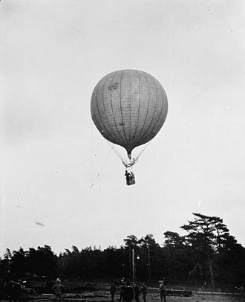
Notes:
The Confederates believe their movements have been seen by a Union observation Balloon, but no report on Confederate troop movements was filed.

Slide 5
5:30 PM
The Union soldiers are enjoying dinner.
Their weapons are unloaded and stacked.
Suddenly, dozens of deer, rabbits and foxes burst out of the woods to their right.
They are followed by 21,000 Confederate infantry howling the Rebel Yell.

Slide 6
Union Army Was Unprepared
Unaware of the enemy around them
Suffered a major defeat
2500 Casualties
Another devastating loss for the Army of the Potomac.
They were not WATCHING
Notes:
Added to the defeats at Bull Run, Fredericksburg,
No one was watching for the enemy.

Slide 7
On the Other Hand…
Watchfulness on the part of the U.S. has thus far prevented the much-feared nuclear conflagration.
Notes:
In the early 1950s, the Soviet Union believed they could prevail in an all-out nuclear war.
U.S. policy and strategy was constructed to dissuade the Soviets of that notion.

Slide 8

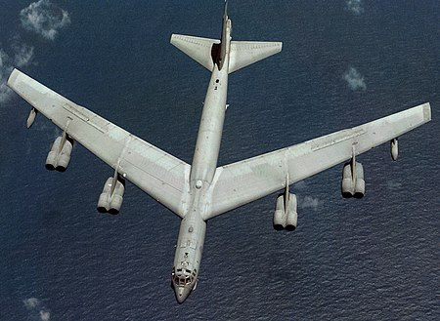
Notes:
Three different strategic weapon systems prevented Russia from being confident of a victory (Strategic Bombers, Polaris Subs, Land-Based Missiles). Impossible to disable all three.
Planes and ships monitored the skies above the Atlantic and Pacific.
B-52 strategic bombers patrolled the skies.

Slide 9
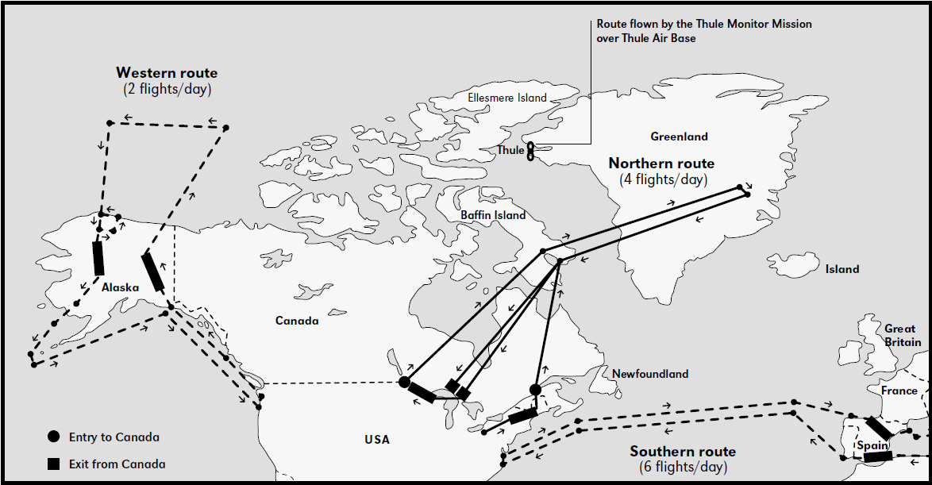
Notes:
From 1960 until 1969 there were always twelve B-52s in the air, flying in patterns around the Arctic Circle, ready to unleash a devastating counterattack across the Pole if Russian missiles or planes delivered a nuclear strike on the United States.

Slide 10
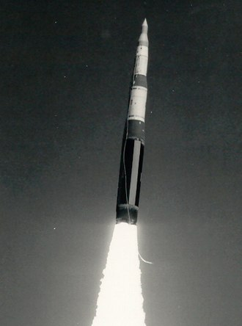
Notes:
Missile silos were constructed across the country.

Slide 11
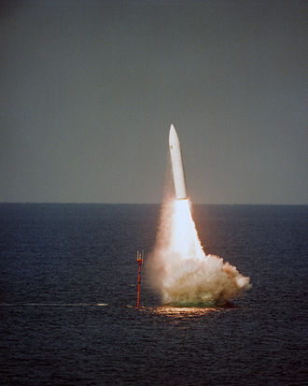
Notes:
Polaris missile submarines hide in the depths of the ocean, nearly impervious to attack.

Slide 12
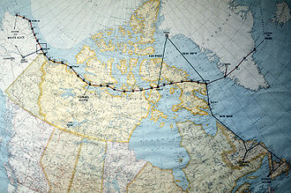
Notes:
Discuss the D.E.W. line above the arctic circle.
Ships routinely patrolled the coasts and the North Atlantic and North Pacific oceans

Slide 13
The Dreaded Attack Never Came
We were Aware.
We Were Awake.
We Were Ready.
We were WATCHING!

Slide 14
Consequences of Not Watching
Matthew 13:24–30 (LEB) — 24 He put before them another parable, saying, “The kingdom of heaven may be compared to a man who sowed good seed in his field. 25 But while his people were sleeping, his enemy came and sowed tares in the midst of the wheat and went away.
Notes:
Tares are a weed that resembles wheat until the ear appears.
When we are not watching, we are susceptible to attack.
Our enemies gain an advantage over us.
We are vulnerable.
We suffer loss or harm.

Slide 15
Jesus Tells Us To Watch,
MAR 13:34 KJV For the Son of Man is as a man taking a far journey, who left his house, and gave authority to his servants, and to every man his work, and commanded the porter [doorkeeper] to watch.
Notes:
The issue in this story is to watch against attack or theft.

Slide 16
…To Be Awake
Mar 13:35 Watch therefore: for ye know not when the master of the house cometh, at even, or at midnight, or at the cockcrowing, or in the morning: 36 Lest coming suddenly he find you sleeping. 37 And what I say unto you I say unto all, Watch.
Notes:
Porter = doorkeeper, the protector of the household.
We must live our lives in an attitude of watchfulness.
Attacks and danger appear suddenly and when not expected.
We don’t know how long our vigil will last.
Be awake and watching!

Slide 17
Be Alert To Threats and Danger
Luke 12:36–39 (NKJV) — 36 and you yourselves be like men who wait for their master, when he will return from the wedding, that when he comes and knocks they may open to him immediately. 37 Blessed are those servants whom the master, when he comes, will find watching. Assuredly, I say to you that he will gird himself and have them sit down to eat, and will come and serve them.
Notes:
It is clear that Jesus is telling us to watch for threats and danger.
V40 Be ready, because the Son of Man comes at an our when you don’t expect Him.
He is telling us to be ready at all times.

Slide 18
Be Alert To Threats and Danger
Mark 13:38 And if he should come in the second watch, or come in the third watch, and find them so, blessed are those servants. 39 But know this, that if the master of the house had known what hour the thief would come, he would have watched and not allowed his house to be broken into.

Slide 19
What is it to Watch?
To watch is to be sober and awake.
1 Thessalonians 5:5–6 (NKJV) — 5 You are all sons of light and sons of the day. We are not of the night nor of darkness. 6 Therefore let us not sleep, as others do, but let us watch and be sober.
Notes:
To watch is to be sober and awake.

Slide 20
What is it to Watch?
To watch is to be aware and alert to one’s spiritual condition
Revelation 16:15 (NKJV) — 15 “Behold, I am coming as a thief. Blessed is he who watches, and keeps his garments, lest he walk naked and they see his shame.”
Notes:
Nowhere in the Bible are we admonished to watch word events.
Our garments are a metaphor for our spiritual state.
Since the garden of Eden, nakedness has been a metaphor for shame.
Mat 25 contains a parable about the danger of lack of watchfulness

Slide 21
Matt 25: Lack of Watchfulness
8 And the foolish said unto the wise, Give us of your oil; for our lamps are gone out. 9 But the wise answered, saying, Not so; lest there be not enough for us and you: but go ye rather to them that sell, and buy for yourselves. 10 And while they went to buy, the bridegroom came; and they that were ready went in with him to the marriage: and the door was shut.

Slide 22
Matt 25: Lack of Watchfulness
11 Afterward came also the other virgins, saying, Lord, Lord, open to us. 12 But he answered and said, Verily I say unto you, I know you not. 13 Watch therefore, for ye know neither the day nor the hour wherein the Son of man cometh.
Notes:
The lesson here is about watching, not the Holy Spirit.
Jesus tells the foolish virgins to buy oil. You can’t buy the holy spirit. Act 8 18-20
Can’t Jesus use the word Oil without invoking the symbol of the holy spirit?
He uses the word OIL on four occasions. In no case is He referring to the holy spirit.
Focusing on the oil, we have missed the lesson Jesus is teaching.
The lack of oil only points to the lack of the ability to watch.
He isn’t telling us to get the holy spirit, he is telling us to watch!
If you can’t see, you can’t watch.
They lost out on salvation because they were unaware of their spiritual condition!
The lesson of this story is that we must watch!!!

Slide 23
To Watch is to Protect When Danger is Present
LUK 2:8 And there were in the same country shepherds abiding in the field, keeping watch over their flock by night.
Notes:
We must watch the same way these shepherds watched.
We are warned to guard against dangers in the spiritual realm.
Where is the spiritual realm?
Between our ears!

Slide 24
To Be Awake and Alert, Not Asleep
Definition of WATCH from Vine’s Dictionary
Vine’s 1. gregoreo (1127), "to watch," is used (a) of
Keeping awake
Spiritual alertness
Being vigilant
Notes:
It isn’t having one’s finger on the pulse of world events 24/7.

Slide 25
A Similar Idea: To Take Heed,
To Pay attention.
Luke 21:34–36 (NKJV) — 34 “But take heed to yourselves, lest your hearts be weighed down with carousing, drunkenness, and cares of this life, and that Day come on you unexpectedly. 35 For it will come as a snare on all those who dwell on the face of the whole earth. 36 Watch therefore, and pray always that you may be counted worthy to escape all these things that will come to pass, and to stand before the Son of Man.”
Notes:
It means Turn your attention to…
Pay Attention
Take Care
Be Alert
Often used in passages that admonish us to Watch
Jesus tells us to take heed to OURSELVES!

Slide 26
The Day Will Be a Surprise
Luk 21:35 For it will come as a snare on all those who dwell on the face of the whole earth.
Notes:
The Day of the Lord will be a total shock to the unprepared.
Even Christians who are not aware of their spiritual state.
Watching world events will not protect us from this trap!
Jesus tells us what to watch!

Slide 27
What Are We Supposed to Watch?
Luke 21:34–36 (NKJV) — 34 “But take heed to yourselves…
Notes:
Jesus isn’t concerned about our awareness of world events.
Jesus cautions us about falling back into old habits.
About failing to maintain self-discipline.

Slide 28
Distractions of this Life
  The distractions of this life steal time from the things that count.
  Not just the worries, the things we enjoy can do it too.
  Television, for example, consumes 9 years of our lives.
  Who is the person you would have been if you had spent that eleven years studying, praying, meditating, doing charitable deeds?

Slide 29
21st Century Life is too Complicated
Too many things to do
Don’t have time to pause and think
To ponder our state of mind
To review our actions of the day
To evaluate our thoughts, our motives
Our behavior
Applying the lessons of scripture
Notes:
We should reflect periodically about what is going on in our heads.
These are activities that comprise WATCHING

Slide 30
Not the Life God Intended
Christians who are distracted, trapped or snared by the things of this life will be caught off-guard by the return of Christ.
Notes:
Jesus is telling us to watch internal factors, not world news.
Even those who are focused on world events will be snared if they are ignoring what is going on in their heads.
To watch means TO KEEP WATCH ON YOUR SPIRITUAL LIFE!!!!

Slide 31
What Should We Watch?

Slide 32
Watch Out For the Devil
1 Peter 5:8–9 (NKJV) — 8 Be sober, be vigilant; because your adversary the devil walks about like a roaring lion, seeking whom he may devour. 9 Resist him, steadfast in the faith, knowing that the same sufferings are experienced by your brotherhood in the world.
Notes:
He is looking for opportunity
He feeds on the weak
Grow strong through prayer and Bible study

Slide 33
Your D.E.W. Line Must Detect
  Divisions
  Malice and slander
  Sedition
  Accusations
  Temptations
  Assaults against faith
  Bad moods and depressions
Notes:
We’ve got to have a DEW line.
A system that gives an early warning of an attack
We must recognize these tools and strategies and steadfastly resist

Slide 34
Resist Him!
JAM 4:7 Submit yourselves therefore to God. Resist the devil, and he will flee from you.
Notes:
Resist temptations
Rebuke slanderers, gossipers, those who spread sedition
This is your Operation Hard Hat, your B-52 fleet.

Slide 35
Watch Out For Potential Sin
PSA 141:3 Set a watch, O LORD, before my mouth; keep the door
of my lips.
Notes:
The easiest way to sin is with the mouth.
Takes no prep, no planning.
Just a second to slip up in vigilance about what erupts from our mouths.

Slide 36
Watch When You Are Under Stress
MAT 26:41 Watch and pray, that ye enter not into temptation: the spirit indeed is willing, but the flesh is weak.
Notes:
Jesus knew that the disciples were about to become embroiled in a very taxing and stressful situation.
He didn’t want them to lose heart or faint.
He didn’t want them to become discouraged at His death and give up their discipleship and the way of life He had taught them.
He wanted them to pray with Him that they all might weather the storm.
He wanted the opportunity to strengthen them in prayer that night.
He was probably confident about His ability to endure the trial. He might not have been so sure about theirs.
Be extra watchful when you are under stress.
We are more apt to err when under stress.

Slide 37
Watch For End-Time Dangers
Mark 13:9 “But watch out for yourselves, for they will deliver you up to councils, and you will be beaten in the synagogues. You will be brought before rulers and kings for My sake, for a testimony to them. 10 And the gospel must first be preached to all the nations.
Notes:
Be prepared.
How will you respond
To persecution
To pressure to sin
To pressure to drop out
Jesus is looking for a good example from you.

Slide 38
Watch Out: Is Your Light Darkness?
Luk 18:35 (LEB) Therefore pay careful attention [take heed] that the light in you is not darkness! 36 If therefore your whole body is full of light, not having any part dark, it will be completely full of light, as when the lamp with its light gives light to you.”
Notes:
Another admonition to be aware of our spiritual condition.
Light and darkness are metaphors for Good and Evil.
A paradoxical statement, like “…if the salt loses its saltiness…”
Another admonition to be aware of your spiritual condition.
Are we really full of light, or are we deceiving ourselves?
We might somehow perceive our darkness as light.
We must Soberly assess where we are and where our heads are.

Slide 39
Watch Out For Covetousness
Luke 12:13–16 (LEB) — 13 Now someone from the crowd said to him, “Teacher, tell my brother to divide the inheritance with me!” 14 But he said to him, “Man, who made me a judge or an arbitrator over you?” 15 And he said to them, “Watch out and guard yourselves from all greediness, because not even when someone has an abundance does his life consist of his possessions.”
Notes:
Someone always wants somebody else’s piece of the pie.
Income equality
Just a fancy name for covetousness.

Slide 40
Watch For an Unforgiving Attitude
Luke 17:3–4 (NKJV) — 3 Take heed to yourselves. If your brother sins against you, rebuke him; and if he repents, forgive him. 4 And if he sins against you seven times in a day, and seven times in a day returns to you, saying, ‘I repent,’ you shall forgive him.”
Notes:
An unforgiving attitude is a danger.
When we nurse old grudges, we are in danger.
We need to watch out for this kind of thinking and eliminate it.
If we want to be like God, we must do this. Not optional
Forgive
Love
Do good
Pray

Slide 41
Watch For A Self-Sufficient Attitude
1 Corinthians 10:12 (NKJV) Therefore let him who thinks he stands take heed lest he fall.
Notes:
We can assume that we are OK when we’re not.
We need to be sure we’re paying attention to our spiritual state.
We need to remain aware, alert and awake.
We must question ourselves and examine ourselves.

Slide 42
Watch Out For Unbelief
Hebrews 3:12 (LEB) — Watch out, brothers, lest there be in some of you an evil [troublesome,Painful], unbelieving heart, with the result that you fall away from the living God.
Notes:
Is your belief in God solid?
This is an aspect of our faith that can be broken in times of duress.

Slide 43
Take Heed to the Words of Jesus
2 Peter 1:19 (LEB) — 19 and we possess as more reliable the prophetic word, to which you do well if you pay attention to it as to a lamp shining in a dark place, until the day dawns and the morning star rises in your hearts…
Notes:
Jesus said we would be His friends if we did all He commanded (John 15 14).
We need to know and to pay attention to the commands of Jesus.
There are about 26 specific commands issued by Jesus.
A good extended study would be to find and understand all Jesus’ commands..

Slide 44
Watch To Ensure Watchfulness
Luke 12:35 (LEB) You must be prepared for action and your lamps burning [vision]. 36 And you, be like people who are waiting for their master when he returns from the wedding feast, so that when he comes back and knocks, they can open the door for him immediately.
Notes:
Jesus makes it clear that we must be on watch continually.
We must be aware of our spiritual condition.
We must be sensitive to potential threats.
We must be attuned to the potential threats we have explored today.

Slide 45
“You Can Observe a Lot Just by Watching”
The Bible warns us to watch continually.
To be aware, awake, alert to our spiritual condition
To be observant of the things happening in the spiritual realm
It is the responsibility of each member to identify an watch for areas of potential danger in our spiritual lives.

