Slide 1


Faithful Tithing– Part II
United Church of God
December 26, 2020
Photo by Tim Pebworth

Slide 2
The Three Tithes of the Bible
 | Numbers 18:21-24 | Deuteronomy 14:22-27 | Deuteronomy 14:28-29
Levitical Tithe (1st Tithe) | Given to the Levites for the work of tabernacle and as their inheritance (Levites are to tithe on the tithes they receive verse:25-26)
Festival Tithe (2nd Tithe) |  | Eaten or exchanged for money and spent on what the giver’s heart desires at the Festival in the place God chooses
Charity Tithe (3rd Tithe) |  |  | Every 3rd year, stored within the giver’s gates to provide for the Levite, the stranger, the fatherless and widow
Photo by Tim Pebworth

Slide 3

How is our “increase” defined ?
Deuteronomy 14:22
“You shall truly tithe all the increase...”
Photo by Jungwoo Hong on Unsplash
New International Version “Be sure to set aside a tenth of all that your fields produce each year.” New Living Translation "You must set aside a tithe of your crops--one-tenth of all the crops you harvest each year.”

Slide 4
How is our “increase defined? (cont.)
Deuteronomy 14:22
“You shall truly tithe all the increase..”
Photo by Jungwoo Hong on Unsplash
English Standard Version “You shall tithe all the yield of your seed that comes from the field year by year. Holman Christian Standard Bible Each year you are to set aside a tenth of all the produce grown in your fields.

Slide 5

“Increase” Defined
Strong’s: tebuah: product, revenue
Original Word: תְּבוּאָה Transliteration: tebuah Phonetic Spelling: (teb-oo-aw') Short Definition: produce
NAS Exhaustive Concordance – product, revenue NASB Translation crop (4), crops (6), gain (1), harvest (4), income (4), increase (3), produce (10), product (3), revenue (2), yield (5), yield may increase (1)

Slide 6
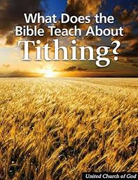
Tithe - A Simple Example
If a farmer harvests 10 bushels of wheat, he’d give one bushel to the priests.
If the farmer must pay the neighbor for water to grow his wheat and agrees to pay one bushel of wheat, then the farmers increase is 10-1 or 9 bushels. We would then pay 9/10ths of a bushel of wheat as a Levite tithe.
Tithes should consider:
“cost of production”

Slide 7
Tithe – For Most of Us
If we are paid $15 per hour to work at In-N-Out Burger – we have entered into an employment agreement to trade one hour of our time for $15.
$15 is our increase
We should not confuse:
“cost of production with
cost of service”

Slide 8
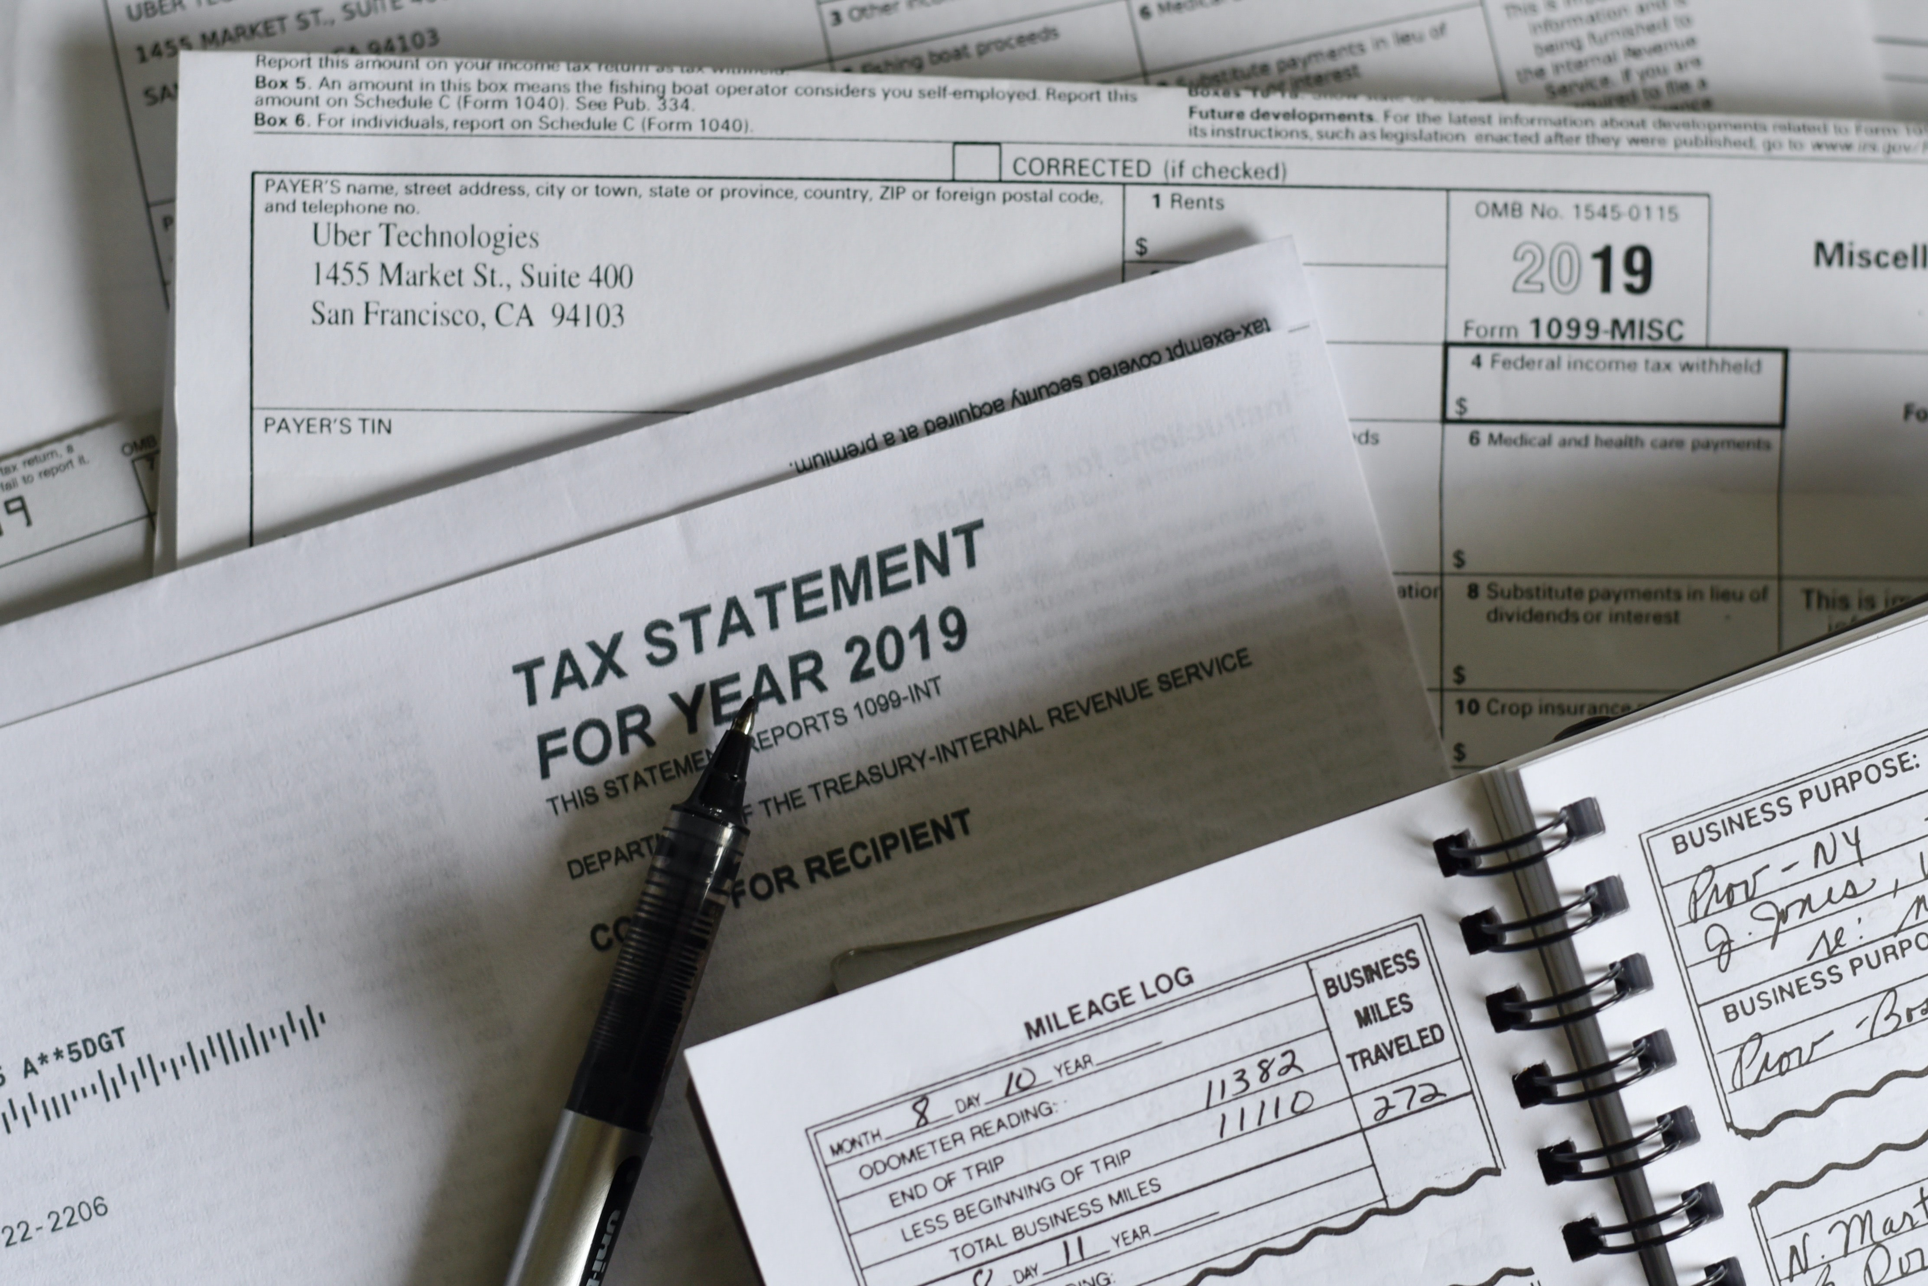
What about Taxes?
In 1982 the church came to the conclusion that since brethren in various European countries had no control over the deduction of taxes from their income and derived only minimal economic benefit from payment of such taxes, the taxes withheld should not be considered increase for the purpose of tithing. The church subsequently applied this principle to other nations.
Photo by Olga DeLawrence on Unsplash
UCG Doctrinal Statement on Tithing on Net Income

Slide 9
Second Tithe
It’s commanded just like the other tithes
Should create a separate bank account to hold this tithe
Should not borrow from it during the year
Required for the Feasts (Deuteronomy 14:22) which are commanded assemblies
Nehemiah 8:18 – “they kept the feast seven days and on the eighth day there was a sacred assembly, according to the prescribed manner.”

Slide 10
Deuteronomy 26:12 – New King James Version
¹² “When you have finished laying aside all the tithe of your increase in the third year—the year of tithing—and have given it to the Levite, the stranger, the fatherless, and the widow, so that they may eat within your gates and be filled, then you shall say before the Lord your God: ‘I have removed the ^{[a]}holy tithe from my house, and also have given them to the Levite, the stranger, the fatherless, and the widow, according to all Your commandments which You have commanded me; I have not transgressed Your commandments, nor have I forgotten them.

Slide 11
Deuteronomy 26:12 – Brenton Septuagint
“And when thou shalt have completed all the tithings of thy fruits in the third year, thou shalt give the second tenth to the Levite, and stranger, and fatherless, and widow; and they shall eat it in thy cities, and be merry.”

Slide 12
Key Verses on Tithing and the “Charity Tithe”
Leviticus 25:3-5
Leviticus 25:20-21
Deuteronomy 31:10-11

Slide 13

What about 3rd Tithe?
In 1982, the Church was presented with the facts regarding a form of taxation in Britain and Scandinavia and the impact it had on the individual’s wages in those nations. The church recognized that these modern states in Europe had, to a large extent, assumed the Church’s responsibility in caring for the needy.
Photo by Austin Kehmeier on Unsplash
UCG Doctrinal Statement on 3rd Tithe

Slide 14
What about 3rd Tithe?
“The Council of Elders has resolved that where governments provide programs, the intent and purpose of which is to provide for the needs of those that the biblical third tithe was designed to assist and that where such programs are funded by an annual rate of taxation greater than the biblical third tithe, members who are so taxed are not obligated to pay what amounts to an additional third tithe to the Church. Members not taxed in this manner should follow the scriptural instruction to pay the third tithe.”
Photo by Austin Kehmeier on Unsplash
UCG Doctrinal Statement on 3rd Tithe

