Slide 1
The Church
Against the Gates of Hades

Slide 2
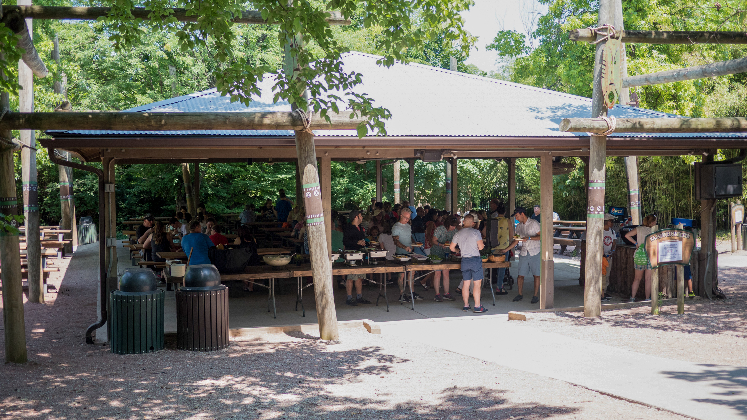
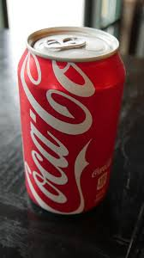
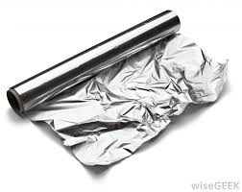
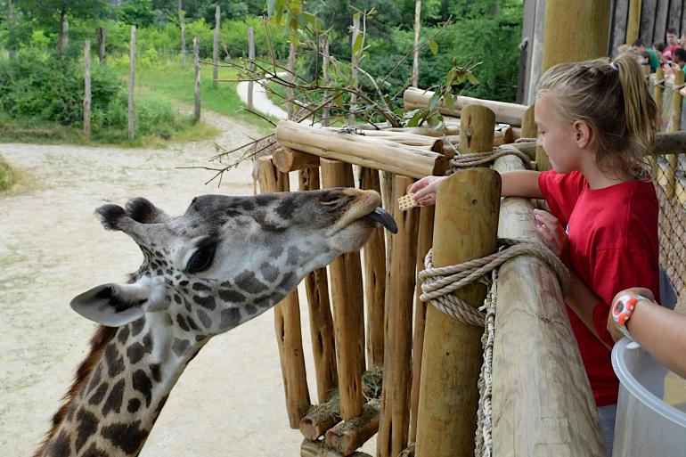

Slide 3
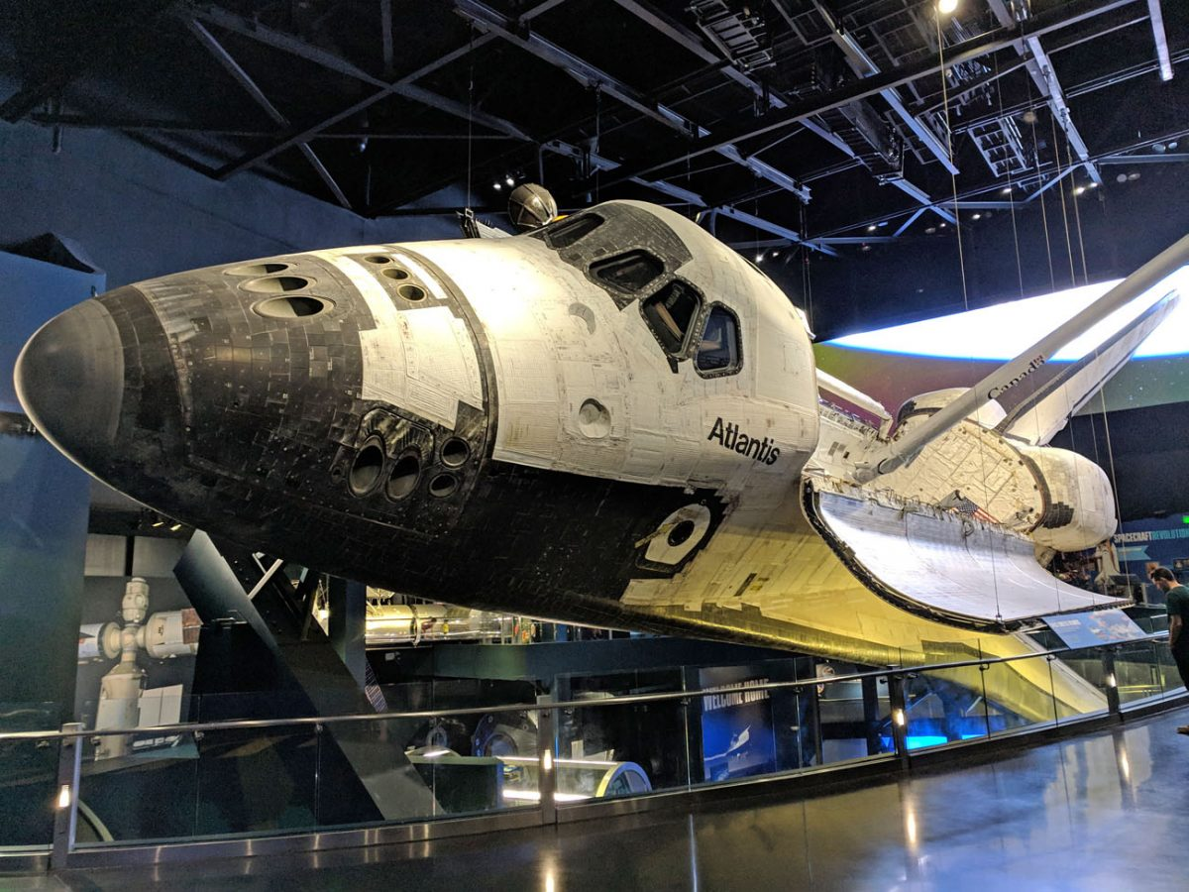
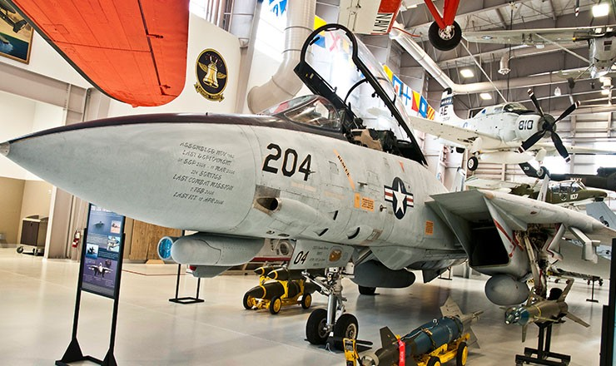
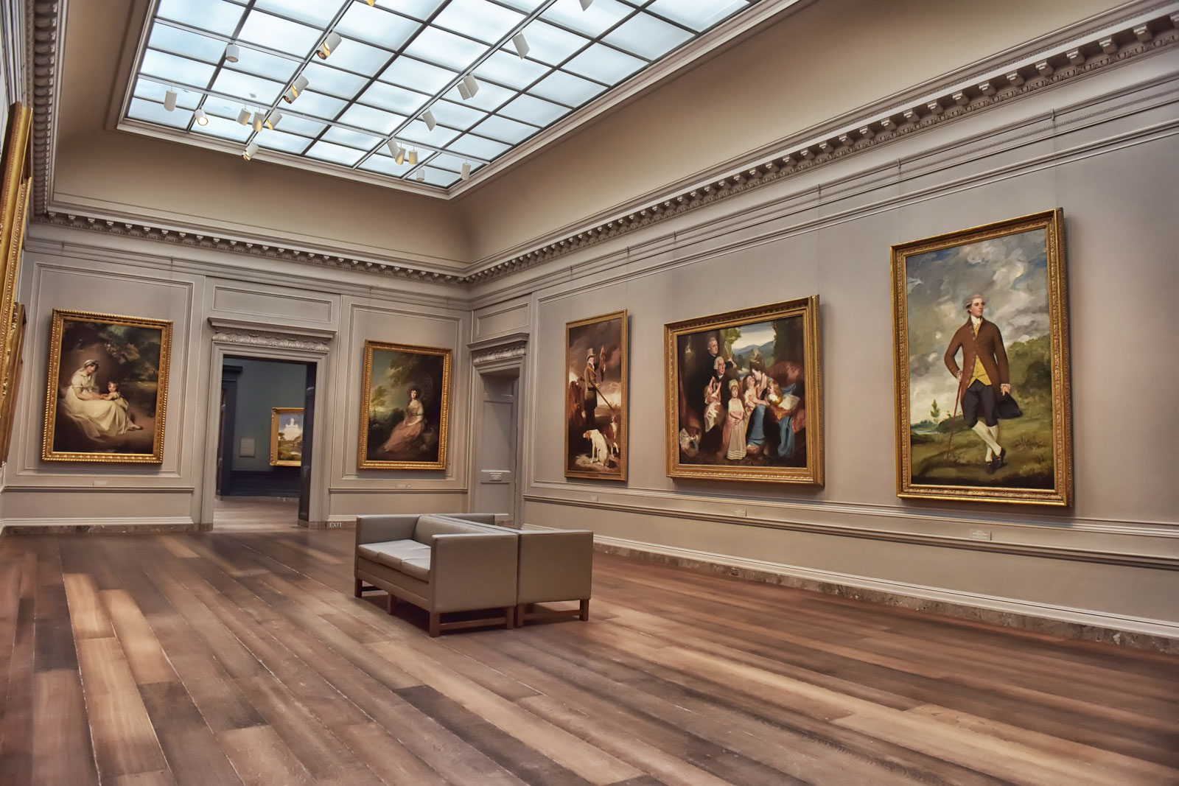

Slide 4
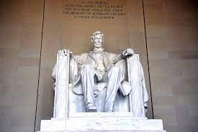

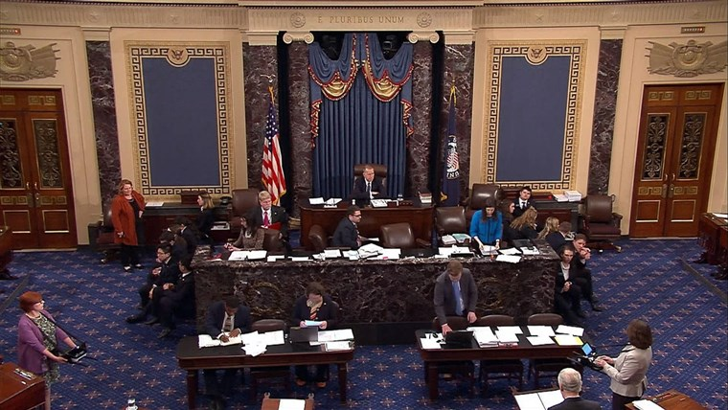
Washington DC

Slide 5
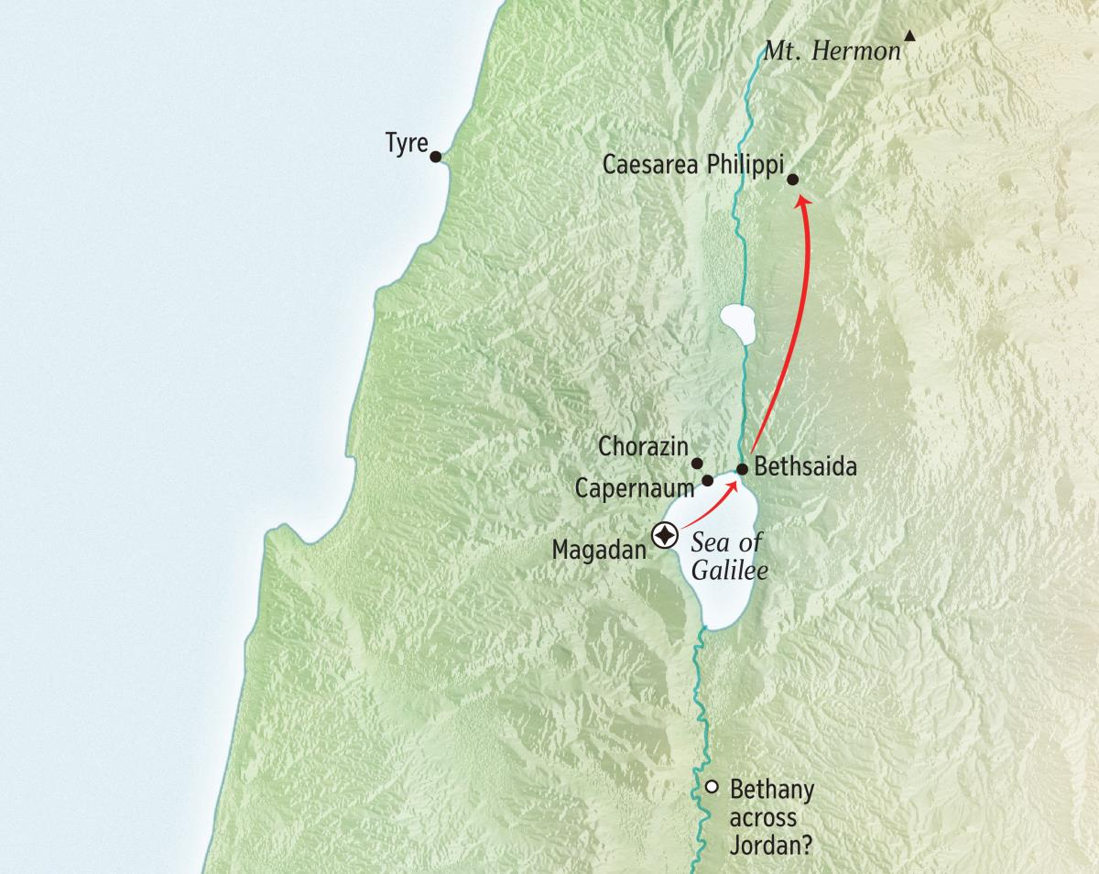
30 miles
10 hours

Slide 6
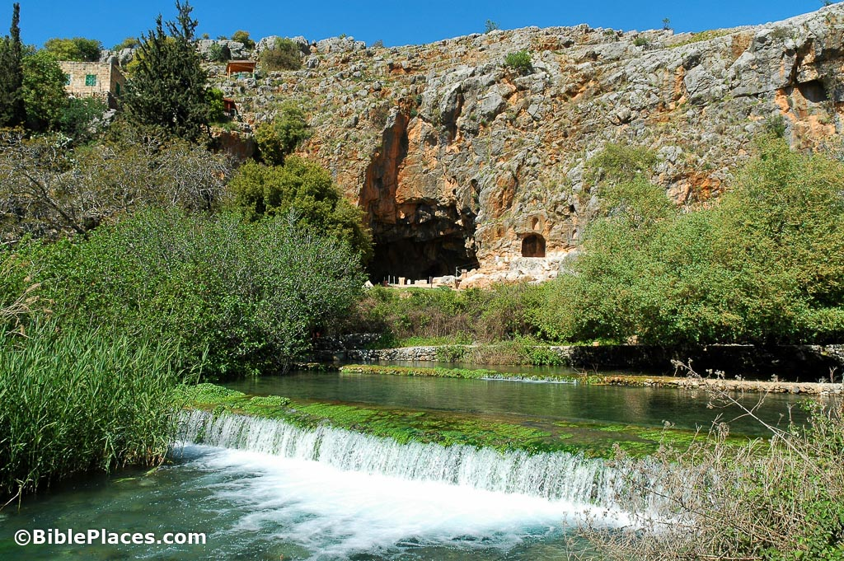
Panias
Banias
Banyias
Caesarea
Philippi

Slide 7
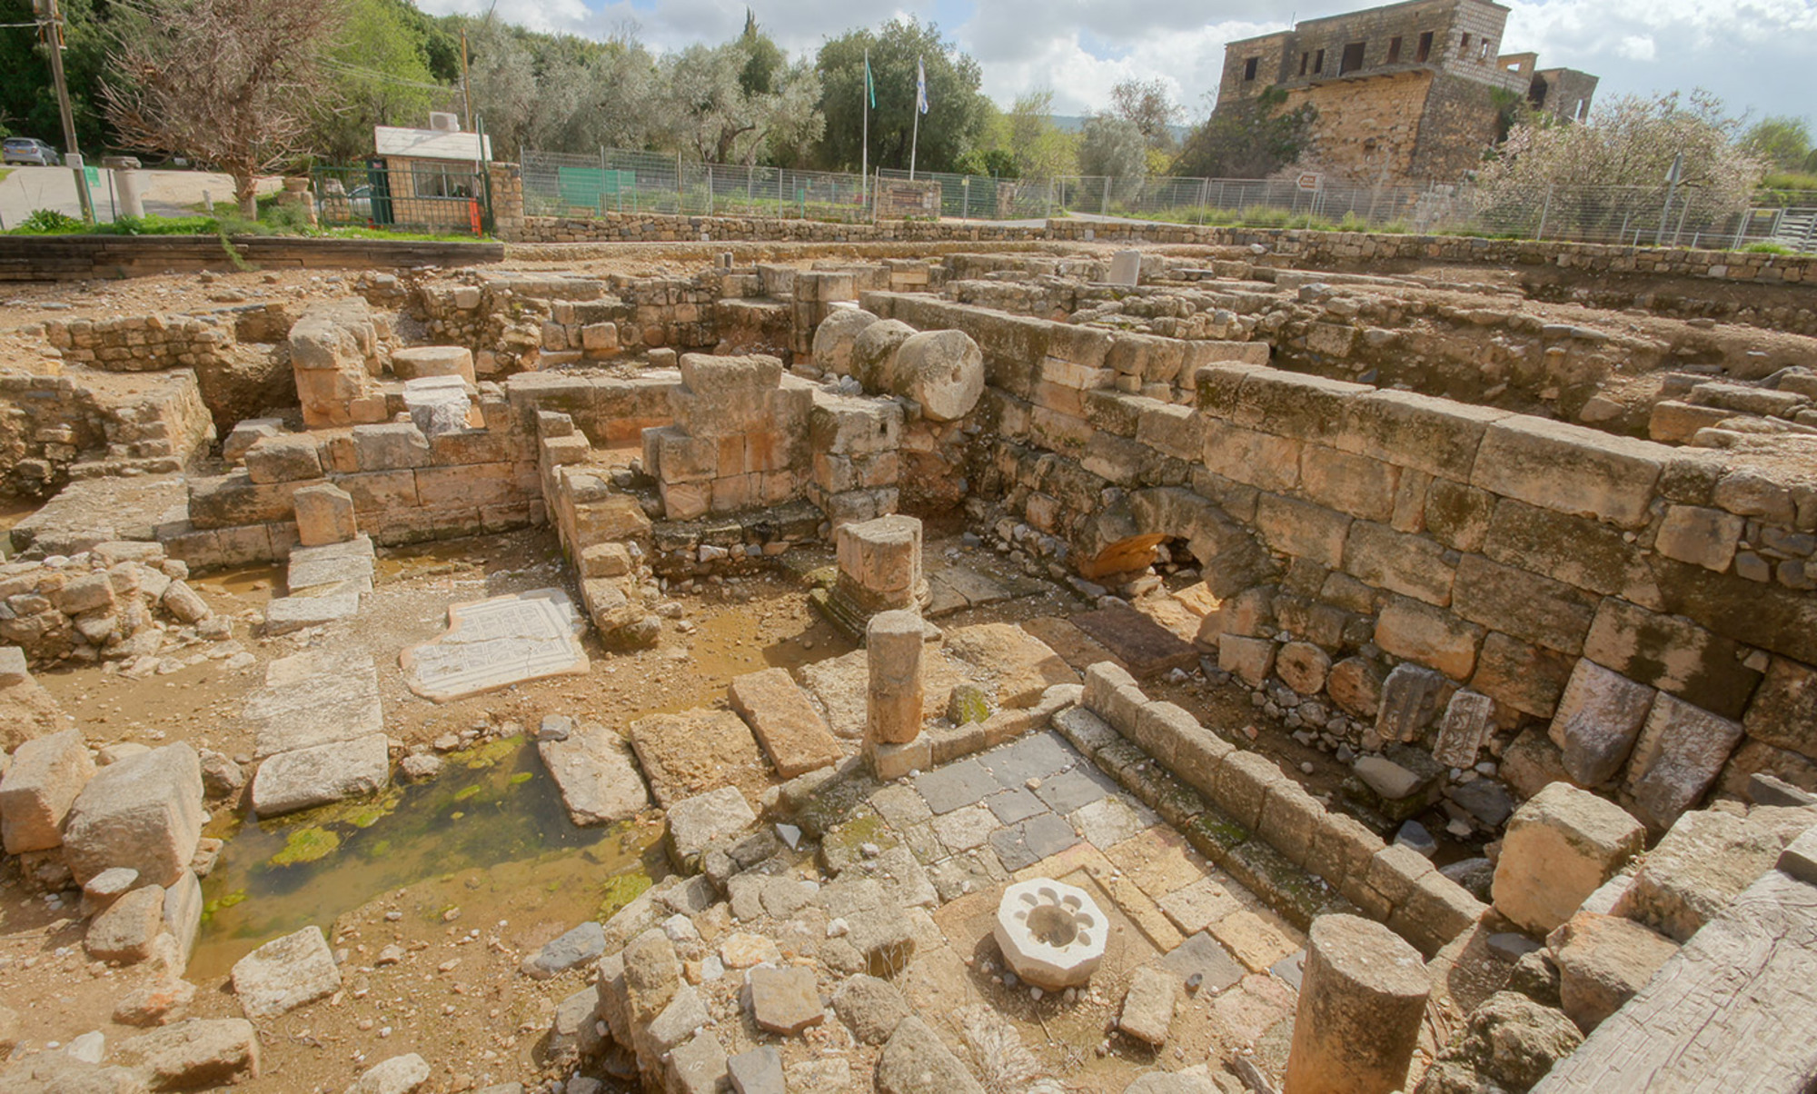
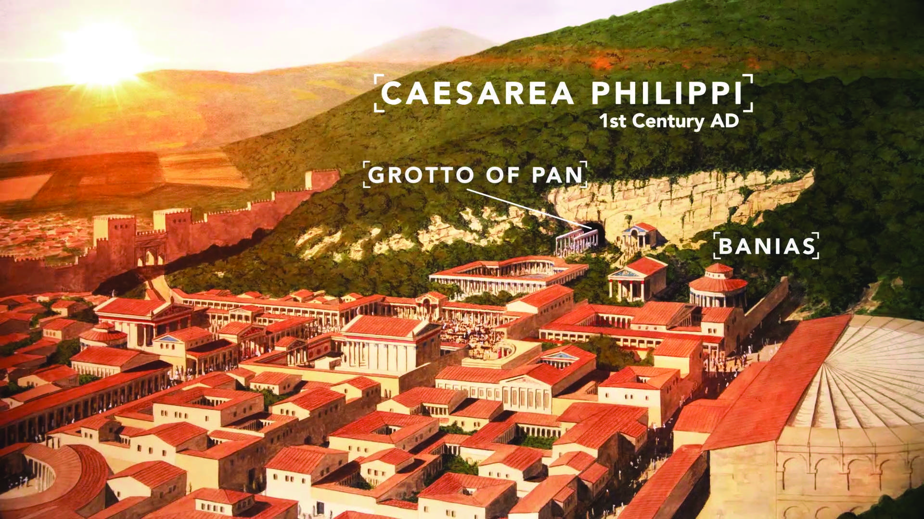

Slide 8
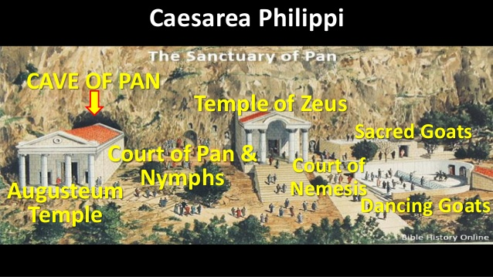

Slide 9
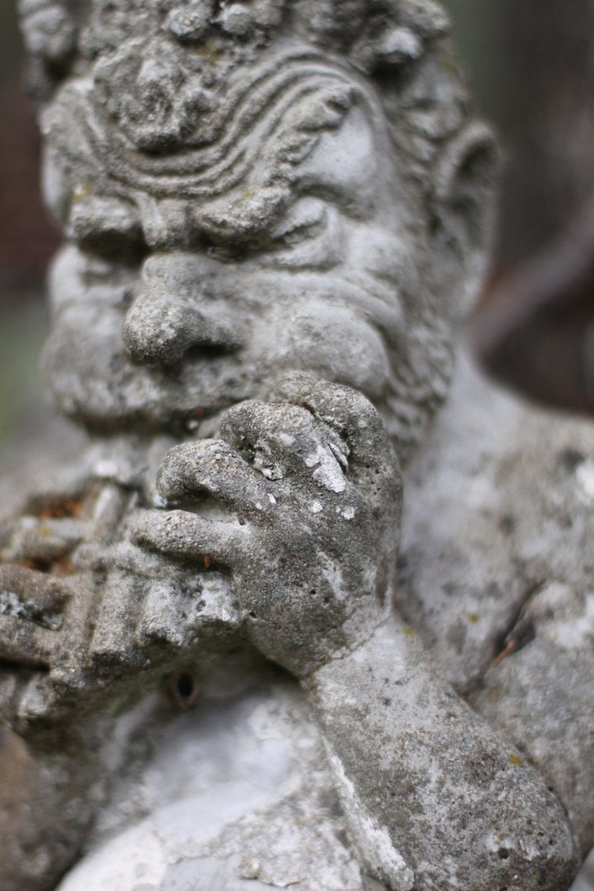
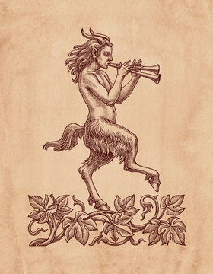
Pan

Slide 10
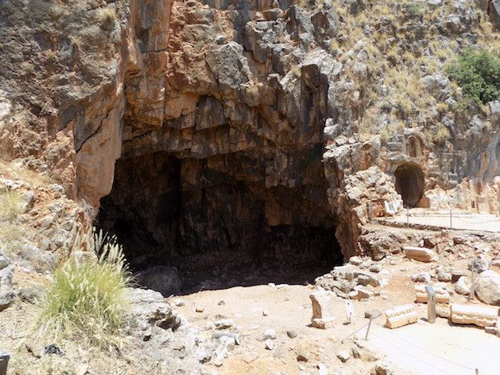
Cave of Pan
Gate of Hades

Slide 11
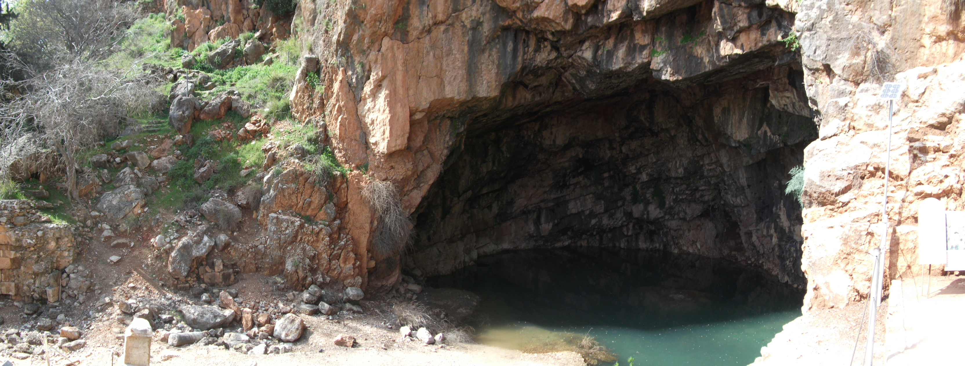
Cave of Pan
Gate of Hades

Slide 12
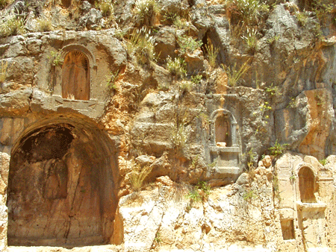

Slide 13
Matthew 16:13 (Parallel in Mark 8)
Mat 16:13 When Jesus came into the region of Caesarea Philippi, …

Slide 14
Matthew 16:13 (Parallel in Mark 8)
Mat 16:13 When Jesus came into the region of Caesarea Philippi,
He asked His disciples, saying, "Who do men say that I, the Son of Man, am?"

Slide 15
Matthew 16:14 (Parallel in Mark 8)
Mat 16:14 So they said, "Some say John the Baptist, some Elijah, and others Jeremiah or one of the prophets."

Slide 16
Matthew 16:14 (Parallel in Mark 8)
Mat 16:14 So they said, "Some say John the Baptist, some Elijah, and others Jeremiah or one of the prophets."
Metempsychosis: transmigration at death of the soul of a human being or animal into a new body of the same or a different species.

Slide 17
Matthew 16:14 (Parallel in Mark 8)
Josephus (a Pharisee):
"Every soul is immortal; those of the good only enter into another body, but those of the bad are tormented with everlasting punishment."

Slide 18
Matthew 16:15 (Parallel in Mark 8)
Mat 16:15 He said to them, "But who do you say that I am?"

Slide 19
Matthew 16:16 (Parallel in Mark 8)
Mat 16:16 Simon Peter answered and said, "You are the Christ, the Son of the living God."

Slide 20
Matthew 16:16 (Parallel in Mark 8)
Mat 16:16 Simon Peter answered and said, "You are the Christ, the Son of the living God."
Christos – Messiah – “Anointed”

Slide 21
Acts 10:38
Act 10:38 how God anointed Jesus of Nazareth with the Holy Spirit and with power, who went about doing good and healing all who were oppressed by the devil, for God was with Him.

Slide 22
Matthew 16:16 (Parallel in Mark 8)
Mat 16:16 Simon Peter answered and said, "You are the Christ, the Son of the living God."

Slide 23
Matthew 16:17 (Parallel in Mark 8)
Mat 16:17 Jesus answered and said to him, "Blessed are you, Simon Bar-Jonah, for flesh and blood has not revealed this to you, but My Father who is in heaven.

Slide 24
Matthew 16:17 (Parallel in Mark 8)
Mat 16:17 Jesus answered and said to him, "Blessed are you, Simon Bar-Jonah, for flesh and blood has not revealed this to you, but My Father who is in heaven.

Slide 25
Matthew 16:18 (Parallel in Mark 8)
Mat 16:18 And I also say to you that you are Peter, …

Slide 26
Matthew 16:18 (Parallel in Mark 8)
Mat 16:18 And I also say to you that you are Peter, …
Petros – name from John 1:42
Christ renamed Simon – Peter “A stone”
Joh 1:42 And he brought him to Jesus. Now when Jesus looked at him, He said, "You are Simon the son of Jonah. You shall be called Cephas" (which is translated, A Stone).

Slide 27
Matthew 16:18 (Parallel in Mark 8)
Mat 16:18 And I also say to you that you are Peter, and on this rock…
Petra: meaning “Mass of Rock / large stone”
16x in New Testament. Never used for anyone other than Jesus Christ.

Slide 28
Matthew 7:24
Mat 7:24 "Therefore whoever hears these sayings of Mine, and does them, I will liken him to a wise man who built his house on the rock (petra):
Mat 7:25 and the rain descended, the floods came, and the winds blew and beat on that house; and it did not fall, for it was founded on the rock (petra).

Slide 29
Compare: Romans 9:33 & 1 Corinthians 10:4
Rom 9:33 As it is written: "BEHOLD, I LAY IN ZION A STUMBLING STONE AND ROCK (PETRA) OF OFFENSE, AND WHOEVER BELIEVES ON HIM WILL NOT BE PUT TO SHAME."
1Co 10:4 and all drank the same spiritual drink. For they drank of that spiritual Rock (Petra) that followed them, and that Rock (Petra) was Christ.

Slide 30
Compare: EphISIANS 2:19 & 1 Peter 2:5
Eph 2:19 Now, therefore, you are no longer strangers and foreigners, but fellow citizens with the saints and members of the household of God,
Eph 2:20 having been built on the foundation of the apostles and prophets, Jesus Christ Himself being the chief cornerstone,
Eph 2:21 in whom the whole building, being fitted together, grows into a holy temple in the Lord,
Eph 2:22 in whom you also are being built together for a dwelling place of God in the Spirit.

Slide 31
Compare: EphISIANS 2:19 & 1 Peter 2:5
1Pe 2:5 you also, as living stones, are being built up a spiritual house, a holy priesthood, to offer up spiritual sacrifices acceptable to God through Jesus Christ.

Slide 32
Matthew 16:18 (Parallel in Mark 8)
Mat 16:18 And I also say to you that you are Peter, and on this rock I will build My church, …

Slide 33
Matthew 16:18 (Parallel in Mark 8)
Mat 16:18 And I also say to you that you are Peter, and on this rock I will build My church, …
First time Church (Ekklesia) is used.
Church – Ekklesia – “A Calling Out” “Called Out Ones”

Slide 34
Matthew 16:18 (Parallel in Mark 8)
Mat 16:18 And I also say to you that you are Peter, and on this rock I will build My church, and the gates of Hades shall not prevail against it.

Slide 35
Matthew 16:18 (Parallel in Mark 8)
Mat 16:18 And I also say to you that you are Peter, and on this rock I will build My church, and the gates of Hades shall not prevail against it.

Slide 36
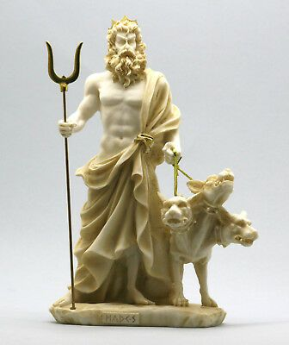
Hades
god of the Underworld

Slide 37
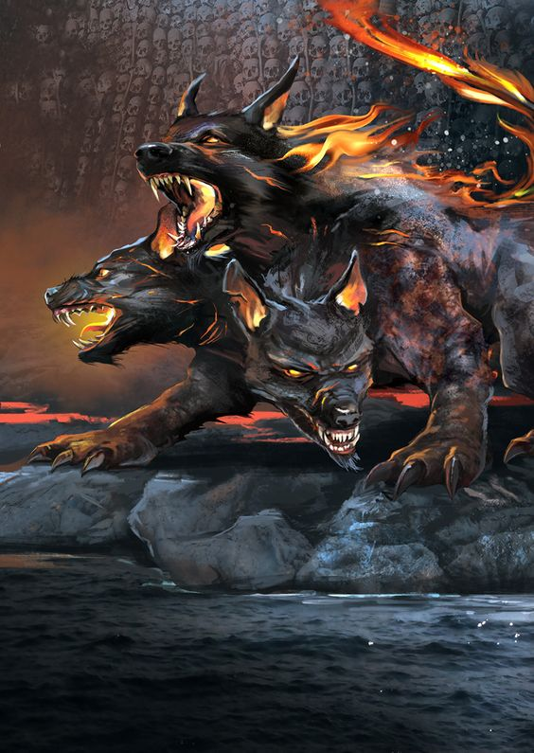
Hades
god of the Underworld

Slide 38
Matthew 16:18 (Parallel in Mark 8)
Mat 16:18 …gates of Hades shall not prevail against it.
Prevail against: katischuō -
1) to be strong to another’s detriment, to prevail against
2) to be superior in strength
3) to overcome
4) to prevail

Slide 39
Matthew 16:18 (Parallel in Mark 8)
Mat 16:18 …gates of Hades shall not prevail against it.
Gates of Hades will not be in superior strength to the Church

Slide 40
Matthew 16:18 (Parallel in Mark 8)
Mat 16:18 …gates of Hades shall not prevail against it.
Gates of Hades will not be in superior strength to the Church
Gates of Hades will not be strong to the detriment of the Church

Slide 41
Luke 23:23
Luk 23:23 But they were insistent, demanding with loud voices that He be crucified. And the voices of these men and of the chief priests prevailed.

Slide 42
4 Ways THIS SCRIPTURE IS TRUE!
1. The Church will not be overcome (Die out)

Slide 43
4 Ways THIS SCRIPTURE IS TRUE!
2. Christ Overcame Death

Slide 44
4 Ways THIS SCRIPTURE IS TRUE!
2. Christ Overcame Death
1Co 15:12 Now if Christ is preached that He has been raised from the dead, how do some among you say that there is no resurrection of the dead?
1Co 15:13 But if there is no resurrection of the dead, then Christ is not risen.
1Co 15:14 And if Christ is not risen, then our preaching is empty and your faith is also empty.

Slide 45
4 Ways THIS SCRIPTURE IS TRUE!
2. Christ Overcame Death
1Co 15:17 And if Christ is not risen, your faith is futile; you are still in your sins!
1Co 15:20 But now Christ is risen from the dead, and has become the firstfruits of those who have fallen asleep.

Slide 46
4 Ways THIS SCRIPTURE IS TRUE!
2. Christ Overcame Death
1Co 15:23 But each one in his own order: Christ the firstfruits, afterward those who are Christ's at His coming.
1Co 15:24 Then comes the end, when He delivers the kingdom to God the Father, when He puts an end to all rule and all authority and power.
1Co 15:25 For He must reign till He has put all enemies under His feet.
1Co 15:26 The last enemy that will be destroyed is death.

Slide 47
4 Ways THIS SCRIPTURE IS TRUE!
2. Christ Overcame Death
Christ overcame and will destroy death.
Death – Greek Thanatos

Slide 48
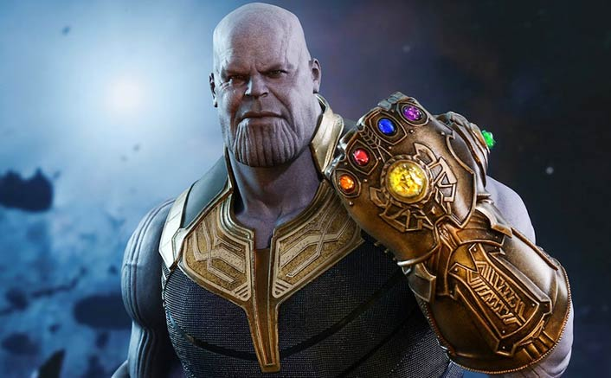
4 Ways THIS SCRIPTURE IS TRUE!
2. Christ Overcame Death
Christ overcame and will destroy death.
Death – Greek Thanatos

Slide 49
4 Ways THIS SCRIPTURE IS TRUE!
2. Christ Overcame Death
Act 2:23 Him (Jesus Christ), being delivered by the determined purpose and foreknowledge of God, you have taken by lawless hands, have crucified, and put to death;
Act 2:24 whom God raised up, having loosed the pains of death, because it was not possible that He should be held by it.

Slide 50
4 Ways THIS SCRIPTURE IS TRUE!
2. Christ Overcame Death
Act 2:25 For David says concerning Him: 'I FORESAW THE LORD ALWAYS BEFORE MY FACE, FOR HE IS AT MY RIGHT HAND, THAT I MAY NOT BE SHAKEN.
Act 2:26 THEREFORE MY HEART REJOICED, AND MY TONGUE WAS GLAD; MOREOVER MY FLESH ALSO WILL REST IN HOPE.
Act 2:27 FOR YOU WILL NOT LEAVE MY SOUL IN HADES, NOR WILL YOU ALLOW YOUR HOLY ONE TO SEE CORRUPTION.

Slide 51
4 Ways THIS SCRIPTURE IS TRUE!
2. Christ Overcame Death
Rom 6:8 Now if we died with Christ, we believe that we shall also live with Him,
Rom 6:9 knowing that Christ, having been raised from the dead, dies no more. Death no longer has dominion over Him.

Slide 52
4 Ways THIS SCRIPTURE IS TRUE!
3. The Church will overcome death
1Co 15:50 Now this I say, brethren, that flesh and blood cannot inherit the kingdom of God; nor does corruption inherit incorruption.
1Co 15:51 Behold, I tell you a mystery: We shall not all sleep, but we shall all be changed—
1Co 15:52 in a moment, in the twinkling of an eye, at the last trumpet. For the trumpet will sound, and the dead will be raised incorruptible, and we shall be changed.

Slide 53
4 Ways THIS SCRIPTURE IS TRUE!
3. The Church will overcome death
1Co 15:53 For this corruptible must put on incorruption, and this mortal must put on immortality.
1Co 15:54 So when this corruptible has put on incorruption, and this mortal has put on immortality, then shall be brought to pass the saying that is written: "DEATH IS SWALLOWED UP IN VICTORY."

Slide 54
4 Ways THIS SCRIPTURE IS TRUE!
3. The Church will overcome death
1Co 15:55 "O DEATH (Thanatos), WHERE IS YOUR STING? O HADES, WHERE IS YOUR VICTORY?"
1Co 15:56 The sting of death is sin, and the strength of sin is the law.
1Co 15:57 But thanks be to God, who gives us the victory through our Lord Jesus Christ.

Slide 55
4 Ways THIS SCRIPTURE IS TRUE!
3. The Church will overcome death
Rev 20:14 Then Death (Thanatos) and Hades were cast into the lake of fire. This is the second death.

Slide 56
4 Ways THIS SCRIPTURE IS TRUE!
4. The Church will attack the Gate of Hades

Slide 57
4 Ways THIS SCRIPTURE IS TRUE!
4. The Church will attack the Gate of Hades
1Co 15:58 Therefore, my beloved brethren, be steadfast, immovable, always abounding in the work of the Lord, knowing that your labor is not in vain in the Lord.

Slide 58
4 Ways THIS SCRIPTURE IS TRUE!
4. The Church will attack the Gate of Hades
Act 1:8 But you shall receive power when the Holy Spirit has come upon you; and you shall be witnesses to Me in Jerusalem, and in all Judea and Samaria, and to the end of the earth."

Slide 59
4 Ways THIS SCRIPTURE IS TRUE!
4. The Church will attack the Gate of Hades
1Pe 3:15 But sanctify the Lord God in your hearts, and always be ready to give a defense to everyone who asks you a reason for the hope that is in you, with meekness and fear;
1Pe 3:16 having a good conscience, that when they defame you as evildoers, those who revile your good conduct in Christ may be ashamed.

Slide 60
4 Ways THIS SCRIPTURE IS TRUE!
4. The Church will attack the Gate of Hades
Mar 8:35 For whoever desires to save his life will lose it, but whoever loses his life for My sake and the gospel's will save it.
Mar 8:36 For what will it profit a man if he gains the whole world, and loses his own soul (breath of life/life)?
Mar 8:37 Or what will a man give in exchange for his soul?

Slide 61
4 Ways THIS SCRIPTURE IS TRUE!
4. The Church will attack the Gate of Hades
Mar 8:38 For whoever is ashamed of Me and My words in this adulterous and sinful generation, of him the Son of Man also will be ashamed when He comes in the glory of His Father with the holy angels."

Slide 62
4 Ways THIS SCRIPTURE IS TRUE!
4. The Church will attack the Gate of Hades
1 Cor 15:58…knowing that your labor is not in vain in the Lord.

Slide 63
4 Ways THIS SCRIPTURE IS TRUE!
4. The Church will attack the Gate of Hades
Act 14:22 strengthening the souls of the disciples, exhorting them to continue in the faith, and saying, "We must through many tribulations enter the kingdom of God."

Slide 64
4 Ways THIS SCRIPTURE IS TRUE!
4. The Church will attack the Gate of Hades
Joh 15:18 "If the world hates you, you know that it hated Me before it hated you.
Joh 15:19 If you were of the world, the world would love its own. Yet because you are not of the world, but I chose you out of the world, therefore the world hates you.

Slide 65
Matthew 16:18
I will build My church

Slide 66
Matthew 16:18
I will build My church,
and the gates of Hades shall not prevail against it.

