Slide 1
Resisting Secular Christianity’s “Kingdom Now” Mindset

Slide 2
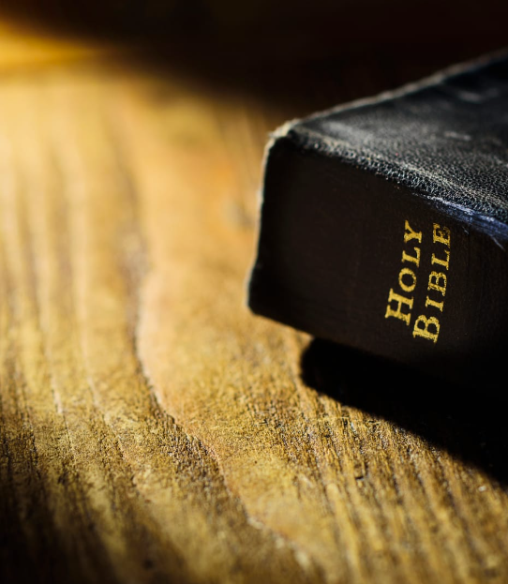
John 18:33
Then Pilate entered the Praetorium again, called Jesus, and said to Him, “Are You the King of the Jews?”
Jesus answered him, “Are you speaking for yourself about this, or did others tell you this concerning Me?” Pilate answered, “Am I a Jew? Your own nation and the chief priests have delivered You to me. What have You done?”
Jesus answered, “My kingdom is not of this world. If My kingdom were of this world, My servants would fight, so that I should not be delivered to the Jews; but now My kingdom is not from here.”

Slide 3
Luke 4:16
So He came to Nazareth, where He had been brought up. And as His custom was, He went into the synagogue on the Sabbath day, and stood up to read. And He was handed the book of the prophet Isaiah. And when He had opened the book, He found the place where it was written:
“The Spirit of the Lord is upon Me,
Because He has anointed Me
To preach the gospel to the poor;
He has sent Me to heal the brokenhearted,
To proclaim liberty to the captives
And recovery of sight to the blind,
To set at liberty those who are oppressed;
To proclaim the acceptable year of the Lord.”

Slide 4
Luke 4:16 (cont.)
Then He closed the book, and gave it back to the attendant and sat down. And the eyes of all who were in the synagogue were fixed on Him.
And He began to say to them, “Today this Scripture is fulfilled in your hearing.”

Slide 5
Those to whom Jesus preached the gospel
John 4:7 A woman of Samaria came to draw water. Jesus said to her, “Give Me a drink.”
Matthew 4:23 Jesus went about all Galilee, teaching in their synagogues, preaching the gospel of the kingdom, and healing all kinds of sickness and all kinds of disease among the people.
Matthew 19:13-15 Then little children were brought to Him that He might put His hands on them and pray, but the disciples rebuked them. But Jesus said, “Let the little children come to Me, and do not forbid them; for of such is the kingdom of heaven.” And He laid His hands on them and departed from there.
Matthew 9:10 …as Jesus sat at the table in the house, that behold, many tax collectors and sinners came and sat down with Him and His disciples.

Slide 6
John 18:10-11
Then Simon Peter, having a sword, drew it and struck the high priest’s servant, and cut off his right ear. The servant’s name was Malchus.
So Jesus said to Peter, “Put your sword into the sheath. Shall I not drink the cup which My Father has given Me?”

Slide 7
2 Peter 2:1-3
But there were also false prophets among the people, even as there will be false teachers among you, who will secretly bring in destructive heresies, even denying the Lord who bought them, and bring on themselves swift destruction.
And many will follow their destructive ways, because of whom the way of truth will be blasphemed.
By covetousness they will exploit you with deceptive words; for a long time their judgment has not been idle, and their destruction does not slumber.

Slide 8
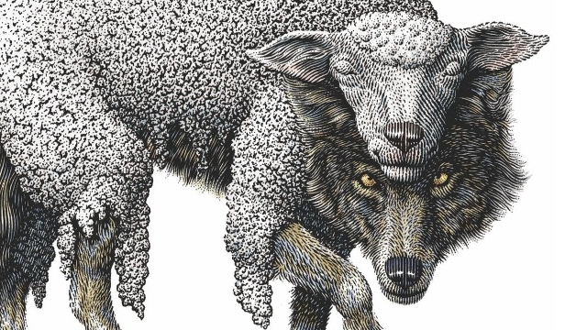

Slide 9
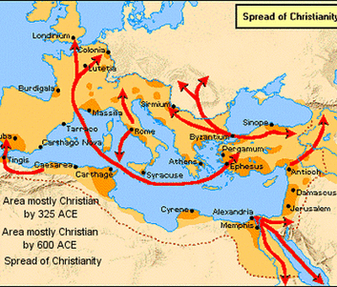
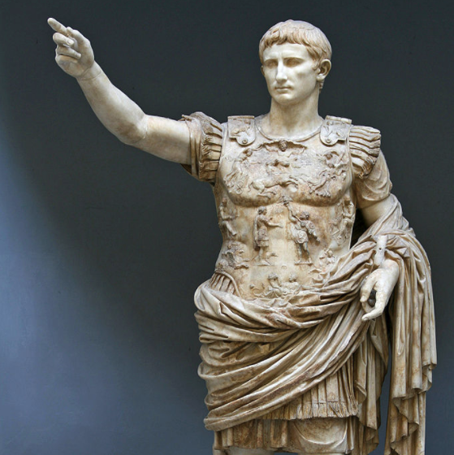
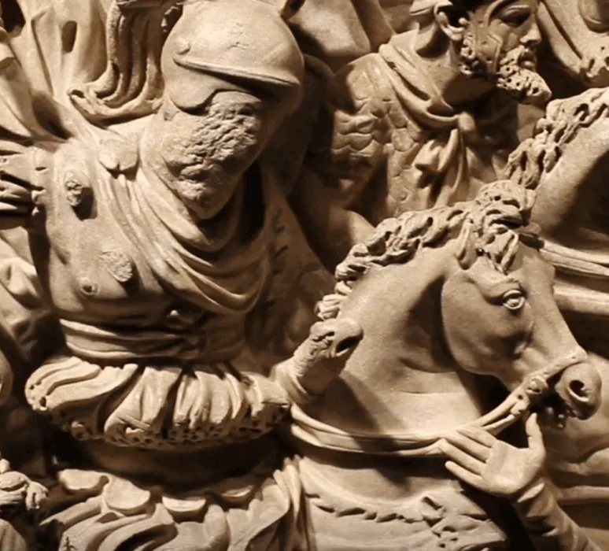
Spread of False Christianity Under the Roman Empire

Slide 10
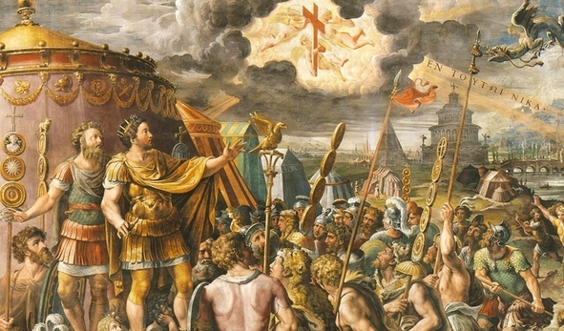
Constantine (312 A.D.)

Slide 11
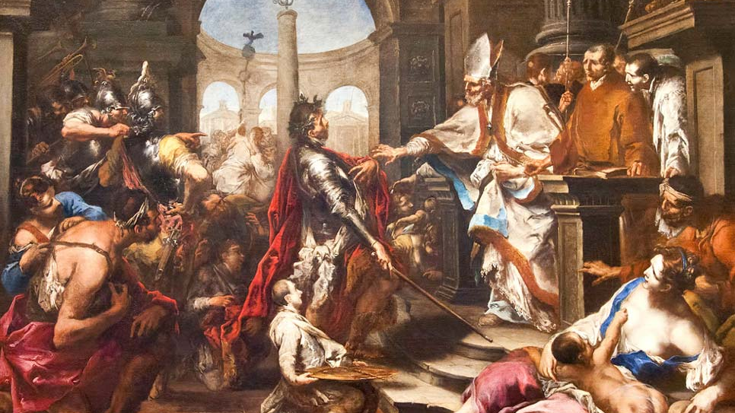
Edict of Thessalonica (380 A.D.)

Slide 12
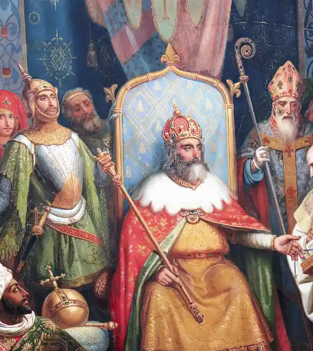
New World Encyclopedia
At its peak the Holy Roman Empire encompassed the territories of present-day Germany, Switzerland, Liechtenstein, Luxembourg, Czech Republic, Austria, Slovenia, Belgium, and the Netherlands as well as large parts of modern Poland, France and Italy.
At the time of its dissolution, it consisted of its core German territories and smaller parts of France, Italy, Poland, Croatia, Belgium, and the Netherlands.
The Holy Roman Empire was created in 800 when Charlemagne was crowned by Pope Leo III. Behind this lay the conviction that Christendom should be a single political unit in which religion and governance combined to serve one Lord, Jesus Christ, who is enthroned in heaven above all earthly rulers.

Slide 13
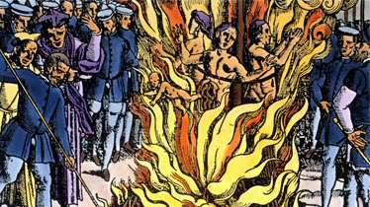
Persecution of Christians Deemed Unorthodox

Slide 14
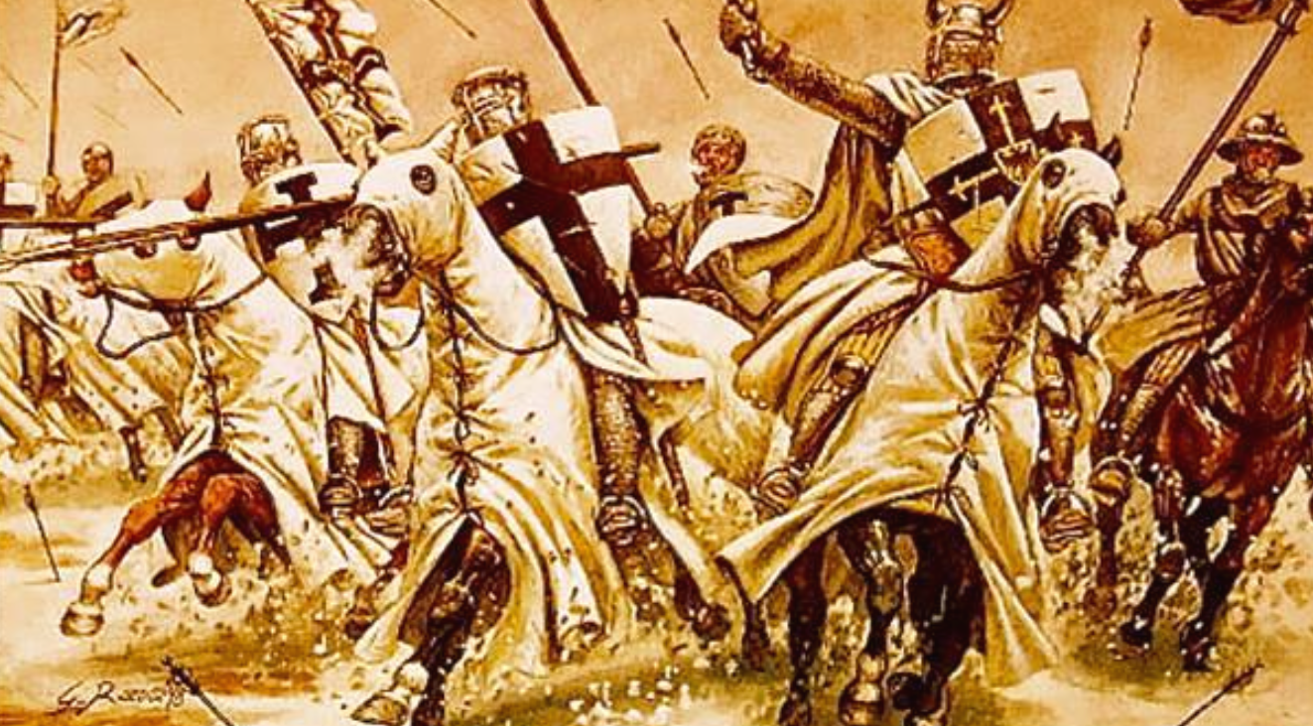
Crusades (1095 – 1291 A.D.)

Slide 15
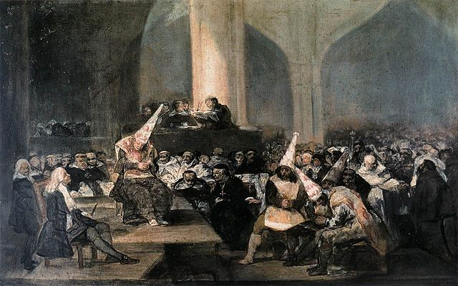
Inquisitions (12th Century – early 20th Century A.D.)

Slide 16
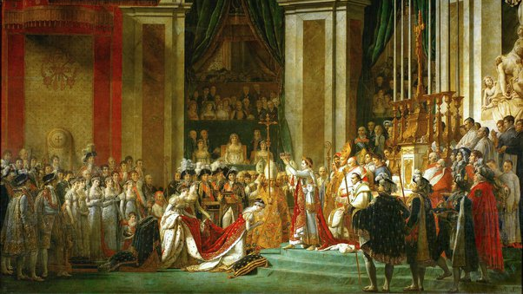
End of Holy Roman Empire (1806 A.D.)

Slide 17
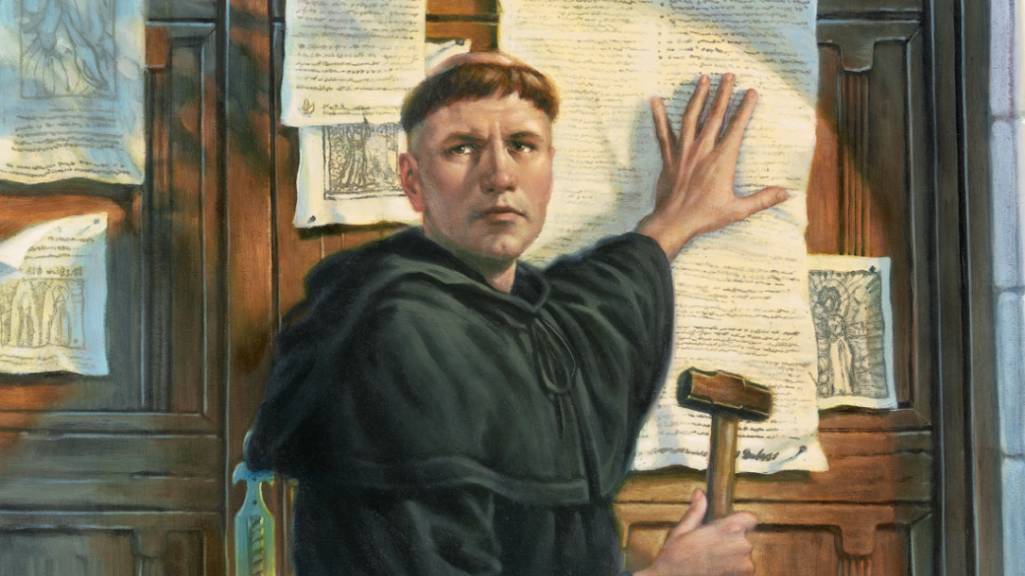
Luther (1517 A.D.)

Slide 18
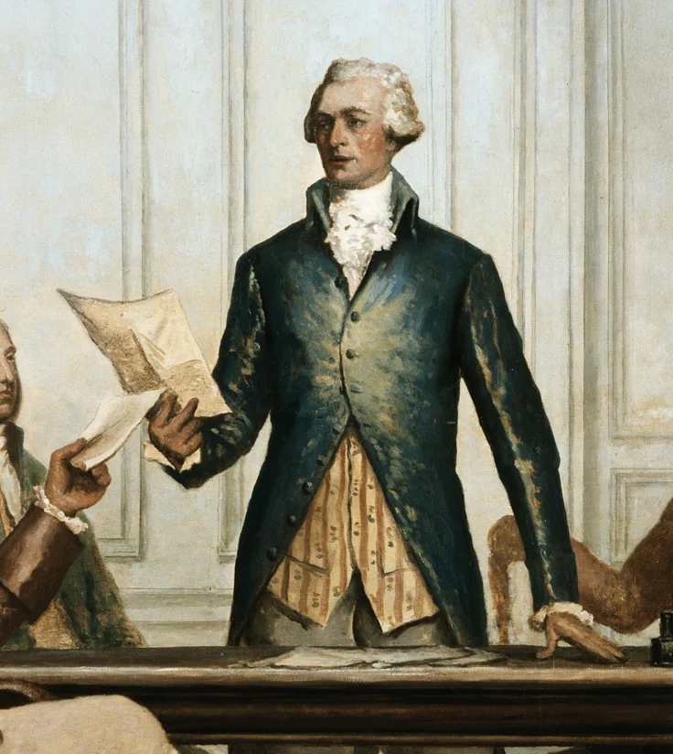
Library of Congress – “Religion and the Founding of the American Republic”
The religious persecution that drove settlers from Europe to the British North American colonies sprang from the conviction, held by Protestants and Catholics alike, that uniformity of religion must exist in any given society.
This conviction rested on the belief that there was one true religion and that it was the duty of the civil authorities to impose it, forcibly, if necessary, in the interest of saving the souls of all citizens.
Nonconformists could expect no mercy and might be executed as heretics. The dominance of the concept, denounced by Roger Williams as "enforced uniformity of religion," meant majority religious groups who controlled political power punished dissenters in their midst.

Slide 19
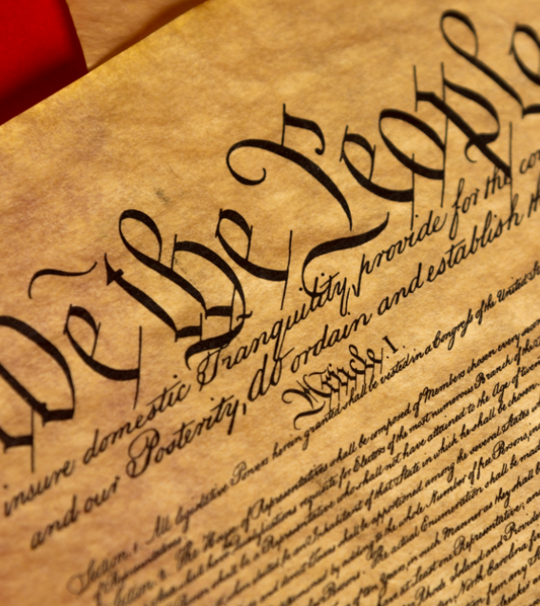
Declaration of Independence
“We hold these truths to be self-evident, that all men are created equal, that they are endowed by their Creator with certain unalienable Rights, that among these are Life, Liberty and the pursuit of Happiness.”

Slide 20
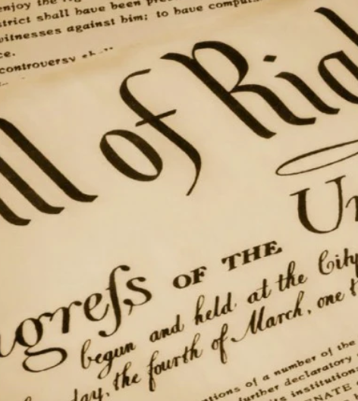
U. S. Bill of Rights
“Congress shall make no law respecting an establishment of religion, or prohibiting the free exercise thereof; or abridging the freedom of speech, or of the press; or the right of the people peaceably to assemble, and to petition the Government for a redress of grievances.”

Slide 21
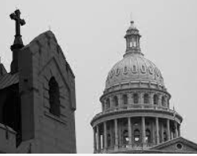
Separation of Church and State
From Wikipedia –
Thomas Jefferson wrote that the First Amendment erected a "wall of separation between church and state“.
James Madison, often regarded as the "Father of the Bill of Rights", also often wrote of the "perfect separation“ or "line of separation", "strongly guarded as is the separation between religion and government in the Constitution of the United States", and "total separation of the church from the state".
Madison explicitly credited Martin Luther as the theorist who "led the way" in providing the proper distinction between the civil and the ecclesiastical spheres with his doctrine of the two kingdoms.

Slide 22
1 Peter 2:9
But you are a chosen generation, a royal priesthood, a holy nation, His own special people, that you may proclaim the praises of Him who called you out of darkness into His marvelous light;

Slide 23
Revelation 3:7-8
“And to the angel of the church in Philadelphia write,
These things says He who is holy, He who is true, “He who has the key of David, He who opens and no one shuts, and shuts and no one opens”: “I know your works. See, I have set before you an open door, and no one can shut it; for you have a little strength, have kept My word, and have not denied My name.”

Slide 24
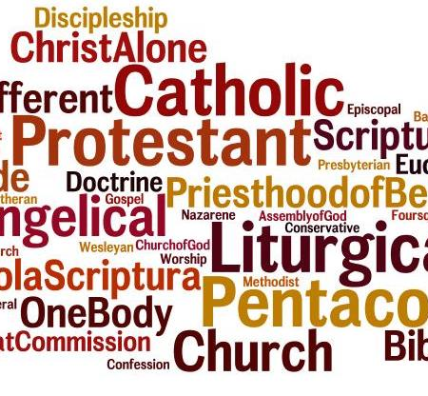


For better and for worse, the 1st Amendment guarantees a voice for all…

Slide 25
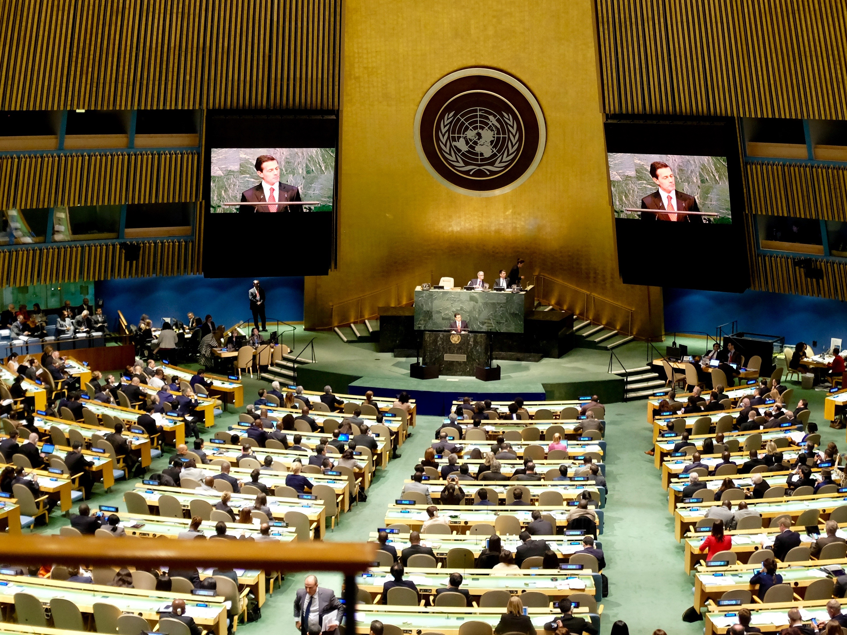


Slide 26
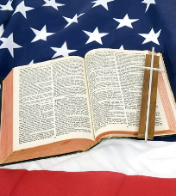
Integralism
From Wikipedia -
Integralism emerged during the 19th and early 20th century polemics within the Catholic Church, especially in France.
The term was used as an epithet to describe those who opposed the modernists, who had sought to create a synthesis between Christian theology and the liberal philosophy of secular modernity.
Proponents of Catholic political integralism taught that all social and political action ought to be based on the Catholic Faith. They rejected the separation of Church and State, arguing that Catholicism should be the proclaimed religion of the State.

Slide 27
Dominionism
From Wikipedia –
Dominion theology (also known as dominionism) is a group of Christian political ideologies that seek to institute a nation which is governed by Christians and based on their understandings of biblical law.

Slide 28
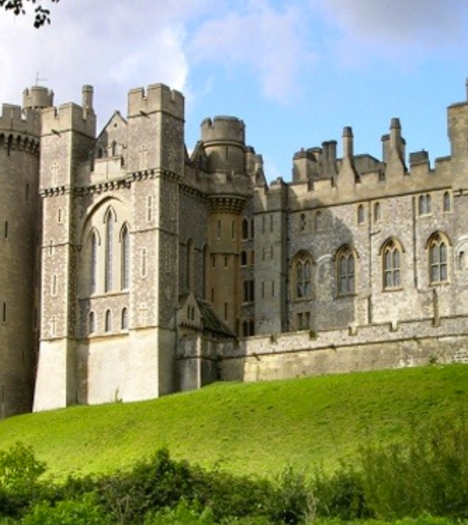
Kingdom Now Theology
From Wikipedia –
Kingdom Now theology is a branch of dominion theology which has had a following within Pentecostalism. It attracted attention in the late 1980s.
Kingdom Now theology states that although Satan has been in control of the world since the Fall, God is looking for people who will help him take back dominion.
Those who yield themselves to the authority of God's apostles and prophets will take control of the kingdoms of this world, being defined as all social institutions, the "kingdom" of education, the "kingdom" of science, the "kingdom" of the arts, etc.

Slide 29
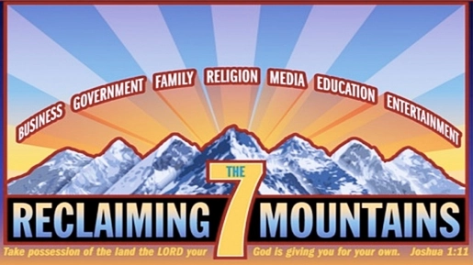

Slide 30
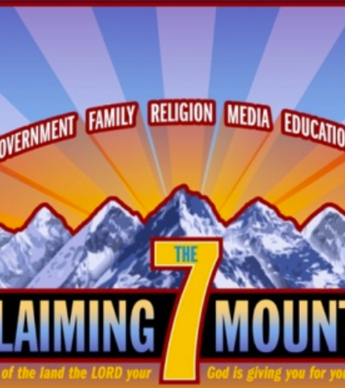
Seven Mountains Dominionism
From Wikipedia –
Characteristics shared by all forms of Dominionism:
Celebrate Christian nationalism - believe that the United States once was, and should once again be, a Christian nation.
Promote religious supremacy - generally do not respect the equality of other religions, or even other versions of Christianity.
Endorse theocratic visions - believe that the Ten Commandments, or "biblical law," should be the foundation of American law, and that the U.S. Constitution should be seen as a vehicle for implementing Biblical principles.

Slide 31
Seven Mountains Dominionism (cont.)
At its most extreme edges, Seven Mountain dominionism holds that Christ will not return unless and until the church successfully invades or “occupies” each of the seven key spheres of life.
Seven Mountain dominionism joins with other forms of Protestant Christian dominionism, Christian nationalism, and newly emergent strains of Catholic integralism (which seeks to integrate Catholic “religious authority with political power”) to place an immense amount of spiritual importance on political leadership.
– The Dispatch

Slide 32
Seven Mountains Dominionism (cont)
“The movement rejected the belief in Christ’s close coming (premillenni-alism) as something that had been useful up to that point but is, in reality, false hope. This change in eschatology was a result of a different understanding of God’s kingdom.”
“(They hold that) we are entering into the Kingdom Age in a sense now, for the Kingdom is being formed in us and when it is completed ... all judicial as well as religious authority will be vested in the church of Christ.”
KAIROS Theological Seminary
Evangelical Journal of Theology

Slide 33
Revelation 7:1-6
Then one of the seven angels who had the seven bowls came and talked with me, saying to me, “Come, I will show you the judgment of the great harlot who sits on many waters, with whom the kings of the earth committed fornication, and the inhabitants of the earth were made drunk with the wine of her fornication.”
So he carried me away in the Spirit into the wilderness. And I saw a woman sitting on a scarlet beast which was full of names of blasphemy, having seven heads and ten horns.

Slide 34
Revelation 7:1-6 cont.
The woman was arrayed in purple and scarlet, and adorned with gold and precious stones and pearls, having in her hand a golden cup full of abominations and the filthiness of her fornication. And on her forehead a name was written:
MYSTERY, BABYLON THE GREAT,
THE MOTHER OF HARLOTS
AND OF THE ABOMINATIONS
OF THE EARTH.
I saw the woman, drunk with the blood of the saints and with the blood of the martyrs of Jesus. And when I saw her, I marveled with great amazement.

Slide 35
Critical Issues Poll (May, 2022) - University of Maryland
National Poll of 2,091 participants
Does the Constitution allow the U.S. government to declare the U.S. a “Christian Nation.”?
Yes - 70 % (81% of Republicans, 57% of Democrats)
Would you favor or oppose the U.S. officially declaring the U.S to be a Christian Nation?
Yes – 38% (61% of Republicans, 17% Democrats)
Percentage of those (Democrats and Republicans) who favor declaring the U.S. a Christian Nation who identify as Christians.
78% Republicans, 52% Democrats

Slide 36
Matthew 24:1-25
Now as He sat on the Mount of Olives, the disciples came to Him privately, saying, “Tell us, when will these things be? And what will be the sign of Your coming, and of the end of the age?”
And Jesus answered and said to them: “Take heed that no one deceives you. For many will come in My name, saying, ‘I am the Christ,’ and will deceive many. And you will hear of wars and rumors of wars.
See that you are not troubled; for all these things must come to pass, but the end is not yet. For nation will rise against nation, and kingdom against kingdom. And there will be famines, pestilences, and earthquakes in various places. All these are the beginning of sorrows.

Slide 37
Matthew 24:1-25
Skipping to verse 23
“Then if anyone says to you, ‘Look, here is the Christ!’ or ‘There!’ do not believe it.
For false christs and false prophets will rise and show great signs and wonders to deceive, if possible, even the elect.
See, I have told you beforehand.

Slide 38



The movement toward a
New World Order

Slide 39
John 16:2
…the time is coming that whoever kills you will think that he offers God service.

Slide 40
Revelation 18:4,8
And I heard another voice from heaven saying, “Come out of her, my people, lest you share in her sins, and lest you receive of her plagues.”
For her sins have reached to heaven, and God has remembered her iniquities.
Skipping to verse 8…
Therefore her plagues will come in one day—death and mourning and famine.
And she will be utterly burned with fire, for strong is the Lord God who judges her.

Slide 41
Revelation 18:9-11,19
The kings of the earth who committed fornication and lived luxuriously with her will weep and lament for her, when they see the smoke of her burning, standing at a distance for fear of her torment, saying, Alas, alas, that great city Babylon, that mighty city! For in one hour your judgment has come.’
“And the merchants of the earth will weep and mourn over her, for no one buys their merchandise anymore:
Skipping to verse 19

Slide 42
Revelation 18:9-11,19
Skipping to verse 19
“They threw dust on their heads and cried out, weeping and wailing, and saying, ‘Alas, alas, that great city, in which all who had ships on the sea became rich by her wealth!
For in one hour she is made desolate.’

Slide 43
Revelation 18:20
“Rejoice over her, O heaven, and you holy apostles and prophets, for God has avenged you on her!”

Slide 44
What Should We Do?
2 Corinthians 6:17-18
“Come out from among them
And be separate, says the Lord.
Do not touch what is unclean,
And I will receive you.”
18 “I will be a Father to you,
And you shall be My sons and daughters,
Says the Lord Almighty.”
Revelation 18:4
And I heard another voice from heaven saying, “Come out of her, my people, lest you share in her sins, and lest you receive of her plagues.

Slide 45
John 18:36
“My kingdom is not of this world.
If My kingdom were of this world, My servants would fight, so that I should not be delivered to the Jews; but now My kingdom is not from here.”

Slide 46
What Should We Do?
Hebrews 11:10
By faith Abraham obeyed when he was called to go out to the place which he would receive as an inheritance. And he went out, not knowing where he was going. 9 By faith he dwelt in the land of promise as in a foreign country, dwelling in tents with Isaac and Jacob, the heirs with him of the same promise; 10 for he waited for the city which has foundations, whose builder and maker is God.

Slide 47
Luke 4:16
“The Spirit of the Lord is upon Me,
Because He has anointed Me
To preach the gospel to the poor;
He has sent Me to heal the brokenhearted,
To proclaim liberty to the captives
And recovery of sight to the blind,
To set at liberty those who are oppressed;
To proclaim the acceptable year of the Lord.”

Slide 48
Matthew 24:14
And this gospel of the kingdom will be preached in all the world as a witness to all the nations, and then the end will come.

Slide 49
John 9:4-5
I must work the works of Him who sent Me while it is day; the night is coming when no one can work.
As long as I am in the world, I am the light of the world.”

Slide 50
Revelation 11:15
Then the seventh angel sounded: And there were loud voices in heaven, saying, “The kingdoms of this world have become the kingdoms of our Lord and of His Christ, and He shall reign forever and ever!”

