Slide 1
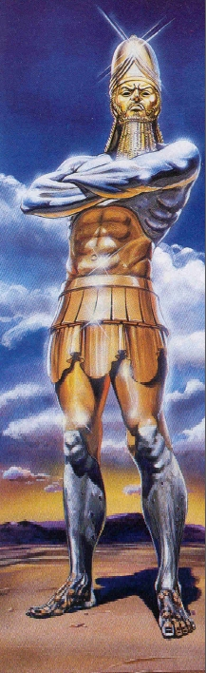
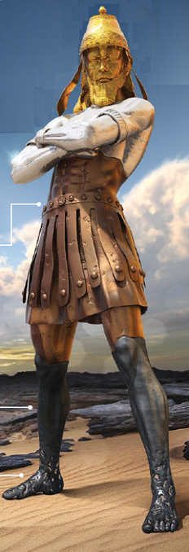
Prophesy
Dead
Reckoning
Dead Reckoning is the process of calculating the current position of a moving object by using a previously determined position
Notes:
Greetings. {Introductions} 27% of the Bible is Prophesy or predictive past and future (Payne, J. B., The Encyclopedia of Biblical Prophecy, Baker Pub. Group, 1980, p. 675). Two key bible books for end-time prophesy is Daniel and Revelation. Daniel is the key to understanding Revelation. One could say if Daniel is misunderstood than Revelation will be misunderstood. We know that the final superpower will be God’s Kingdom with our Lord and Saviour Jesus Christ as King. But in Revelation we read about a superpower or super government that is in power just before Jesus Christ return.
Church leaders can calculate the current / future prophesy by using a previously determined prophesy. Prophesy Dead Reckoning can give us confidence that what God’s has revealed at a high level is true and correct.

Slide 2

“Mystery of the Ages”
Pages 270-271
Those called now, I repeat emphatically, are not called just for salvation. They are called for a special training provided only in God’s Church
Notes:
{Start in a different place}
The person who says “I will get my salvation alone, outside of the Church” is totally deceived. This is not the time when salvation is opened to those in Satan’s world.
Those called now, I repeat emphatically, are not called just for salvation. They are called for a special training provided only in God’s Church

Slide 3


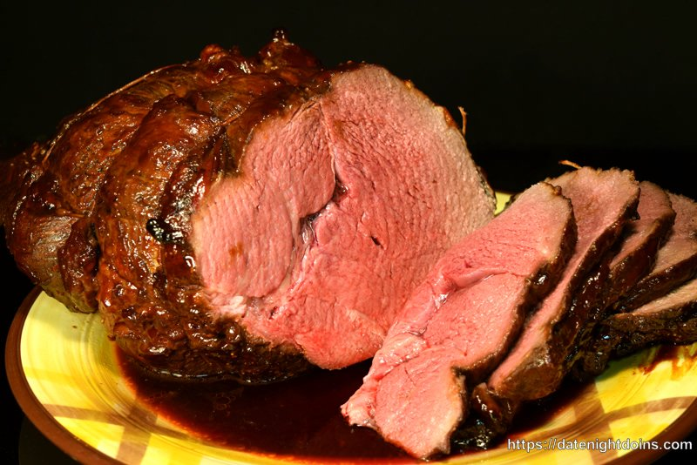
Matt 24:42-47
Watch
Prepare
Give meat in due season
Notes:
Matthew 24:42-47
New King James Version
⁴² Watch therefore, for you do not know what ^{[a]}hour your Lord is coming. ⁴³ But know this, that if the master of the house had known what ^{[b]}hour the thief would come, he would have watched and not allowed his house to be broken into. ⁴⁴ Therefore you also be ready, for the Son of Man is coming at an hour you do not expect.
The Faithful Servant and the Evil Servant
⁴⁵ “Who then is a faithful and wise servant, whom his master made ruler over his household, to give them food ^{[c]}in due season? ⁴⁶ Blessed is that servant whom his master, when he comes, will find so doing. ⁴⁷ Assuredly, I say to you that he will make him ruler over all his goods.

Slide 4
Question to Ponder
If I am Spiritually “Prepared” to be the “Bride of Christ”, do I need to “Watch” and “Give Food (Meat) in Due Season”?
I believe the answer is
YES
Notes:
{Read}

Slide 5

Revealed Prophesy Comes from God
Daniel 2:20-22
20 …“Blessed be the name of God forever and ever, For wisdom and might are His.
21 And He changes the
times and the seasons;
He removes kings and
raises up kings; He gives
wisdom to the wise And knowledge
to those who have understanding.
22 He reveals deep and secret things;…
Notes:
In Daniel we find a very reassuring verse. Let’s read Dan 2:20-22
{Read}
God does the revealing.

Slide 6
Prophesy Dead Reckoning
Let’s look at one example of a future prophesy that has been partially revealed through the fulfillment of historical prophesy.
The Ten Toes of Iron and Clay
Dan 2:32-35
Notes:
{Read}
Daniel 2:32-35
New King James Version
³² This image’s head was of fine gold, its chest and arms of silver, its belly and ^{[a]}thighs of bronze, ³³ its legs of iron, its feet partly of iron and partly of ^{[b]}clay. ³⁴ You watched while a stone was cut out without hands, which struck the image on its feet of iron and clay, and broke them in pieces. ³⁵ Then the iron, the clay, the bronze, the silver, and the gold were crushed together, and became like chaff from the summer threshing floors; the wind carried them away so that no trace of them was found. And the stone that struck the image became a great mountain and filled the whole earth.

Slide 7
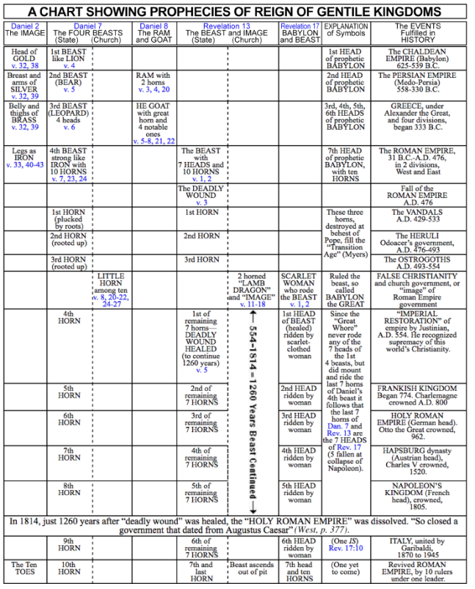
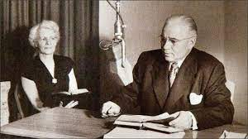
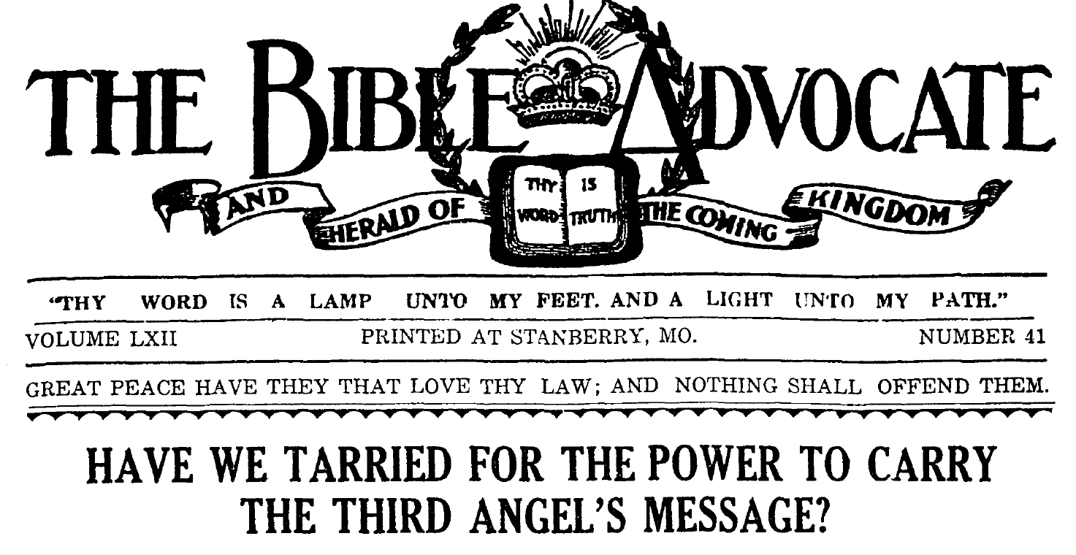
Chart Showing Prophecies of Reign of Gentile Kingdoms
AKA: The beast Chart
Revealing began ~100 years
Revealed to Mr. and Mrs. Armstrong ~1928-1959
10/16/1928
Notes:
{English}
Hebert W Armstrong Autobiography
“From the time of my conversion Mrs. Armstrong has always studied with me. We didn't realize it then, but God was calling us together. We were always a team, working together in unity.”
The Bible Advocate produce by Church of God Seventh Day – Stanberry MO.
BA 1928 October – Urgency to understand the Third Angel’s message of Revelation 14.

Slide 8
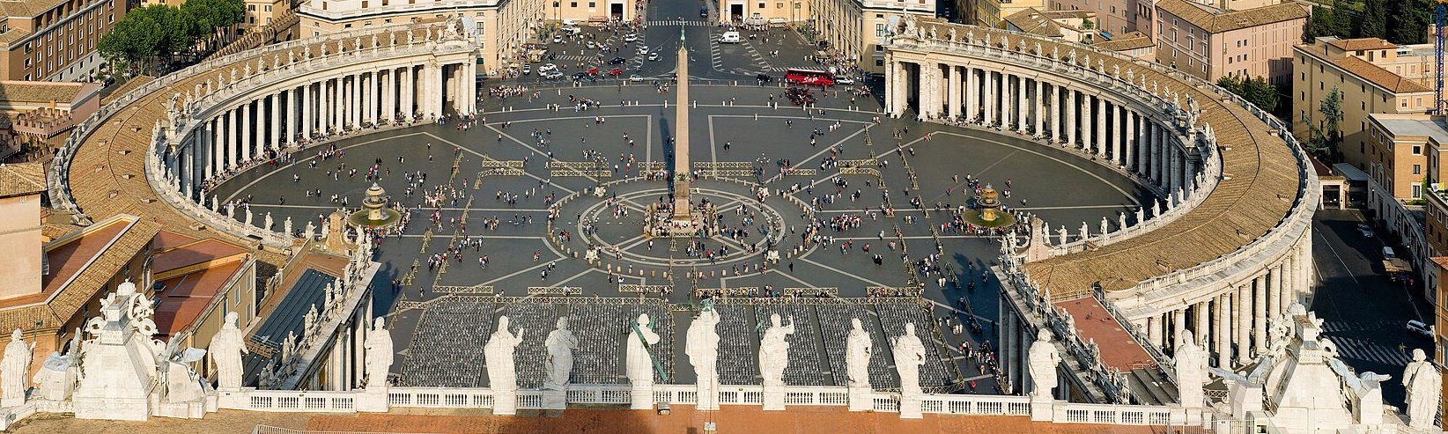

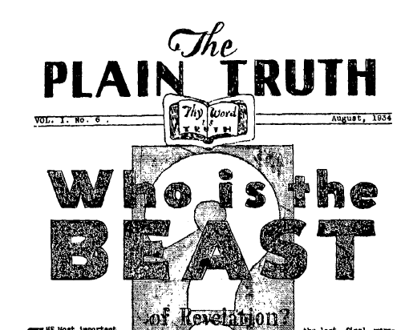
Beast Chart Revealed ~1928-1959
Papal State, extinct since 1870 was revived.
Photo by
David Lliff
License: CC BY-SA 3.0
Studentsof
history.com
1934
1st Beast Chart. Incomplete
Some flaws
Notes:
{English}
1929 was an epochal year in world events, too! The Papal State, extinct since 1870, was revived as a state, or nation by the Lateran Treaty. The Lateran Treaty (Italian: Patti Lateranensi; Latin: Pacta Lateranensia) was one component of the Lateran Pacts of 1929, agreements between the Kingdom of Italy under King Victor Emmanuel III (with his powerful Prime Minister Benito Mussolini) and the Holy See under Pope Pius XI to settle the long-standing Roman Question. The treaty and associated pacts were named after the Lateran Palace where they were signed on 11 February 1929, and the Italian parliament ratified them on 7 June 1929. The treaty recognized Vatican City as an independent state under the sovereignty of the Holy See. The Italian government also agreed to give the Roman Catholic Church financial compensation for the loss of the Papal States. In 1948, the Lateran Treaty was recognized in the Constitution of Italy as regulating the relations between the state and the Catholic Church. The treaty was significantly revised in 1984, ending the status of Catholicism as the sole state religion.
Another significant event of that year was, the New York Stock Market crash occurred October 29, 1929, with $14 Billion lost.
{Click}
Now let’s Jump to 1934, were we have first documentation I could find of the beast chart and specially the 10 Toes of the Image in Daniel.
In this plain truth we can see progress but the there are misunderstandings. God is patiently working with Mr. and Mrs. Armstrong.
The Ten Toes are thought to be 10 revivals not 10 Kings. Mussolini is believed to be the last revival of the Roman Empire and that His Majesty Jesus Christ with return soon.

Slide 9
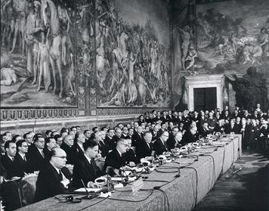
Jump to 1957
The Treaty of Rome, or Treaty establishing the European Economic Community (EEC)
Signed on
25 March 1957
Famous Quote from a German Delegate
Today we are all Romans
Notes:
{English} {Read} {Click}{Read}

Slide 10
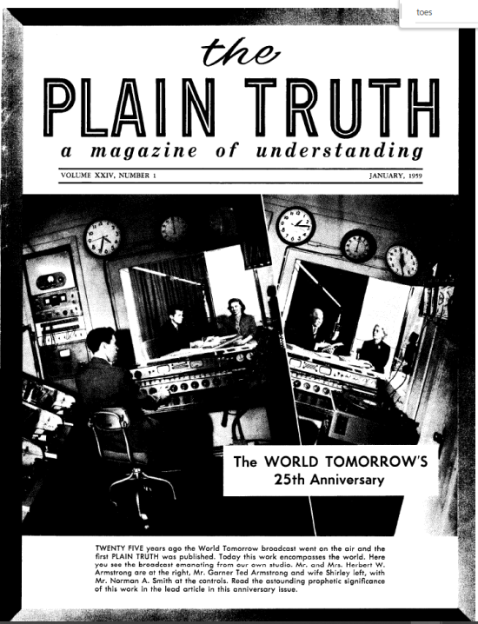

Jump to 1959
No Chart included but Ten Toes are
specifically
defined
CORRECT.
01/1959
There are TEN toes on two feet, pictured as being a mixture of iron and miry clay. “And whereas thou sawest iron mixed with miry clay, they shall mingle themselves with the seed of men (a UNION of men, or nations)
Notes:
{Read}
There are TEN toes on two feet, pictured as being a mixture of iron and miry clay. “And whereas thou sawest iron mixed with miry clay, they shall mingle themselves with the seed of men (a UNION of men, or nations)

Slide 11

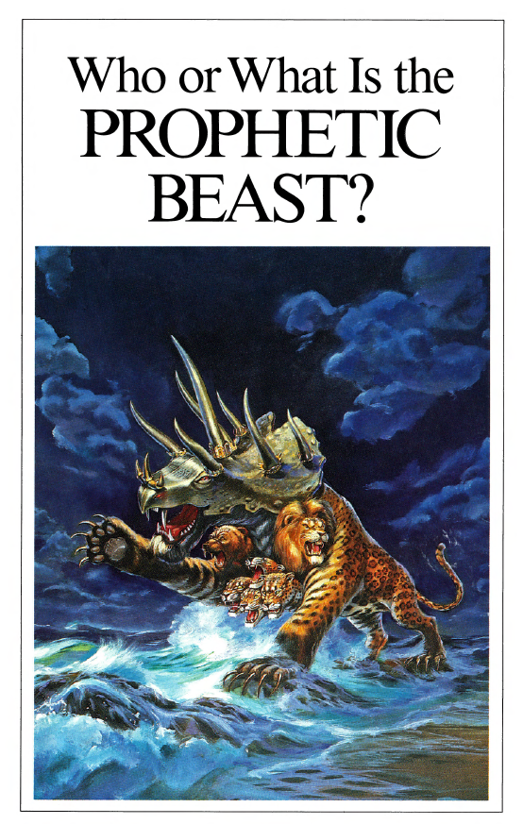
It took ~30 years to completely understand the Prophecies in Dan 2, 7, 8, Rev 13, 17
Notes:
{English}{Read}

Slide 12
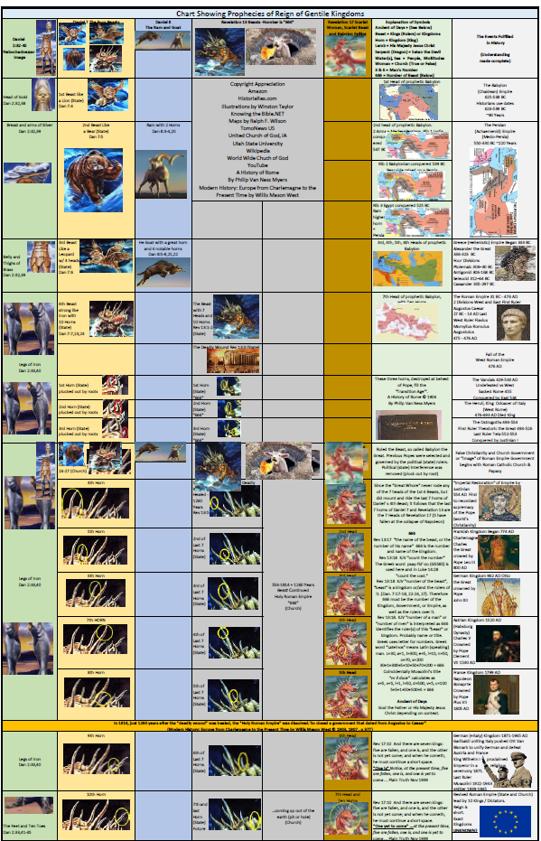
The Updated Beast Chart
Beast Chart from 1980s WWCG
Who or What Is the Prophetic Beast ? Printed 1985s WWCG
The Final Superpower
2013 UCG
Book of Revelation Unveiled 2005 UCG
Who is the Beast 1960 WWCG
A few sermons from my own research.
Notes:
{English}{Read}
We are going to do a high level overview of the chart. Its main purpose is a bible study aid.

Slide 13
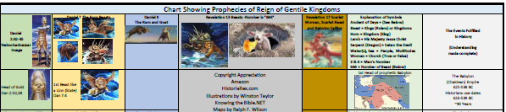
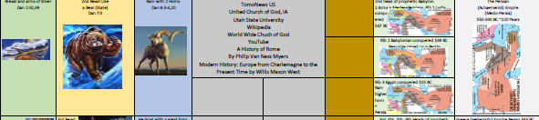
Updated Beast Chart
Dan 2, Dan 7, Dan 8, Rev 13, Rev 17
Notes:
{English}
Chart has two sides. We know the details of the chart from Prophesy that has been fulfilled. Dead Reckoning
{Click} Meads and Persians

Slide 14



Updated Beast Chart
Notes:
{English}{Read from Chart}
{Click}{Read From Chart}
{Click}{Read From Chart}

Slide 15
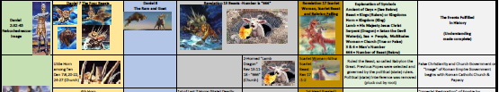
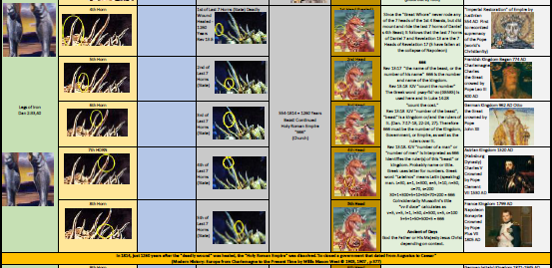
Updated Beast Chart Back Side
Notes:
{English}{Read From Chart}
{Click}{Read From Chart}

Slide 16


Updated Beast Chart Back Side
The Ten Toes of Dan 2, The 10 Horns of Rev 17
Future Prophesy.
How do we know where this will be fulfilled?
We know because of Prophesy History or Prophesy Dead Reckoning.
But we do not know specific details.
Notes:
{English}{Read From Chart}
{Click}{Read From Chart} [Ten Toes]

Slide 17


The Feet and Ten Toes present and future
When will Europe (The Beast) and the Religious Power (False Prophet) revive for the last time?
Has Not Been Revealed
Prophesy Dead Reckoning can:
Help you to know where to “Watch”
Assist your understanding in “Prepare”
Allow you to “Give Meat in Due Season”
Notes:
{English}{Read}
Take the updated Beast Chart and do the study for your self. Use the Chart as a Study guide. If you would like an electronic copy, please let me know.

Slide 18
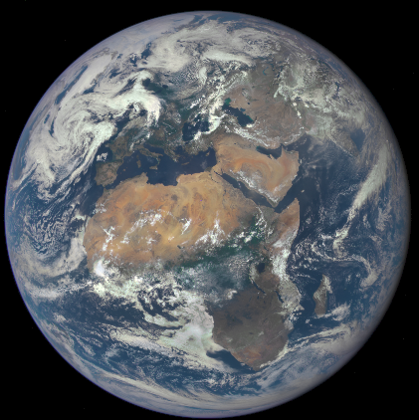
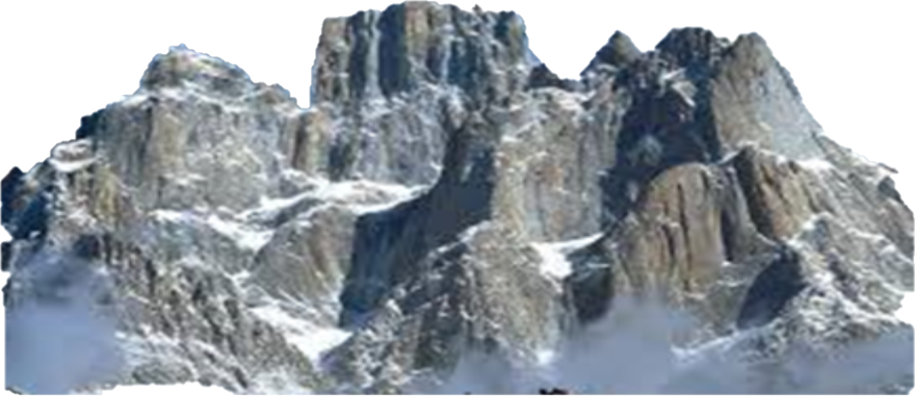
The Feet and Ten Toes present and future
Dan 2:34-35, 44-45
Notes:
{English}
Daniel 2:34 (NKJV)
34 You watched while a stone was cut out without hands, which struck the image on its feet of iron and clay, and broke them in pieces. 35 Then the iron, the clay, the bronze, the silver, and the gold were crushed together, and became like chaff from the summer threshing floors; the wind carried them away so that no trace of them was found. And the stone that struck the image {Click} became a great mountain and filled the whole earth.
Daniel 2:44-45
New King James Version
⁴⁴ And in the days of these kings the God of heaven will set up a kingdom which shall never be destroyed; and the kingdom shall not be left to other people; it shall ^{[a]}break in pieces and ^{[b]}consume all these kingdoms, and it shall stand forever. ⁴⁵ Inasmuch as you saw that the stone was cut out of the mountain without hands, and that it broke in pieces the iron, the bronze, the clay, the silver, and the gold—the great God has made known to the king what will come to pass after this. The dream is certain, and its interpretation is sure.”

