Slide 1
Where did the pagan gods come from – and who are they really?
Steve Corley

Slide 2
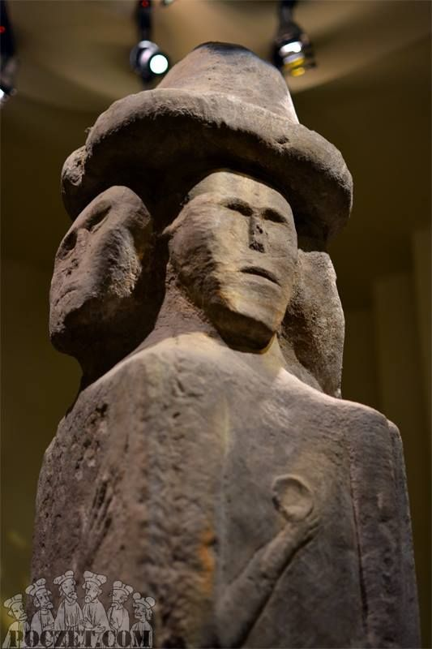
Creating a pagan god from the appearance of a cherub?
Cherubim appeared to Ezekiel with four faces (Ezekiel 10:14, 21) and “full of eyes all around” (verse 12)
A pagan Slavic deity, Światowid (or Svetovit) was imagined as having four faces (one in each direction)
  Name may mean “world view,” “view of light,” “splendid view” or “holy view”
The Roman god Janus was imagined with two faces, front and back (origin of name of month “January”)
Remember that Satan was a cherub (Ezekiel 28:14) and has a tremendous desire to be worshiped! (Matt. 4:9)

Slide 3
Example of deification of ancestor or other prominent person
Tubal-cain (Gen. 4:22)
  Can be pronounced “Tuval-cain”
  “Instructor of every craftsman in bronze and iron”

Slide 4
Example of deification of ancestor or other prominent person
Tubal-cain (Gen. 4:22)
  Can be pronounced “Tuval-cain”
  “Instructor of every craftsman in bronze and iron”
Roman god of the forge was named “Vulcan”
In Germanic mythology the master blacksmith was named “Wieland” or “Wayland,” with one of the names of Odin being “Völundr rómu” (“smith of battle”)

Slide 5
Another example of deification of ancestor or other prominent person
Seba and Raamah, sons of Cush (Gen. 10:7)

Slide 6
Another example of deification of ancestor or other prominent person
Seba (can be pronounced Seva) and Raamah, sons of Cush (Gen. 10:7)
  One of the major strains of Cushites migrated to India (possibly gave name to Hindu Kush mountains)
  The Hindu god of destruction is named “Shiva”
  “Rama” is the name of a figure in Hinduism sometimes regarded as a god, sometimes as a human hero

Slide 7
Applying the name of the True God to a pagan god
The chief god of the Roman pantheon was named “Jupiter” (“Juppiter” or “Iuppiter” in Latin)
  How does the name “Juppiter” have a connection with the name of the True God?
  It is not yet obvious because we have not looked at how the form of the name changes in Latin with its use in a sentence! (Latin declension)

Slide 8
What happens to the Latin name “Juppiter” in cases other than the nominative?
“Juppiter” is a third declension Latin noun:
Latin case | Form of name
Nominative (subject) | Juppiter
Genitive (possessive) | Jovis
Dative (indirect object) | Jovi
Accusative (direct object) | Jovem
Ablative (miscellaneous uses) | Jove
In cases other than the nominative the relationship to the Hebrew name of the True God (YHWH) becomes obvious!

Slide 9
Applying the name of the True God to a pagan god – another example
One of the pagan gods of the Canaanites was called “El” (identified as father of the various Baals)
  (singular form of the Hebrew name “Elohim” of the True God; the Hebrew expression for “God Almighty” is “El Shaddai” and the Hebrew for “God Most High” is “El Elyon”)

Slide 10
Applying the name of the True God to a pagan god – a third example
One of the pagan gods of the Greeks (a fertility god, said to “die” and “rise” at definite times each year) was called “Adonis” (= Tammuz, Ezekiel 8:14)
  (similar to the Biblical Hebrew names “Adonai” or “Adon” for the True God)

Slide 11
Total paganization of a title originally applied to the True God
Hebrew word “ba’al” (Strong’s 1167) originally meant “master” or “owner” (cf. Ex. 22:8, Judges 19:22) and was a title which at one time was appropriately used for the True God
Designation (by nations surrounding Israel) of their pagan gods as “Baals” or “masters” became so widespread that the title “Baali” or “my Master” became no longer appropriate to use in referring to the True God (Hosea 2:16)

