Slide 1
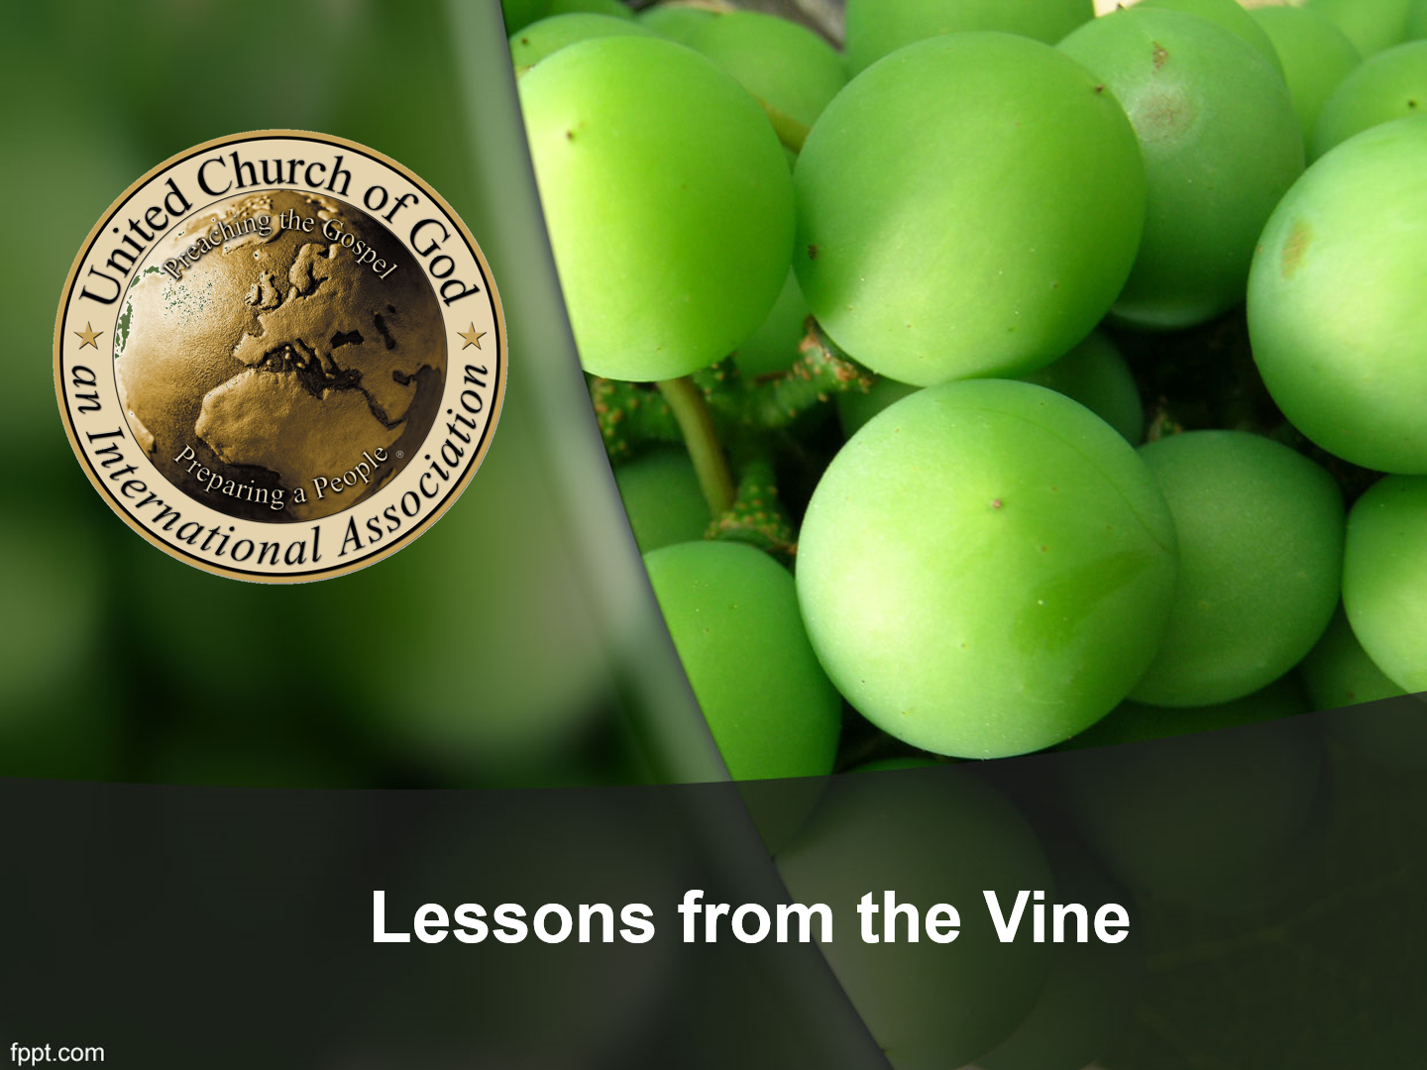

Slide 2
John 15:1-4
“I am the true vine, and My Father is the vinedresser. Every branch in Me that does not bear fruit He takes away; and every branch that bears fruit He prunes, that it may bear more fruit. You are already clean because of the word which I have spoken to you. Abide in Me, and I in you. As the branch cannot bear fruit of itself, unless it abides in the vine, neither can you, unless you abide in Me.”

Slide 3
John 15:5-8
⁵ “I am the vine, you are the branches. He who abides in Me, and I in him, bears much fruit; for without Me you can do nothing. ⁶ If anyone does not abide in Me, he is cast out as a branch and is withered; and they gather them and throw them into the fire, and they are burned. ⁷ If you abide in Me, and My words abide in you, you will ask what you desire, and it shall be done for you. ⁸ By this My Father is glorified, that you bear much fruit; so you will be My disciples.”

Slide 4
John 15:5-8
⁵ “I am the vine, you are the branches. He who abides in Me, and I in him, bears much fruit; for without Me you can do nothing. ⁶ If anyone does not abide in Me, he is cast out as a branch and is withered; and they gather them and throw them into the fire, and they are burned. ⁷ If you abide in Me, and My words abide in you, you will ask what you desire, and it shall be done for you. ⁸ By this My Father is glorified, that you bear much fruit; so you will be My disciples.”

Slide 5
John 15:16
“You did not choose Me, but I chose you and appointed you that you should go and bear fruit…”

Slide 6
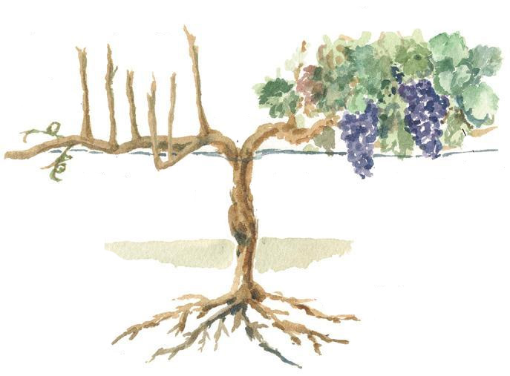
Branches = Disciples
Fruit:
Inward = Love, joy…
Outward = Good works
Vine = Jesus Christ

Slide 7
Galatians 5:22-23
“But the fruit of the Spirit is love, joy, peace, longsuffering, kindness, goodness, faithfulness, ²³ gentleness, self-control.

Slide 8
Ephesians 2:10
“For we are His workmanship, created in Christ Jesus for good works, which God prepared beforehand that we should walk in them.”

Slide 9
John 15:1-4
“I am the true vine, and My Father is the vinedresser. ² Every branch in Me that does not bear fruit He takes away; and every branch that bears fruit He prunes, that it may bear more fruit. ³ You are already clean because of the word which I have spoken to you. ⁴ Abide in Me, and I in you. As the branch cannot bear fruit of itself, unless it abides in the vine, neither can you, unless you abide in Me.”

Slide 10
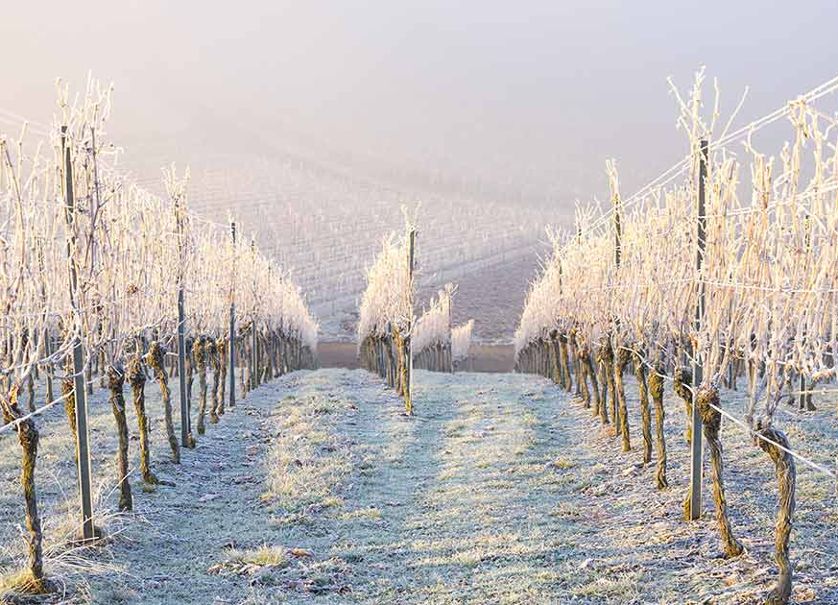
Ecclesiastes 9:11
“…time and chance happen to them all.”

Slide 11
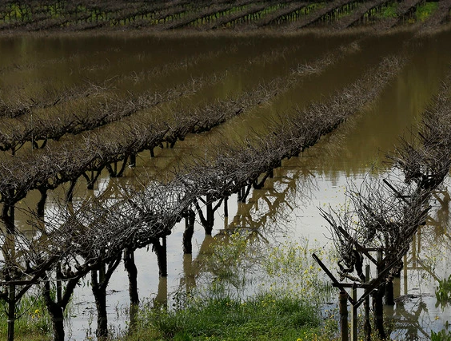
Ecclesiastes 9:11
“…time and chance happen to them all.”

Slide 12
John 14:30
“I will no longer talk much with you, for the ruler of this world is coming, and he has nothing in Me.”

Slide 13
Romans 8:22
“For we know that the whole creation groans and labors with birth pangs together until now.”

Slide 14
John 15:1-4
“I am the true vine, and My Father is the vinedresser. ² Every branch in Me that does not bear fruit He takes away; and every branch that bears fruit He prunes, that it may bear more fruit. ³ You are already clean because of the word which I have spoken to you. ⁴ Abide in Me, and I in you. As the branch cannot bear fruit of itself, unless it abides in the vine, neither can you, unless you abide in Me.”

Slide 15
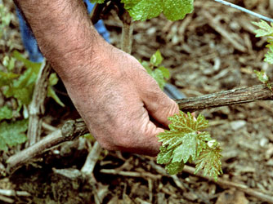
“…He take away.”
Gr. Airo = Lifts up, elevate

Slide 16
John 15:1-4
“I am the true vine, and My Father is the vinedresser. ² Every branch in Me that does not bear fruit He takes away; and every branch that bears fruit He prunes, that it may bear more fruit. ³ You are already clean because of the word which I have spoken to you. ⁴ Abide in Me, and I in you. As the branch cannot bear fruit of itself, unless it abides in the vine, neither can you, unless you abide in Me.”

Slide 17
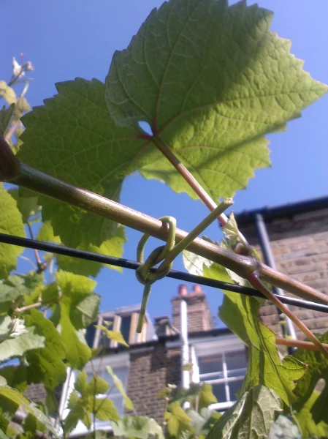
Hebrews 12:5-6
“…whom the Lord loves He chastens, And scourges every son whom He receives.”

Slide 18
1 Corinthians 11:30
“For this reason many are weak and sick among you, and many sleep.”

Slide 19
1 Corinthians 11:30
“For this reason many are weak and sick among you, and many sleep.”

Slide 20
Hebrews 5:8
“He learned obedience by the things which He suffered.”

Slide 21
Hebrews 12:11
“Now no chastening seems to be joyful for the present, but painful; nevertheless, afterward it yields the peaceable fruit of righteousness to those who have been trained by it.”

Slide 22
Jeremiah 17:9
“The heart is deceitful above all things, And desperately wicked; Who can know it?”

Slide 23
John 15:1-4
“I am the true vine, and My Father is the vinedresser. ² Every branch in Me that does not bear fruit He takes away; and every branch that bears fruit He prunes, that it may bear more fruit. ³ You are already clean because of the word which I have spoken to you. ⁴ Abide in Me, and I in you. As the branch cannot bear fruit of itself, unless it abides in the vine, neither can you, unless you abide in Me.”

Slide 24
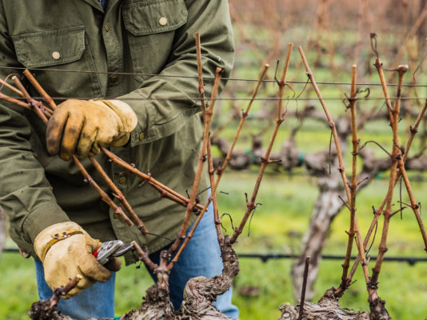

Slide 25
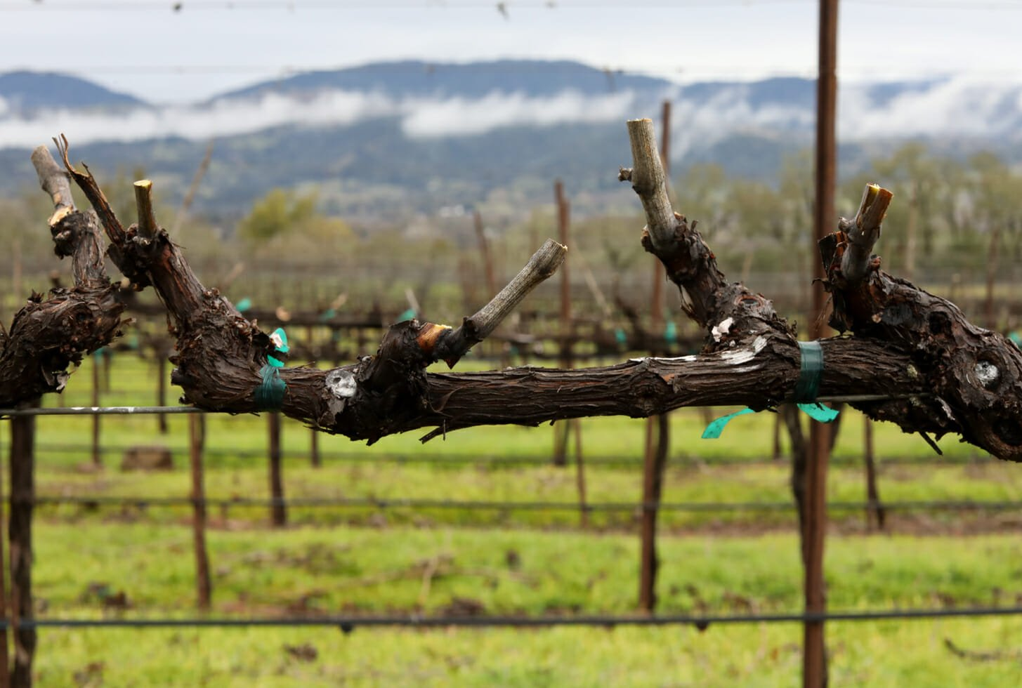
1 Corinthians 1:27-29
“But God has chosen the foolish things of the world to put to shame the wise, and God has chosen the weak things of the world to put to shame the things which are mighty; ²⁸ and the base things of the world and the things which are despised God has chosen, and the things which are not, to bring to nothing the things that are, ²⁹ that no flesh should glory in His presence.”

Slide 26
2 Corinthians 10:4-5
“For the weapons of our warfare are not carnal but mighty in God for pulling down strongholds, ⁵ casting down arguments and every high thing that exalts itself against the knowledge of God, bringing every thought into captivity to the obedience of Christ…”

Slide 27
Luke 16:13
“No servant can serve two masters; for either he will hate the one and love the other, or else he will be loyal to the one and despise the other. You cannot serve God and mammon.”

Slide 28
Luke 16:13
“No servant can serve two masters; for either he will hate the one and love the other, or else he will be loyal to the one and despise the other. You cannot serve God and mammon.”

Slide 29
Matthew 6:25-34
“Therefore I say to you, do not worry about your life, what you will eat or what you will drink; nor about your body, what you will put on. Is not life more than food and the body more than clothing?

Slide 30
Matthew 6:25-34
Skip to verse 31
“Therefore do not worry, saying, ‘What shall we eat?’ or ‘What shall we drink?’ or ‘What shall we wear?’ For after all these things the Gentiles seek. For your heavenly Father knows that you need all these things.”

Slide 31
Matthew 6:25-34
“But seek first the kingdom of God and His righteousness, and all these things shall be added to you. Therefore do not worry about tomorrow, for tomorrow will worry about its own things. Sufficient for the day is its own trouble.”

Slide 32
Matthew 10:37-39
“He who loves father or mother more than Me is not worthy of Me. And he who loves son or daughter more than Me is not worthy of Me. And he who does not take his cross and follow after Me is not worthy of Me. He who finds his life will lose it, and he who loses his life for My sake will find it.”

Slide 33
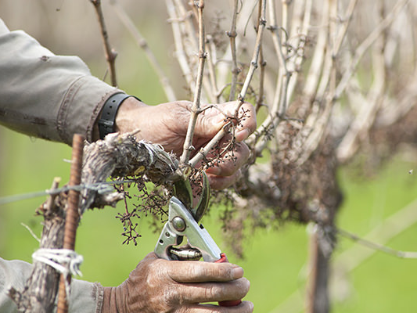

Slide 34
1 Corinthians 10:13
“No temptation has overtaken you except such as is common to man; but God is faithful, who will not allow you to be tempted beyond what you are able, but with the temptation will also make the way of escape, that you may be able to bear it.”

Slide 35
John 10:10
“I have come that they may have life, and that they may have it more abundantly.”

Slide 36
Luke 12:16-31
“Then He spoke a parable to them, saying: “The ground of a certain rich man yielded plentifully. And he thought within himself, saying, ‘What shall I do, since I have no room to store my crops?’ So he said, ‘I will do this: I will pull down my barns and build greater, and there I will store all my crops and my goods. And I will say to my soul, “Soul, you have many goods laid up for many years; take your ease; eat, drink, and be merry.”

Slide 37
Luke 12:16-31
“But God said to him, ‘Fool! This night your soul will be required of you; then whose will those things be which you have provided?’ “So is he who lays up treasure for himself, and is not rich toward God.”

Slide 38
Luke 12:16-31
“Then He said to His disciples, “Therefore I say to you, do not worry about your life, what you will eat; nor about the body, what you will put on. Life is more than food, and the body is more than clothing.”

Slide 39
Luke 12:16-31
Skipping to verse 29
“And do not seek what you should eat or what you should drink, nor have an anxious mind. For all these things the nations of the world seek after, and your Father knows that you need these things.”

Slide 40
Luke 12:16-31
“But seek the kingdom of God, and all these things shall be added to you.”

Slide 41
Philippians 3:4-15
“…though I also might have confidence in the flesh. If anyone else thinks he may have confidence in the flesh, I more so: circumcised the eighth day, of the stock of Israel, of the tribe of Benjamin, a Hebrew of the Hebrews; concerning the law, a Pharisee; concerning zeal, persecuting the church; concerning the righteousness which is in the law, blameless.”

Slide 42
Philippians 3:4-15
“But what things were gain to me, these I have counted loss for Christ. Yet indeed I also count all things loss for the excellence of the knowledge of Christ Jesus my Lord, for whom I have suffered the loss of all things, and count them as rubbish, that I may gain Christ…”

Slide 43
Philippians 3:4-15
Skipping to verse 13
“Brethren, I do not count myself to have apprehended; but one thing I do, forgetting those things which are behind and reaching forward to those things which are ahead, I press toward the goal for the prize of the upward call of God in Christ Jesus.”

Slide 44
Philippians 3:4-15
“Therefore let us, as many as are mature, have this mind; and if in anything you think otherwise, God will reveal even this to you.”

Slide 45
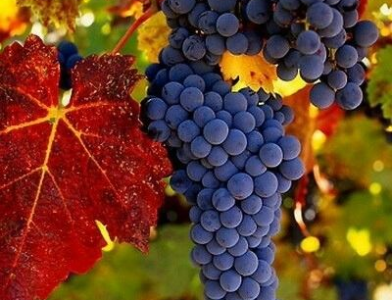
Ask and Examine

Slide 46
Discipline?
Repent
2 Chronicles 7:14
“…if My people who are called by My name will humble themselves, and pray and seek My face, and turn from their wicked ways, then I will hear from heaven, and will forgive their sin and heal their land.”

Slide 47
Pruning?
Submit with
Thankfulness
James 1:2-3
“My brethren, count it all joy when you fall into various trials, knowing that the testing of your faith produces patience.”

Slide 48
Time and Chance? Ask for Strength
Phil. 4:13
“I can do all things through Christ who strengthens me.”

Slide 49
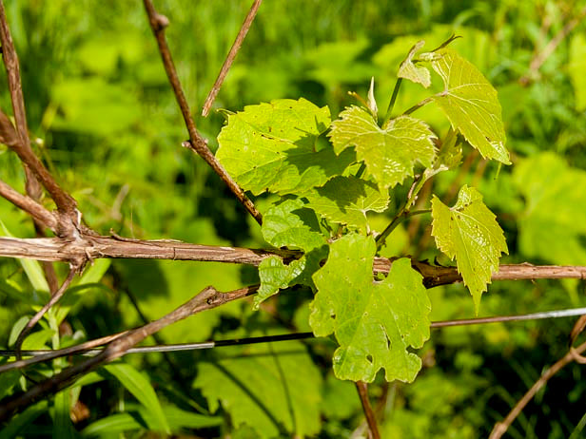
No Abundnance for no reason?

Slide 50
No Abundnance for no reason?
Humble Yourself
1 Peter 5:6-7
“Therefore humble yourselves under the mighty hand of God, that He may exalt you in due time, casting all your care upon Him, for He cares for you.”

Slide 51
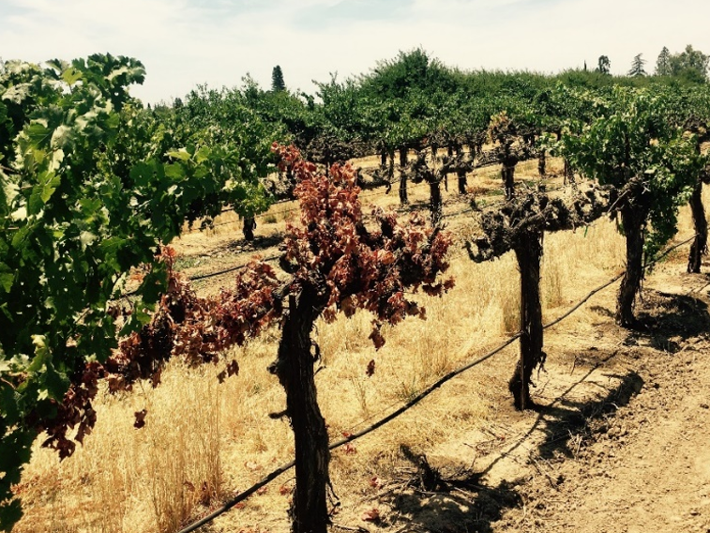

Slide 52
John 15:6
“If anyone does not abide in Me, he is cast out as a branch and is withered;…”

Slide 53
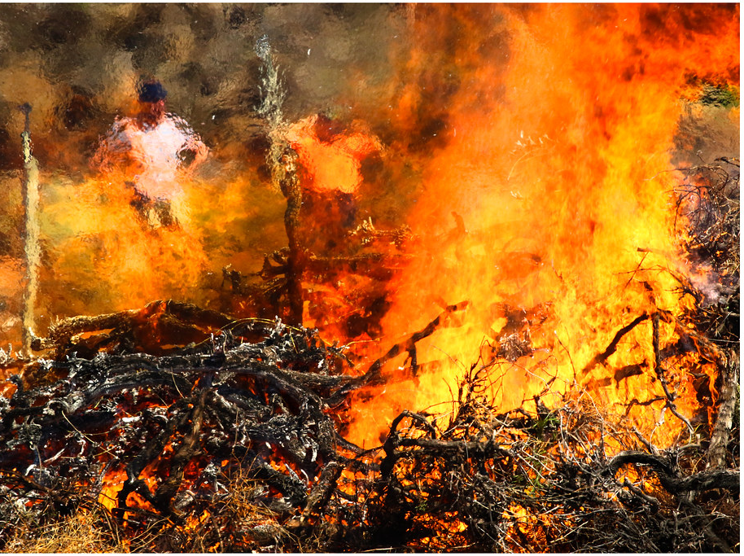
John 15:6
“…and they gather them and throw them into the fire, and they are burned.”

Slide 54
Matthew 8:19-22
“Then a certain scribe came and said to Him, “Teacher, I will follow You wherever You go.” And Jesus said to him, “Foxes have holes and birds of the air have nests, but the Son of Man has nowhere to lay His head.” Then another of His disciples said to Him, “Lord, let me first go and bury my father.” But Jesus said to him, “Follow Me, and let the dead bury their own dead.”

Slide 55
John 15:8
“By this My Father is glorified, that you bear much fruit; so you will be My disciples.”

