Slide 1
Grace at the heart of Thanksgiving
By Troy Phelps

Slide 2
Do you consistently express your thankfulness?

Slide 3
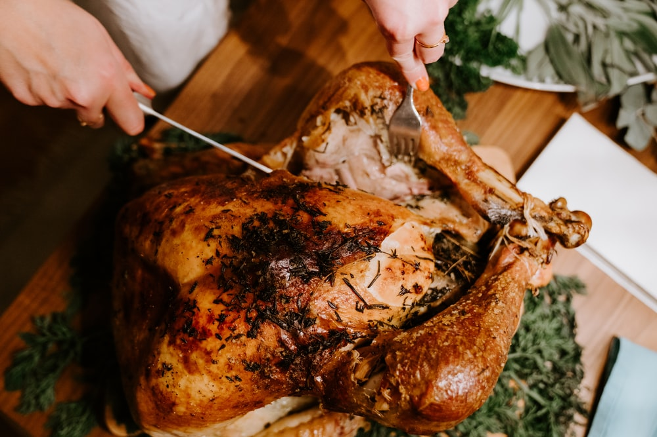

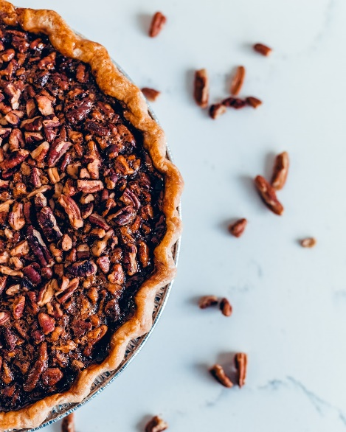

Thanksgiving or Turkeyday?
Images from unsplash.com

Slide 4
2 Timothy 3:1-5 [NKJV]
“But know this, that in the last days perilous times will come:
For men will be lovers of themselves, lovers of money, boasters, proud, blasphemers, disobedient to parents, unthankful, unholy,
unloving, unforgiving, slanderers, without self-control, brutal, despisers of good, traitors, headstrong, haughty, lovers of pleasure rather than lovers of God, having a form of godliness but denying its power. And from such people turn away!

Slide 5

George Washington – 1789
“Whereas it is the duty of all Nations to acknowledge the providence of Almighty God, to obey his will, to be grateful for his benefits, and humbly to implore his protection and favor—

Slide 6
George Washington – 1789
and whereas both Houses of Congress have by their joint Committee requested me to recommend to the People of the United States a day of public thanksgiving and prayer to be observed by acknowledging with grateful hearts the many signal favors of Almighty God especially by affording them an opportunity peaceably to establish a form of government for their safety and happiness.”

Slide 7
George Washington – 1789
Now therefore I do recommend and assign Thursday the 26th day of November next to be devoted by the People of these States to the service of that great and glorious Being, who is the beneficent Author of all the good that was, that is, or that will be—

Slide 8
George Washington – 1789
That we may then all unite in rendering unto him our sincere and humble thanks—for his kind care and protection of the People of this Country previous to their becoming a Nation—”

Slide 9
George Washington – 1789
“and in general for all the great and various favors which he hath been pleased to confer upon us.

Slide 10
George Washington – 1789
and also that we may then unite in most humbly offering our prayers and supplications to the great Lord and Ruler of Nations and beseech him to pardon our national and other transgressions—”

Slide 11
Abraham Lincoln– 1863
“The year that is drawing towards its close, has been filled with the blessings of fruitful fields and healthful skies.

Slide 12
Abraham Lincoln– 1863
To these bounties, which are so constantly enjoyed that we are prone to forget the source from which they come, others have been added, which are of so extraordinary a nature, that they cannot fail to penetrate and soften even the heart which is habitually insensible to the ever watchful providence of Almighty God.”

Slide 13
Abraham Lincoln– 1863
“No human counsel hath devised nor hath any mortal hand worked out these great things. They are the gracious gifts of the Most High God, who, while dealing with us in anger for our sins, hath nevertheless remembered mercy.

Slide 14
Abraham Lincoln– 1863
It has seemed to me fit and proper that they should be solemnly, reverently and gratefully acknowledged as with one heart and one voice by the whole American People. I do therefore invite …

Slide 15
Abraham Lincoln– 1863
to set apart and observe the last Thursday of November next, as a day of Thanksgiving and Praise to our beneficent Father who dwelleth in the Heavens.

Slide 16
Abraham Lincoln– 1863
And I recommend to them that while offering up the ascriptions justly due to Him for such singular deliverances and blessings, they do also, with humble penitence for our national perverseness and disobedience, commend to His tender care all those who have become

Slide 17
Abraham Lincoln– 1863
widows, orphans, mourners or sufferers in the lamentable civil strife in which we are unavoidably engaged, and fervently implore the interposition of the Almighty Hand to heal the wounds of the nation and to restore it as soon as may be consistent with the Divine purposes to the full enjoyment of peace, harmony, tranquillity and Union.”

Slide 18
Grace at the Heart of Thanksgiving

Slide 19
Greek “Grace”
-CHARIS-

Slide 20
Greek “Grace”
-CHARIS-
156x
83% translated “Grace”
8x “Thanks/Thank”
8x “Favor”

Slide 21
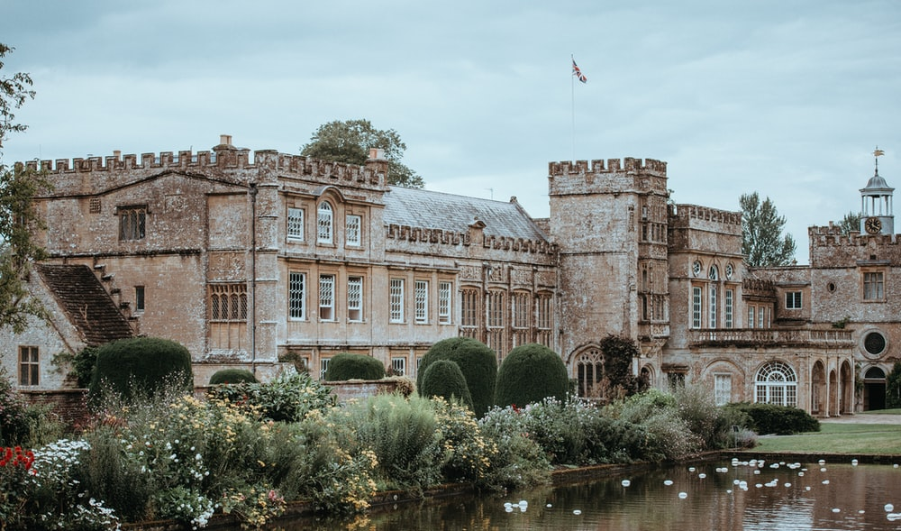
4% of population had:
Power
Influence
Money
Status
Means
Control
Images from unsplash.com

Slide 22
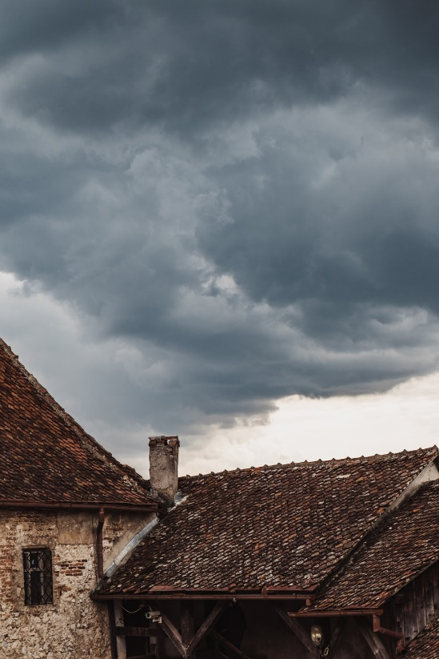
Greek “Grace”
-CHARIS-
4% of population had:
Power
Influence
Money
Status
Means
Control
Images from unsplash.com

Slide 23
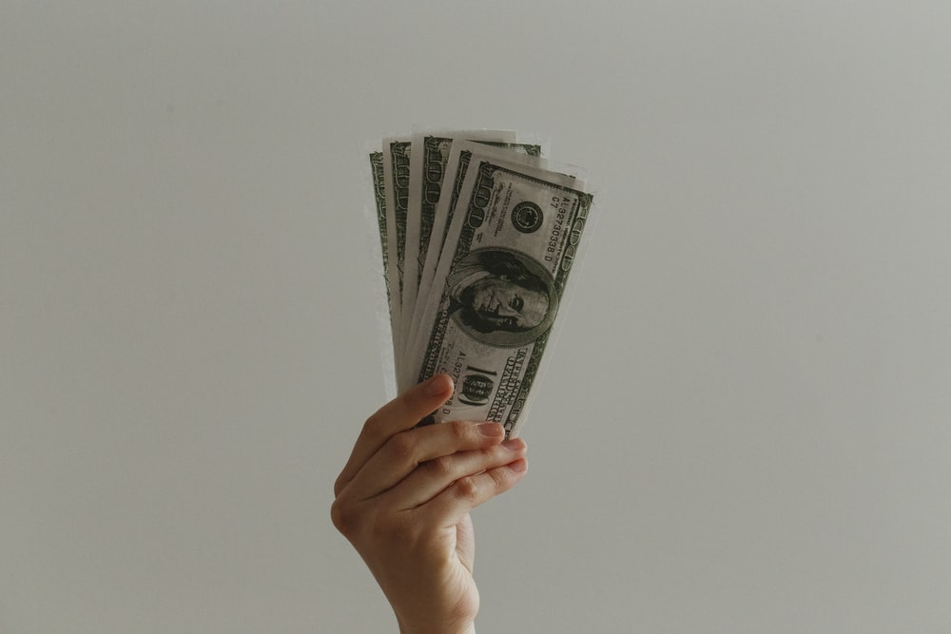
Images from unsplash.com

Slide 24
A+
Images from unsplash.com

Slide 25

A+
Images from unsplash.com

Slide 26
A+
EARNED
Images from unsplash.com

Slide 27
Romans 4:4
NKJV - Now to him who works, the wages are not counted as grace [charis] but as debt.
NLT - When people work, their wages are not a gift [charis], but something they have earned.

Slide 28

Images from unsplash.com

Slide 29

Images from unsplash.com

Slide 30
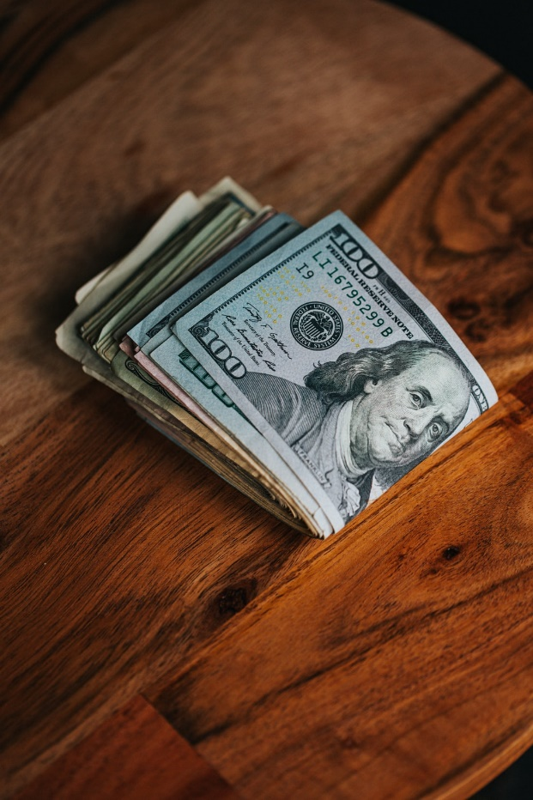
Images from unsplash.com

Slide 31

Images from unsplash.com

Slide 32
1 Corinthians 4:7 [NLT]
“…What do you have that God hasn't given you? And if everything you have is from God, why boast as though it were not a gift?”

Slide 33
James 1:17 [NKJV]
“Every good gift and every perfect gift is from above, and comes down from the Father of lights”

Slide 34
Acts 17:25 [NKJV]
“He gives to all life, breath, and all things.”

Slide 35
Romans 6:23 [NKJV]
What are we truly owed? What have we earned?
“For the wages of sin is death, but the gift of God is eternal life in Christ Jesus our Lord.”

Slide 36
“Thanksgiving”

Slide 37
Grace at the Heart of Thanksgiving

Slide 38
Greek “Grace”
-CHARIS-

Slide 39
Greek “Thansgiving”
eu-CHARIS-tia

Slide 40
Greek “Thansgiving”
eu-CHARIS-tia
Eu = “Good, well done”

Slide 41
Response to God’s Grace =
-CHARIS-

Slide 42
Response to God’s “Grace” = “Thanksgiving”
eu-CHARIS-

Slide 43
Response to God’s “Grace” = “Thanksgiving”
eu-CHARIS-
euCHARIStia – noun – 15x – “Thanksgiving”
euCHARISteo – verb – 39x – “Giving of thanks”
euCHARIStos – adjective – 1x – “thankful”

Slide 44
euCHARIStia: Philippians 4:6 [NKJV]
“Be anxious for nothing, but in everything by prayer and supplication, with thanksgiving [euCHARIStia], let your requests be made known to God;

Slide 45
euCHARIStia: 2 Corinthians 4:14-15 [NLT]
“We know that God, who raised the Lord Jesus, will also raise us with Jesus and present us to Himself together with you.
All of this is for your benefit. And as God's grace reaches more and more people, there will be great thanksgiving [euCHARIStia], and God will receive more and more glory.

Slide 46
euCHARIStia: 2 Corinthians 9:10-12 [NLT]
“For God is the One who provides seed for the farmer and then bread to eat. In the same way, He will provide and increase your resources and then produce a great harvest of generosity in you.
Yes, you will be enriched in every way so that you can always be generous. And when we take your gifts to those who need them, they will thank [euCHARIStia] God.
So two good things will result from this ministry of giving—the needs of the believers in Jerusalem will be met, and they will joyfully express their thanks [euCHARIStia] to God.

Slide 47
euCHARISteo: Matthew 15:36 [NKJV]
“And He took the seven loaves and the fish and gave thanks [euCHARISteo], broke them and gave them to His disciples; and the disciples gave to the multitude.

Slide 48
euCHARISteo: Ephesians 5:20 [NKJV]
“giving thanks [euCHARISteo] always for all things to God the Father in the name of our Lord Jesus Christ,”

Slide 49
euCHARISteo: Colosians 3:17 [NKJV]
“And whatever you do in word or deed, do all in the name of the Lord Jesus, giving thanks [euCHARISteo] to God the Father through Him.”

Slide 50
euCHARISteo: 1 Thesolonians 5:16-18 [NKJV]
“Rejoice always, pray without ceasing, in everything give thanks [euCHARISteo]; for this is the will of God in Christ Jesus for you.”

Slide 51
Greek “Grace”
-CHARIS-

Slide 52
Proper response to God’s Grace is “Thanksgiving”
eu-CHARIS-

Slide 53
Proper response to God’s Grace is “Thanksgiving”
eu-CHARIS-
euCHARIStia – noun – 15x – “Thanksgiving”
euCHARISteo – verb – 39x – “Giving of thanks”
euCHARIStos – adjective – 1x – “thankful”

Slide 54
Improper response to God’s Grace?

Slide 55
Improper response to God’s Grace?
a-CHARIS-tos
2Timothy 3:2 “For men will be lovers of themselves, lovers of money, boasters, proud, blasphemers, disobedient to parents, unthankful [aCHARIStos], unholy,

Slide 56
Improper response to God’s Grace?
a-CHARIS-tos
Prefix ‘a’
Means: “Not or without”
Examples: Asexual, Amoral, Agnostic

Slide 57
Improper response to God’s Grace?
a-CHARIS-tos
A with CHARIS means “Without giving thanks” “Unthankful”

Slide 58
Luke 17:11-19 [NKJV]
“Now it happened as He went to Jerusalem that He passed through the midst of Samaria and Galilee.
Then as He entered a certain village, there met Him ten men who were lepers, who stood afar off.
And they lifted up their voices and said, "Jesus, Master, have mercy on us!"

Slide 59
Luke 17:11-19 [NKJV]
“So when He saw them, He said to them, "Go, show yourselves to the priests." And so it was that as they went, they were cleansed.
And one of them, when he saw that he was healed, returned, and with a loud voice glorified God,
and fell down on his face at His feet, giving Him thanks [euCHARISteo]. And he was a Samaritan.”

Slide 60
Luke 17:11-19 [NKJV]
“So Jesus answered and said, "Were there not ten cleansed? But where are the nine?
Were there not any found who returned to give glory to God except this foreigner?"
And He said to him, "Arise, go your way. Your faith has made you well.”

Slide 61
Expressing Thankfulness

Slide 62
Something Earned = Wages = Not Grace (fair)

Slide 63
Something Earned = Wages = Not Grace (fair)
Not Earned = Receive gift/favor/blessing = Grace

Slide 64
Something Earned = Wages = Not Grace (fair)
Not Earned = Receive gift/favor/blessing = Grace
Not Earned = Nothing received = Not Grace (fair)
Earned penalty = Don’t receive penalty = Grace

Slide 65
Something Earned = Wages = Not Grace (fair)
Not Earned = Receive gift/favor/blessing = Grace
Not Earned = Nothing received = Not Grace (fair)
Earned penalty = Don’t receive penalty = Grace
Not Earned = “I deserve it!” = Entitlement
Earned penalty = “I shouldn’t pay!” = Entitlement

Slide 66

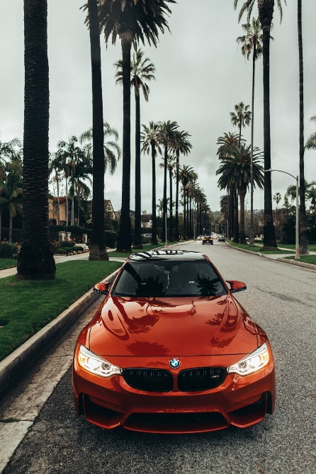
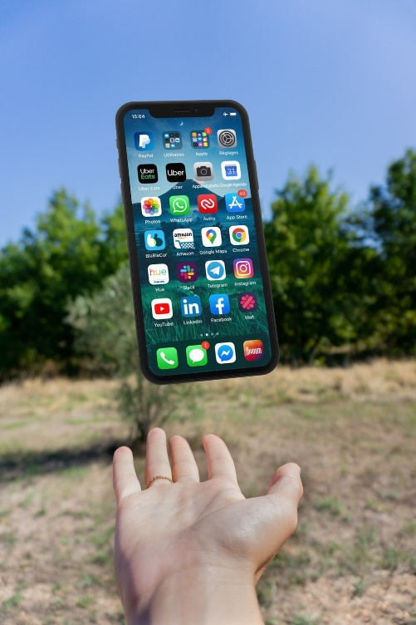
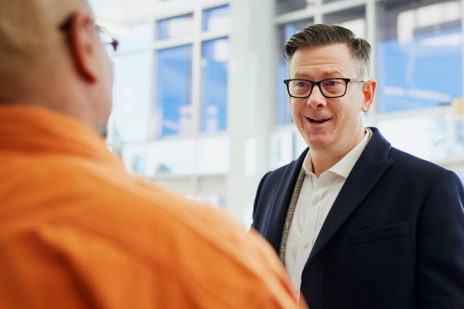
Marketing Strategy: “You Deserve it”
You should too!
They have it…
Images from unsplash.com

Slide 67
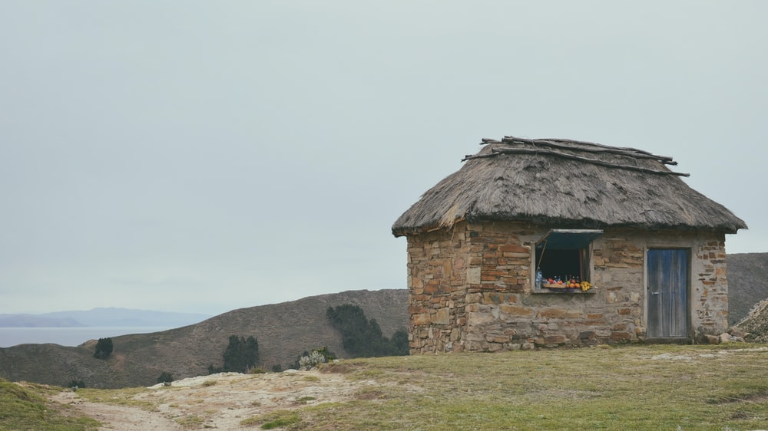
Add a Slide Title - 3
Images from unsplash.com

Slide 68
What do we deserve? Death!

Slide 69
What do we deserve? Death!
What have we been given that we don’t deserve?
Life of Jesus Christ…
Forgiveness…
Promise of the resurrection…
Holy Spirit…
Promise of Eternal life…

Slide 70
What we each can express thankfulness for:
1. Life
2. Our world
3. Basic needs met
4. Loved ones
5. Our calling
6. Sacrifice/Resurrection of Jesus Christ
7. God’s Holy Spirit in us
8. Our place in the Kingdom of God
9. A plan for everyone

Slide 71
Grace at the heart of Thanksgiving
By Troy Phelps

