Slide 1
Filling in Biblical Gaps with Other Sources
There are many things written in scriptures that leave us wondering how this could be. Examples include:
If Herod died in 4 BC as many think, then when was Jesus born?
Moses married Jethro’s daughter, yet scripture says he had married an Ethiopian woman. How did this happen?
To deny the bible, scholars try to say Daniel was written much later AFTER the 1st 3 empires of Babylon, Persia, and Greece. How do we prove it wasn’t?

Slide 2
Since Herod tried to Kill Jesus…
Clearly Herod was alive when Jesus was born.
Matthew 2:16 Then Herod, when he saw that he was mocked of the wise men, was exceeding wroth, and sent forth, and slew all the children that were in Bethlehem, and in all the coasts thereof, from two years old and under, according to the time which he had diligently inquired of the wise men.
Who were these wise men?
If Herod died in 4 BC Jesus would have to be born before this.
If Herod died in 1 BC then Jesus could be born after 4 BC.

Slide 3
Date of Herod’s Death
Scholars use Eclipses to determine the year of Herod’s death.
A Partial Lunar Eclipse occurred March 12/13.4 B.C.
A total lunar eclipse occurred January 10, 1 B.C.

Slide 4
Jesus birth in Scripture…
Mat 2:1 Now when Jesus was born in Bethlehem of Judaea in the days of Herod the king, behold, there came wise men from the east to Jerusalem,
Mat 2:2 Saying, Where is he that is born King of the Jews? for we have seen his star in the east, and are come to worship him.
Mat 2:3 When Herod the king had heard these things, he was troubled, and all Jerusalem with him.
Who were these men, and why was Herod troubled?

Slide 5
Who were the Parthians
When Assyria conquered any nation, they deported the inhabitants to other parts of the empire to remove attempts to revolt.
When Israel was conquered (721-718 BC) the were brought east and north to the areas around the Caspian Sea.
The location of Parthia was where the northern 10 tribes was taken.
While they may have been the “lost tribes” God had not lost them.
Names and other historical migration evidence show this was Israel.
While they had been relocated and not returned to Palestine, they still kept many traditions and traits of Israel.

Slide 6
Herod was King. Why ‘troubled” with these ‘wise men’ coming?
Josephus, the first-century Jewish historian, provides valuable historical accounts of many ancient nations, including Parthia. Some key points regarding Parthia:
Historical Context: (Problems with Rome)
Josephus refers to the Parthians in the context of broader historical events. In "Antiquities of the Jews" and "The Jewish War," he mentions the Parthians primarily in relation to their interactions with other powers, such as the Romans and the Jews.
Parthian Support for Antigonus: (History with Herod)
In "Antiquities of the Jews" (Book 14, Chapter 13), Josephus describes how Antigonus, the son of Aristobulus, allied with the Parthians to seize control of Judea. The Parthians supported Antigonus in his bid to become king, and with their assistance, he captured Jerusalem and deposed Hyrcanus II.
Involvement in Roman Politics: (An enemy of Caesar and Rome)
Josephus notes the Parthians' involvement in Roman political affairs. They played a significant role during the period of civil wars in Rome, often supporting rival factions to further their own interests.

Slide 7
Mat 2:4 And when he had gathered all the chief priests and scribes of the people together, he demanded of them where Christ should be born.
Mat 2:5 And they said unto him, In Bethlehem of Judaea: for thus it is written by the prophet,
Mat 2:6 And thou Bethlehem, in the land of Juda, art not the least among the princes of Juda: for out of thee shall come a Governor, that shall rule my people Israel.
Mat 2:7 Then Herod, when he had privily called the wise men, enquired of them diligently what time the star appeared.

Slide 8
Herod was a very Jealous King
Why did Herod even care about these men?
Why did Herod seek information on the birth without the wise men there?
Why did he ask them “When was this you saw the star?” Who would care?
If it was only a few ‘wise men’ then why was Herod so timid with them?
Would he be troubled if these men were from Parthia? If they were enemies, why not just kill them?

Slide 9
Mat 2:8 And he sent them to Bethlehem, and said, Go and search diligently for the young child; and when ye have found him, bring me word again, that I may come and worship him also.
Mat 2:9 When they had heard the king, they departed; and, lo, the star, which they saw in the east, went before them, till it came and stood over where the young child was.
Mat 2:10 When they saw the star, they rejoiced with exceeding great joy.
Mat 2:11 And when they were come into the house, they saw the young child with Mary his mother, and fell down, and worshipped him: and when they had opened their treasures, they presented unto him gifts; gold, and frankincense, and myrrh.
Mat 2:12 And being warned of God in a dream that they should not return to Herod, they departed into their own country another way.

Slide 10
Herod was ruthless
If it was only a few ‘wise men’ then why was Herod so timid with them by asking them to return to tell him?
Why did he say “so I can worship him?”
Why not send soldiers with them?
Why would men from Parthia look for a king in Judea?
They were coming to see a “King”, so what did they actually bring with them? Was it a few Gold coins, some incense and Myhrr?

Slide 11
Parthian tradition
From Parthia? A tradition in Parthia had a ‘king’ being born in Judea.
Do you know of any nation where they have such a tradition, and why in Judea?
What do you bring as a gift to a potential king of your country?
What was ‘security’ like on the roads at the time?

Slide 12
The Roman/Parthian War
Cultural and Political Influence:
While Josephus does not provide extensive details on Parthian culture or internal politics, he acknowledges their significant influence in the region and their role as a formidable power opposing Roman expansion.
Military Encounters with Rome:
Josephus mentions several military encounters between the Romans and the Parthians. One notable event is the defeat of the Roman general Crassus at the Battle of Carrhae in 53 BCE, a significant Parthian victory.
Ceasar feared Parthia might add to its victory and attack Rome.

Slide 13
Julius Caeser’s decree after defeat.
Josephus (Antiquities of the Jews)speaks of the formidable power of the Parthians and ability to challenge Roman military might.
After Crassus' defeat, Julius Caesar issued a decree to avoid provoking the Parthians. Josephus explains that Caesar, recognizing the strength and threat of the Parthian Empire, instructed Roman forces to refrain from engaging in hostile actions against them. The penalty for any provocation was death.
Caesar's decree was driven by a strategic need to stabilize the Roman Empire's eastern borders and prevent further military losses. The decision to not antagonize Parthia reflects Rome’s foreign policy, prioritizing stability and consolidation over expansion.
This decree influenced Roman-Parthian relations by maintaining a period of cautious diplomacy and avoiding direct military confrontations for some time. It allowed Rome to recover and focus on other pressing issues within the empire.

Slide 14
How much Gold? One example…
1Ki 10:1 And when the queen of Sheba heard of the fame of Solomon concerning the name of the LORD, she came to prove him with hard questions.
1Ki 10:2 And she came to Jerusalem with a very great train, with camels that bare spices, and very much gold, and precious stones: and when she was come to Solomon, she communed with him of all that was in her heart.
2Ch 9:1 And when the queen of Sheba heard of the fame of Solomon, she came to prove Solomon with hard questions at Jerusalem, with a very great company, and camels that bare spices, and gold in abundance, and precious stones:
2Ch 9:9 And she gave the king an hundred and twenty talents of gold (9,000 lbs), and of spices great abundance, and precious stones: neither was there any such spice as the queen of Sheba gave king Solomon.

Slide 15
Herod’s untenable position
If you were sending enough Gold for a king, would you send a simple courier?
With the bandits on the road at the time, wouldn’t you send a small army to protect the gold?
Parthia had helped Antigonas make Herod flee. Rome had put him back in power. Who did Herod fear?
With Ceasar’s decree, would ‘tagging along’ antagonize Parthia?
Would ‘killing’ the ‘king’ while they were there cause repercussions?

Slide 16
The Flight to Egypt
Mat 2:13 And when they were departed, behold, the angel of the Lord appeared to Joseph in a dream, saying, Arise, and take the young child and his mother, and flee into Egypt, and be thou there until I bring thee word: for Herod will seek the young child to destroy him.
Mat 2:14 When he arose, he took the young child and his mother by night, and departed into Egypt:
Mat 2:15 And was there until the death of Herod: that it might be fulfilled which was spoken of the Lord by the prophet, saying, Out of Egypt have I called my son.

Slide 17
Herod Kills the Children
Mat 2:16 Then Herod, when he saw that he was mocked of the wise men, was exceeding wroth, and sent forth, and slew all the children that were in Bethlehem, and in all the coasts thereof, from two years old and under, according to the time which he had diligently enquired of the wise men.
Mat 2:17 Then was fulfilled that which was spoken by Jeremy the prophet, saying,
Mat 2:18 In Rama was there a voice heard, lamentation, and weeping, and great mourning, Rachel weeping for her children, and would not be comforted, because they are not.
The Return to Nazareth
Mat 2:19 But when Herod was dead, behold, an angel of the Lord appeared in a dream to Joseph in Egypt,
Mat 2:20 Saying, Arise, and take the young child and his mother, and go into the land of Israel: for they are dead which sought the young child's life.

Slide 18
How could Joseph afford 2 years in Egypt
Herod was mad when the wise men disappeared without telling him. Now gone, he proceeded to kill all the babies.
Go to Egypt? Do you take enough money to spend 2 years in another country.
Were the “gifts” enough to live in Egypt for 2 years?
The family returns after “the death of Herod”.
While Herod killed any who tried to take his position. It was no longer a threat. They returned to Nazareth.

Slide 19
The Return to Nazareth
Mat 2:19 But when Herod was dead, behold, an angel of the Lord appeareth in a dream to Joseph in Egypt,
Mat 2:20 Saying, Arise, and take the young child and his mother, and go into the land of Israel: for they are dead which sought the young child's life.
So when did Herod die?

Slide 20
In his histories, Josephus says:
Herod ruled 37 years from being proclaimed king in Rome, and 34 years from the death of Antigonus (Antiquities XVII. 191; War I.665).
Josephus specifically says Herod captured the city of Jerusalem 27 years to the day after Rome’s General Pompey had done so in 63 B.C. (Antiquities, XIV. 487-488). That day was memorable: the Day of Atonement in the fall of 36 B.C. Herod carried Antigonus away in bonds from that conquest.
These words from Josephus’ require Herod to have captured Jerusalem in the fall of 36 B.C., exactly 27 years after Pompey’s victory. If King Herod then ruled 34 years from the death of Antigonus, he cannot have died in 4 B.C., but only later.

Slide 21
4 BC or 1 BC
Many historians have their reasons for insisting that 4 B.C. is the year of Herod’s death. The debate has resulted in volumes of books and articles dealing with coin dates, the quality of ancient manuscripts, lunar eclipses, movements of planets and much more.
For a summary of all this see Finegan’s Handbook of Biblical Chronology, Revised Edition, or my When the Bible Meets the Sky: the Star of Bethlehem and Other Mysteries.
It is noteworthy that Finegan wrote his revised edition primarily because he changed his mind on the death year of Herod. He had earlier accepted 4 B.C. More evidence led him to a new conclusion: 1 B.C.

Slide 22
More Evidence for 1 B.C. – Herod’s last days
Herod asked for an apple and a knife. He decided to use the knife to take his life because of his state of physical and mental misery. He was prevented from killing himself by a courtier. Josephus (Antiquities 17:7).
Wailing sounded through the palace, and Herod’s son Antipater heard it from his cell where he was being held for treason. He offered money to be released, thinking the king had died. The enraged king ordered Antipater to be killed immediately, and Herod died five days later. (Josephus (Antiquities 17:7).

Slide 23
Another Josephus Reference
In Herod’s final days he ordered the execution of two religious leaders for heading a raid to remove a Roman eagle from the gate of the Temple. On that night there was an eclipse of the moon. (Antiquities 17:6:4).
In 4 B.C. a partial eclipse of the moon happened on March 12/13. In 1 B.C. a total eclipse happened on January 10.
The apple incident followed the eclipse, whichever eclipse it was. In a land without refrigeration, besides in cool caves, can apples last until March? The answer is given in the photos provided here. An apple was placed in my unheated shop in Illinois, simulating conditions of a cave. The results were that the apple survived in January, but not into March

Slide 24

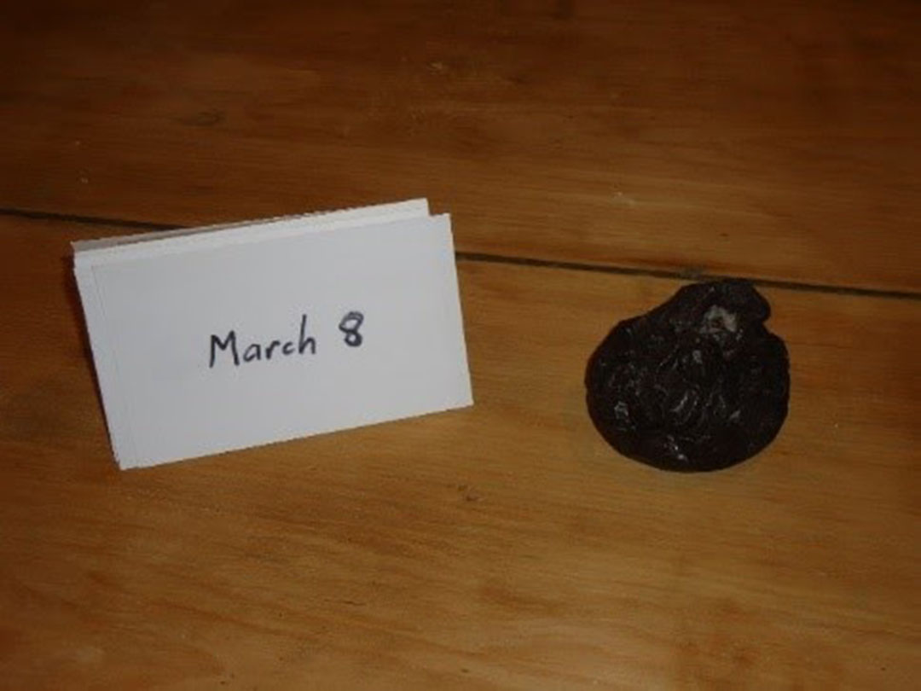
Apples harvested in the fall could easily be preserved until January; making it to March would be much harder. (credit: Fred Baltz)

Slide 25
Astronomy and Revelations 12:
Rev 12:1 And there appeared a great wonder in heaven; a woman clothed with the sun, and the moon under her feet, and upon her head a crown of twelve stars:
Rev 12:2 And she being with child cried, travailing in birth, and pained to be delivered.
Rev 12:3 And there appeared another wonder in heaven; and behold a great red dragon, having seven heads and ten horns, and seven crowns upon his heads.
Rev 12:4 And his tail drew the third part of the stars of heaven, and did cast them to the earth: and the dragon stood before the woman which was ready to be delivered, for to devour her child as soon as it was born.

Slide 26
Possible date for Jesus birth, or perhaps what led the ‘wise men’ to come to Bethlehem?
https://www.youtube.com/watch?v=KRtOETgR-R8
https://www.youtube.com/watch?v=jDJa2gKQf94
NOTE: It is not a salvation issue to know the date of Jesus birth. However men in the old testament knew astronomy, and often astrology and astronomy are morphed. The signs of the zodiac have been found in the mosaic floors of some synagogues in Israel.
While scripture is absolute, this has to go under ‘speculation’.
If true, it is only God who could create such precise timing in the heavenly bodies.

Slide 27
