Slide 1
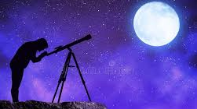
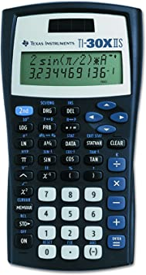
God’s Calendar
Calculated or Observed?
Notes:
Greetings and Happy Sabbath. One topic that had divided the body / the church over the centuries is What days in the year should we be keeping God’s Commanded Assemblies and Holy Days? The detail behind this question is “When does the calendar begin?” “When does a month begin?”. From the bible this is called “When is the New Moon?”. God’s Calendar is a topic that has many areas that can be covered. There are some that believe God’s Calendar was only for the Israelites. There are some that believe to put mathematical rules around God’s Calendar is an abomination. Some have (do) use the Calendar as a form of special knowledge and believe they are the only ones keeping the “True” Calendar of God. But what should our attitude be? Should we be able to calculate the next 20 years of God’s calendar from memory? God’s gave the responsibility for the “Oracles of God” to the Jews, but do the “Oracles” include the calendar? If the Holy Days are Holy Time then how accurate do, we need to be?
The detail behind God’s Calendar could make for the most boring message ever! ☺ but I will try and make it interesting.

Slide 2
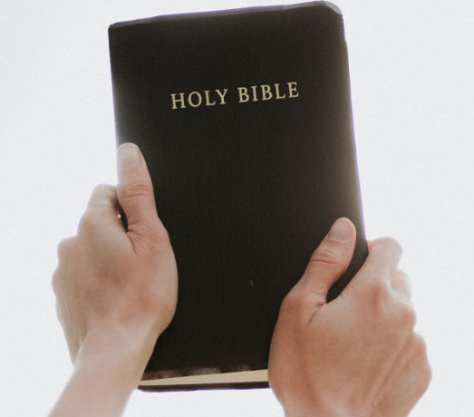
God’s Calendar Calculated or Observed
SPQ: Is God’s Calendar Calculated or Observed?
Why do I need to know this?
1 Cor 11:19 (NKJ)(NIV) - “heresies”. Hold fast to God’s truth to be approved
Where the bible is vague Church Leadership has the authority to decide
Notes:
{Read}
1 Corinthians 11:19 New King James Version
¹⁹ For there must also be factions among you, that those who are approved may be ^{[a]}recognized among you.
1 Corinthians 11:19 New International Version
¹⁹ No doubt there have to be differences among you to show which of you have God’s approval.
{Read}
{Read}

Slide 3
God’s Calendar Calculated or Observed
Part 1
God’s Calendar Importance for Us
Calendar Problems, Lunar/Solar
Observed Definition and Problems
Calculated Proofs and Biblical Evidence
Part 2
Postponements & Oracles
Conclusion
Notes:
{Read}
Since I can’t cover all aspects of the Calendar in one message I thought I would cover these topics. So for today’s message we will cover Part 1 and answer the question. Is God’s Calendar Calculated or Observed? {Repeat}
Here is our agenda for today.
{Read}{Read}{Read}{Read}{Read}

Slide 4
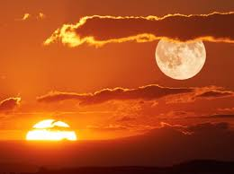
God’s Calendar Importance for Us
Gen 1:14 (NKJ),(NIV), Gen 2:3 Sabbath
Heb: CREN Pronounce: mo-ade’ Strong: H4150
  Appointed place, appointed time, meeting
  Sacred season, set feast, appointed season
  Appointed sign or signal
  Tent of meeting
Were the Annual Feast Days established at recreation week?
Notes:
Genesis 1:14 New King James Version
¹⁴ Then God said, “Let there be lights in the firmament of the heavens to divide the day from the night; and let them be for signs and seasons, and for days and years;
Genesis 1:14 New International Version
¹⁴ And God said, “Let there be lights in the vault of the sky to separate the day from the night, and let them serve as signs to mark sacred times, and days and years,
Word: CREN
Pronounce: mo-ade'
Strong: H4150
Orig: or moled \i mo-ade'\i0\plain\f3\fs21\cf23 ; or (feminine) moweadah (2 Chronicles 8:13) \i mo-aw-daw'\i0\plain\f3\fs21\cf23 ; from 3259; properly, an appointment, i.e. a fixed time or season; specifically, a festival; conventionally a year; by implication, an assembly (as convened for a definite purpose); technically the congregation; by extension, the place of meeting; also a signal (as appointed beforehand):--appointed (sign, time), (place of, solemn) assembly, congregation, (set, solemn) feast, (appointed, due) season, solemn(-ity), synogogue, (set) time (appointed). H3259
Use: TWOT-878b Noun Masculine
Grk Strong: G1012 G1859 G2540 G3141 G3142 G3831 G4592 G5610
1) appointed place, appointed time, meeting
1a) appointed time
1a1) appointed time (general)
1a2) sacred season, set feast, appointed season
1b) appointed meeting
1c) appointed place
1d) appointed sign or signal
1e) tent of meeting
Appointed Times, Times, Appointed Seasons, Seasons are referring to a Calendar.
{Click}{Read}
There are two camps on this topic. Some say no and others say yes. I believe that the Annual Holy Days were not needed yet at creation because Adam (& Eve) had not sinned. But as soon as they sinned there was a need for some of the Holy Days if not all the Holy Days. The weekly Sabbath was established at recreation week. Part of the reason the Sun and Moon were created was for the Weekly Sabbath, Command Assemblies and Holy Days.
Genesis 2:3 New King James Version
³ Then God blessed the seventh day and sanctified it, because in it He rested from all His work which God had created and made.

Slide 5
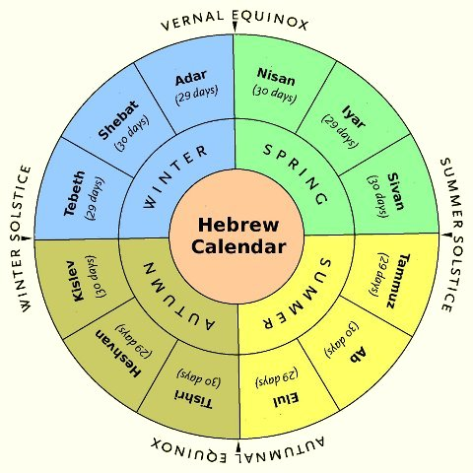
God’s Calendar Importance for Us
Lev 23:1-5 (NKJ)
  Feasts of the LORD – CREN (mo-ade’)
  Are My (God’s) feasts - CREN (mo-ade’)
  Month Strong: H2320 Heb YCG (kho'-desh)
      the new moon, month, monthly
      the first day of the month
      the lunar month
Notes:
Leviticus 23:1-2 KJV Feasts of the Lord
23 And the Lord spoke to Moses, saying,
² “Speak to the children of Israel, and say to them: ‘The feasts of the Lord, which you shall proclaim to be holy convocations, these are My feasts.
The word for Feasts is translated from the word (mo-ade’) strongs 4150
{Read}{Read}
Leviticus 23:3 New King James Version The Sabbath
³ ‘Six days shall work be done, but the seventh day is a Sabbath of solemn rest, a holy convocation.
⁴ ‘These are the feasts of the Lord, holy convocations which you shall proclaim at their appointed times.
⁵ On the fourteenth day of the first month at twilight is the Lord’s Passover.
{Read}

Slide 6
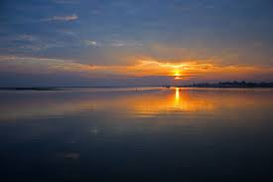
God’s Calendar Importance for Us
Lev 23:32 (NKJ)
Day - evening (sundown) to evening
Rev 11:2-3;12:6;12:6;14;13:5 (NKJ)
Prophetic Year
  Time, times and a half = 3.5 Years
  3.5 Years = 42 Months
  42 Months = 1260 Days
  1260 / 3.5 = 360 Days
  1260 / 42 = 30 Days
  42 / 3.5 = 12 Months – Esther 3:7 (NLT)
Notes:
There are a few places in scripture that define a day, but here is one in Lev 23:32
Leviticus 23:32 New King James Version
³² It shall be to you a sabbath of solemn rest, and you shall ^{[a]}afflict your souls; on the ninth day of the month at evening, from evening to evening, you shall ^{[b]}celebrate your sabbath.”
The year is not defined specifically, but we do have the prophetic year than can be calculated
Revelation 11:2-3 (NKJ)
2 But leave out the court which is outside the temple, and do not measure it, for it has been given to the Gentiles. And they will tread the holy city underfoot for forty-two months. 3 And I will give power to my two witnesses, and they will prophesy one thousand two hundred and sixty days, clothed in sackcloth.”
Revelation 12:6 (NKJ)
6 Then the woman fled into the wilderness, where she has a place prepared by God, that they should feed her there one thousand two hundred and sixty days.
Revelation 12:14 (NKJ)
14 But the woman was given two wings of a great eagle, that she might fly into the wilderness to her place, where she is nourished for a time and times and half a time, from the presence of the serpent.
Revelation 13:5 (NKJ)
5 And he was given a mouth speaking great things and blasphemies, and he was given authority to [a]continue for forty-two months.
Prophetic Year = 360 Days and Prophetic Month = 30 Days. The literal calendar does not equal the Prophetic Calendar, but it is close.

Slide 7
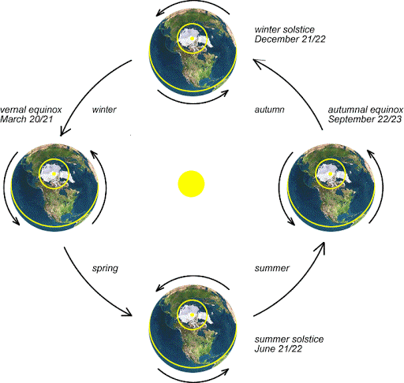
God’s Calendar Importance for Us
Eze 1-8 – Leap Month / Leap Year
Some years have 13 months
The Moon’s Role
  Psa 104:19 Holy Days are connected
  Exo 23:15 Holy Days are seasonal
  Exo 34:22 A Year is a circuit or revolution of time – tekufah H8622
Notes:
We even have the evidence of a 13th month (a leap year) having been added in the time of the Old Testament. This can be found by a careful reading of Ezekiel 1-8.
Turn to Exo 34:22
Psalm 104:19 (NKV) ¹⁹ He appointed the moon for seasons; The sun knows its going down.
moon appointed for seasons (mo’ed)
What this means is that God’s HD’s are either connected to the new moon at the beginning of the month or the full moon at the middle of the month.
Exodus 23:15 (NKV) ¹⁵ You shall keep the Feast of Unleavened Bread (you shall eat unleavened bread seven days, as I commanded you, at the time appointed in the month of Abib, for in it you came out of Egypt; none shall appear before Me empty);
Abib = green ears This along with the timing of the Wave Sheaf offering show that Unleavened Bread must be in early spring.
Exodus 34:22 (NKV) ²² “And you shall observe the Feast of Weeks, of the firstfruits of wheat harvest, and the Feast of Ingathering at the year’s end.
FOT at the end of the year (tekufah – tek-oo-faw) Tekufah literally means a “circuit” or “revolution” of time – a cycle.
This word is only used 4 times in the OT and in a couple of ways in terms of application. In connection to the FOT it implies that it should occur when the cycle of the agricultural year is complete – about the time when summer gives was to fall.
{Side Notes}
Some insist that this word “tekufah” means that the FOT could not take place before the autumnal equinox. To take this position is to take a definition from the Talmud – not the Bible.
Applying 360 points to a circle is significant in mathematics. From that application we get degrees and eventually pi π, trigonometry, etc.
Using 360 points is also found in navigation (compass) which is connected to longitude and latitude.

Slide 8
God’s Calendar Importance for Us
God’s gave us His calendar
How we count time
Reveals God’s commanded assemblies and holy times
Importance of the Sun / Moon
Is one proof we have a Creator
Use in prophecy
Principles are found in mathematics & navigation
Notes:
{Click} {Read} {Click} {Read}{Click} {Read}{Click} {Read}{Click} {Read}{Click} {Read}{Click} {Read}

Slide 9
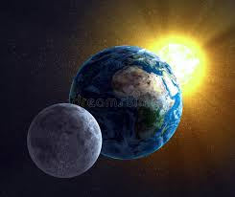
Calendar Problems, Lunar/Solar
The earth rotates on its axis once every (+/-) 24 hours
The moon orbits the earth every 29 days, 12 hours, 44 minutes, 2.8016 seconds
The earth orbits the sun every 365 days, 5 hours, 48 minutes, 34.5 seconds
Notes:
The first issue that any calendar needs to address is how to reconcile the sun / moon in reference to the earth {Read}
In every culture, it was/is common to establish a calendar relative to a lunar and/or solar cycle.
The problem is that a month is not evenly divided by days, lunar months don’t match the length of a solar year, and a solar year is not an even number. Once mankind move away from God’s given calendar and created different calendars these problems became most profound. Did God’s make it hard to move away from His Calendar?
{History}
Our current calendar we use, Gregorian is named after Pope Gregory XIII, who introduced it in October 1582. The calendar was a refinement to the Julian calendar involving a 0.002% correction in the length of the year. The motivation for the reform was to stop the drift of the calendar with respect to the equinoxes and solstices—particularly the northern vernal equinox, which helps set the date for Easter.
The Gregorian reform contained two parts: a reform of the Julian calendar as used prior to Pope Gregory XIII's time and a reform of the lunar cycle used by the Church, with the Julian calendar, to calculate the date of Easter. The reform was a modification of a proposal made by Aloysius Lilius. His proposal included reducing the number of leap years in four centuries from 100 to 97, by making 3 out of 4 centurial years common instead of leap years. Lilius also produced an original and practical scheme for adjusting the epacts of the moon when calculating the annual date of Easter, solving a long-standing obstacle to calendar reform.

Slide 10
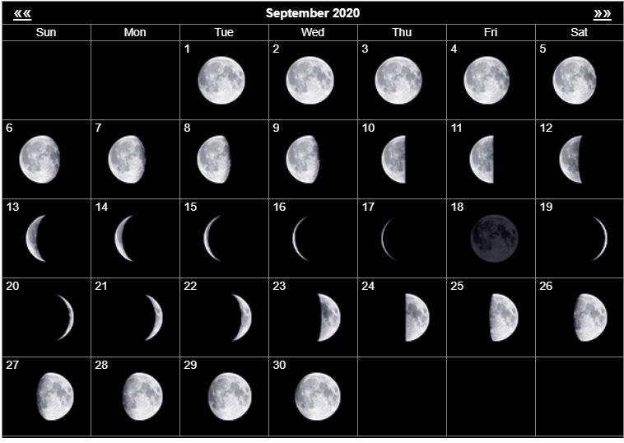
Calendar Problems, Lunar/Solar
Will the real new moon light/dark up?
New moon (kho'-desh) isn’t defined in the bible
Waning Crescent
Dark / No Light
Waxing Crescent
Notes:
{Read}
The term “new moon” isn’t clearly defined in scripture, even with an understanding of the Hebrew language.
There are two Hebrew words translated “moon” in the Old Testament (yereah and l^{e}banah) and when referring to the “new moon,” the biblical authors use the word khodesh meaning “newness” rather than either of the other two standard terms for moon.
Does this mean a crescent moon or is it the precise conjunction (the total absence of light)?
The only way to arrive at the precise conjunction is to use a calculation. Even the word khodesh doesn’t always mean “new moon.”
There are a number of occurrences where it should clearly be translated as simply “month” or “months”.
There is no disagreement in the Old Testament that a solar/lunar calendar was used, the question is how was it determined?
It is assumed by many that the Hebrew calendar was based on observation as late as the end of the Second Temple period in 70AD. But there are other sources that dispute this claim.
The Rabbi Saadia Gaon disputed with the Karaites (factions within the Judaism) in the eighth century whether the calendar should be determined by calculation or by observation. This can be found in Saadia Gaon: His Life and Works by Henry Malter.
{Extra Reading}
Saadia Gaon: His Life and Works by Henry Malter.
Rejecting the fixed calendar as a heretic innovation, the Karaites held that by law of Scripture the beginning of the months must be determined by the appearance of the new crescent and no other means, and that this had been the practice of ancient Israel at all times. Rabbanite refutation of this extreme assertion found its most outspoken exponent in Saadia Gaon, who went to the opposite extreme in “demonstrating” that the fixed calendar, computation of molad and tekufah, has the force of a Mosaic-Sinaitic law that had been followed at all ages of the past, while observation of the new crescent was merely a passing episode in the history of the Jews, introduced at the time of the Sadducees. 22

Slide 11
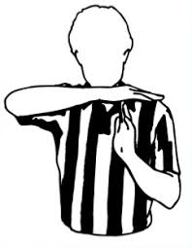
Calendar Problems, Lunar/Solar
Can Church leadership call time (mo-ade’)?
YES
Matt 24:14, 28:18-20 – Church directives
Preach gospel, Prepare people - Declaring a calendar NOT mentioned
Matt 18:18
Bind in earth and heaven
Church
God gave the Church authority to provide clarity
Notes:
{Read}
Matthew 24:14 (NKJ) ¹⁴ And this gospel of the kingdom will be preached in all the world as a witness to all the nations, and then the end will come.
Matthew 28:18-20 (NKJ) ¹⁸ And Jesus came and spoke to them, saying, “All authority has been given to Me in heaven and on earth. ¹⁹ Go ^{[a]}therefore and make disciples of all the nations, baptizing them in the name of the Father and of the Son and of the Holy Spirit, ²⁰ teaching them to observe all things that I have commanded you; and lo, I am with you always, even to the end of the age.” ^{[b]}Ame
The New Testament Church ministry is to preach the Gospel and prepare a people – They were not specifically given the responsibility to declare a calendar.
BUT
Matthew 18:18 (NKJ) ¹⁸ “Assuredly, I say to you, whatever you bind on earth will be bound in heaven, and whatever you loose on earth will be loosed in heaven.
God has given His Church authority to make decisions in situations that are not clear.

Slide 12
Calendar Problems, Lunar/Solar
Sun, moon and earth rotation does NOT divide evenly into day, month, year
When is the new moon NOT clearly defined.
New Testament Church NOT given specific responsibility for declaring a calendar
God gave the Church authority to provide clarity
Notes:
{Click}{Click}{Click} {Click}

Slide 13
Observed Definition and Problems
  Day begins when the sun going down behind the horizon (evening) is sighting
  Month begins when the moon’s waxing crescent is sighted. Typically the day/night after the “conjunction” or “complete blackness” but could be two.
  Variant – Sighting must occur “zero point” (Jerusalem)
  Variant – Sighting must be by you
  Variant – Day calculated; month observed
Notes:
{Read}
It is hard to pin down pure sources on a formal definition of the Observed Calendar. Some of this came from “discussions” I have had with people who believe in observed calendars. I learned some of this from HWA, Bob Fahey, Dan Dowd and others in the church through writings, sermons and direct discussion. If you know a source that states what the observed calendar definition specifics are I would like to read it. This is common Church knowledge compiled over the last 90 years.

Slide 14
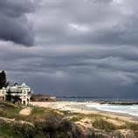
Observed Definition and Problems
  No Seeing, No Calendar?
  Did the calendar in scripture continue when the sun and moon could not be sighted?
  Noah in the Ark
  Gen 6:9 - Walked with God
  Gen 6:16 - Ark window
  Gen 7:11-12 – Rain 40 Days & 40 nights (observing?)
Notes:
{Read}. The first problem with an “Observed Calendar” is that there are times you cannot see sun or moon. Heavy cloud cover, heavy rain, fog and other types of weather can block the sun and moon from being seen.
{Read} {Read}
Genesis 6:9 (NKJ) Noah pleases God
⁹ This is the genealogy of Noah. Noah was a just man, ^{[a]}perfect in his generations. Noah walked with God.
{Read}
Genesis 6:16 (NKJ)
¹⁶ You shall make a window for the ark….. The ark had a window
{Read}
Genesis 7:11-12 (NKJ)
¹¹ In the six hundredth year of Noah’s life, in the second month, the seventeenth day of the month, on that day all the fountains of the great deep were broken up, and the windows of heaven were opened.
¹² And the rain was on the earth forty days and forty nights.

Slide 15

Observed Definition and Problems
  Genesis 8:3-6 Noah in the Ark continued
  150 days = 17/02 (dd/mm) to 17/07
  150 + (30-17) + 30 + 30 = 223 Days
  223 + 40 = 263 Days
  263 Days then window (hatch?) is open
  It appears that for 263 days no one on earth was observing the moon and sun yet the calendar continued
Notes:
{Read}{Comment}
Genesis 8:3-6 (NIV)
³ The water receded steadily from the earth. At the end of the hundred and fifty days the water had gone down, ⁴ and on the seventeenth day of the seventh month the ark came to rest on the mountains of Ararat. ⁵ The waters continued to recede until the tenth month, and on the first day of the tenth month the tops of the mountains became visible.
⁶ After forty days Noah opened a window he had made in the ark

Slide 16
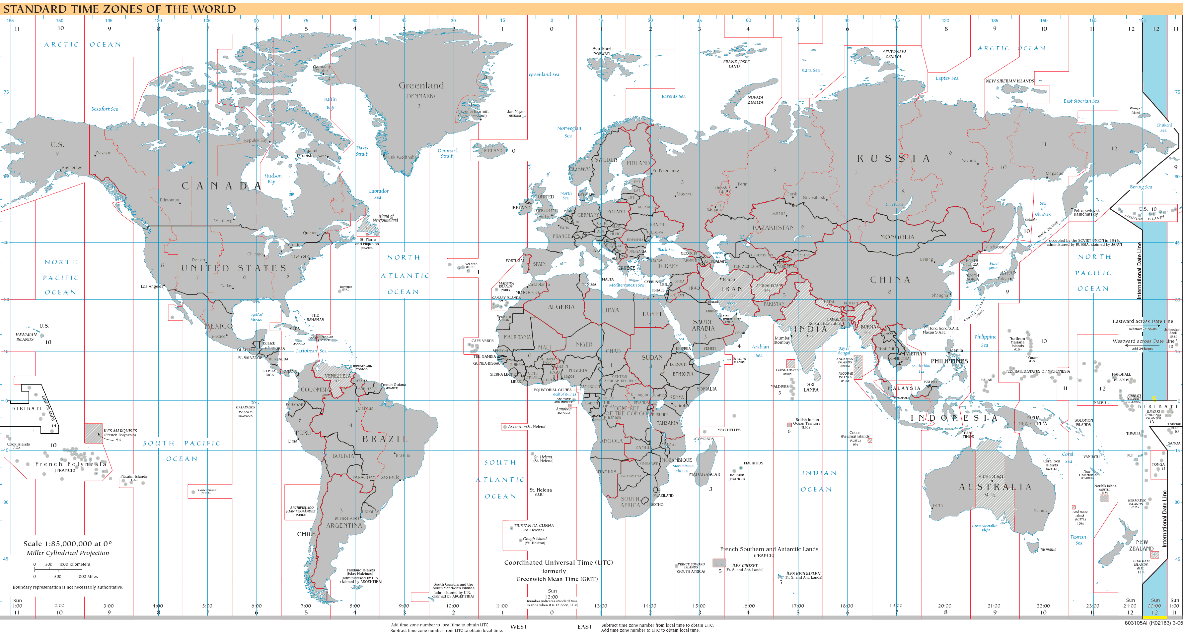
Observed Definition and Problems
  If Jerusalem is the “zero point” for observation, then east of Jerusalem would keep the Holy Days at least one day late!
Calendar
☺
Calendar ☹
  1 Cor
  14:33
  (NKJ)
Notes:
{Read}.
The Jews began to keep two days for each Holy Day due to ancient communication deficiencies. Modern Jews has question this but modern Jewish Scholars go back to Rabbi Hai Gaon (different than Saadia Gaon) which states “Be careful to keep the customs of your forefathers and keep two days of Yom Tov.” Why not state simply that we should keep two days lest there develop some doubt as to the correct day?
This part of the reason the Jews keep the Holy Days (except for Atonement) for 2 days. The Jews are trying to cover all possible scenarios. There are some Jewish Scholars that believe in the calculated calendar and there are other Jewish Scholars that believe in an observed calendar. This causes confusing. Yet, it is clear from Leviticus 23 and Numbers 29 that the Holy Days are only kept for one day.
1 Corinthians 14:33 (NKJ) ³³ For God is not the author of ^{[a]}confusion but of peace, as in all the churches of the saints.
{Extra Reading}
https://www.chabad.org/library/article_cdo/aid/527614/jewish/Why-Do-We-Still-Celebrate-Holidays-for-Two-Days-in-the-Diaspora.htm
Rabbi Hai Gaon was the undisputed authority on Jewish law in the early 11th century. He writes that the requirement that one should keep a second day of Yom Tov outside of Israel really stems from the days of the prophets, and perhaps even from the days of Yehoshua (Joshua) ben Nun.
Based on this, he explains the somewhat curious wording of the Talmud cited earlier: “Be careful to keep the customs of your forefathers and keep two days of Yom Tov.” Why not state simply that we should keep two days lest there develop some doubt as to the correct day?

Slide 17
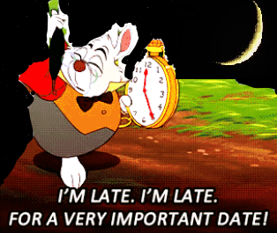
Observed Definition and Problems
  It is Impossible to keep the Feast of Trumpets with a preparation day since Feast of Trumpets begins on the New Moon of the 7th Month
  Is God using the Feast of Trumpets to show calculated?
Notes:
{Read}.

Slide 18

Calculated Proofs and Biblical Evidence
  Did God give the ability or talent (Spirit) for men or women to calculate the calendar?
  Exo 31:1-11 (NIV)
  God filled him with understanding, knowledge and all kinds of skill
  Levites Calculated a Month = 29.53059 days
  Scientist Calculate a Month = 29.530589 days
Notes:
{Read}. Exodus 31:1-11 (NIV)
Bezalel and Oholiab
31 Then the Lord said to Moses, ² “See, I have chosen Bezalel son of Uri, the son of Hur, of the tribe of Judah, ³ and I have filled him with the Spirit of God, with wisdom, with understanding, with knowledge and with all kinds of skills— ⁴ to make artistic designs for work in gold, silver and bronze, ⁵ to cut and set stones, to work in wood, and to engage in all kinds of crafts. ⁶ Moreover, I have appointed Oholiab son of Ahisamak, of the tribe of Dan, to help him. Also I have given ability to all the skilled workers to make everything I have commanded you: ⁷ the tent of meeting, the ark of the covenant law with the atonement cover on it, and all the other furnishings of the tent— ⁸ the table and its articles, the pure gold lampstand and all its accessories, the altar of incense, ⁹ the altar of burnt offering and all its utensils, the basin with its stand— ¹⁰ and also the woven garments, both the sacred garments for Aaron the priest and the garments for his sons when they serve as priests, ¹¹ and the anointing oil and fragrant incense for the Holy Place. They are to make them just as I commanded you.”
http://www.jewishencyclopedia.com/articles/3920-calendar-history-of
I believe calculating the calendar was a skill and Jewish historical documents when compared to modern science seems to back this up. There is a belief in modern science and some who believe in the observe calendar that the Levites could not have calculated the moon cycle accurately.
From Jewish encyclopedia we {Read Levities}
From https://moonblink.info/Eclipse/why/months {Read Scientist}
See The Levites were .000001 wrong… totally off the mark. ☺

Slide 19

Calculated Proofs and Biblical Evidence
  David and Jonathan knew when the new moon would appear
  I Sam 20:5 (NKJ)
  In the future God will change the lights of the day, night but the calendar continues (because it is calculated?)
  Zec 14:6-7, Zec 14:16
Notes:
{Read}.
1 Samuel 20:5 (NKJ) ⁵ And David said to Jonathan, “Indeed tomorrow is the New Moon, and I should not fail to sit with the king to eat. But let me go, that I may hide in the field until the third day at evening.
{Read}
Zechariah 14:6-7 (NIV)
⁶ On that day there will be neither sunlight nor cold, frosty darkness. ⁷ It will be a unique day—a day known only to the Lord—with no distinction between day and night. When evening comes, there will be light.
Zechariah 14:16 (NIV)
¹⁶ Then the survivors from all the nations that have attacked Jerusalem will go up year after year to worship the King, the Lord Almighty, and to celebrate the Festival of Tabernacles.

Slide 20
Calculated Proofs and Biblical Evidence
  Feast of Trumpets begins on the 7th Month New Moon. - Lev 23:24
  Noah’s Ark story is easier to explain with a calculated calendar
  “… unless God has preserved His sacred calendar through the Jews, then we do not know how to figure Passover or any of the Holy Days this year. For there is no authority for any other way.”
  - Herbert W. Armstrong 1940
Notes:
Lev 23:24 (NKJ)
²⁴ “Speak to the children of Israel, saying: ‘In the seventh month, on the first day of the month, you shall have a sabbath-rest, a memorial of blowing of trumpets, a holy convocation.
Mr. C.O. Dodd had rejected the Hebrew Calendar and was planning to observe the Passover a month earlier. Mr. Armstrong studied the issue and then wrote a letter to the membership.
“Briefly, after very exhaustive study, and counsel with brethren who also have made thorough study of the question for years, the facts are these: ...Research reveals two basic points on this question (of intercalary months), 1st, God did not record it in the Bible, which gives us absolutely nothing more to go on than I have stated above. 2nd, history is vague on the subject, shedding little light that can be accepted and trusted. Yet we know God gave his people a fixed rule for calculating time periods, and for figuring when to hold the Festivals of Jehovah…. In conclusion, unless God has preserved His sacred calendar through the Jews, then we do not know how to figure Passover or any of the Holy Days this year. For there is no authority for any other way. There is no Bible authority whatsoever for figuring the 1st day of the 1st month from the new moon nearest the spring equinox! ...God did not commit His oracles, or the preservation of His times to profane history, or to the Roman Catholics, but to the Israelites. And they have been preserved by the Jews.”

Slide 21
Calculated Proofs and Biblical Evidence
  Feast of Trumpets begins on the new moon
  Noah counts time w/o observation
  God gave knowledge, understanding, skills
  David knew the coming of the new moon
  Daylight and nightlight will change in the future, but the calendar will continue
  Church leadership has given clarity
  Observed calendar is confusing and unreliable
Notes:
{Click}{Read} {Click}{Read} {Click}{Read} {Click}{Read} {Click}{Read} {Click}{Read} {Click}{Read}

Slide 22
Postponements & Oracles
Part 2
Notes:
We have decided to give this message in two parts. I will cover the Postponements and Oracles at a latter date. But just to give you a preview.

Slide 23
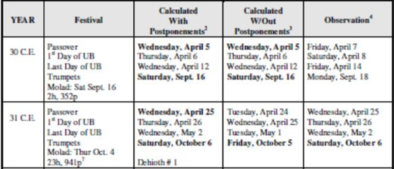
Postponements & Oracles
Are postponements (rules) in God’s Calendar?
Postponements: Christ kept them
John 7-9 FOT/LGD 30AD & 31AD Dates and days only work with postponements
Notes:
The Postponements were in place during years 30 AD and 31 AD of Jesus Christ life. I will be going over the details.

Slide 24
Conclusion
God’s calendar is calculated but proven by observation. The responsibility of the calendar was given to the Jews The Jews have methodically calculated the calendar even renaming the Feast of Trumpets to
“Rosh Hashanah”. Which means Head of the Calendar or Head of the Year.
UCG Summary Statement
Notes:
After a study of all the issues and papers, the Council of Elders has come to the conclusion that the Hebrew calendar is a valid calendar for Christians to use in setting the dates for the observance of God’s Holy Days. While the major issues seem to revolve around the four rules of postponement (Dehioth), the conclusion of the Council is to accept the calendar using the current calculations and rules. The rules of postponement are used in the establishment of the first day of the 7th Month (Tishri). Once the first day of the 7th Month (Tishri) is established, then the calendar can be set, and the first day of the 1st Month (Abib) can be determined.
This, in turn, makes it possible to establish the dates for the Holy Days. It is incorrect to refer to the rules of postponement as “moving” the Holy Days. While we must always be willing to listen and learn, in the absence of any new information, the Council has chosen to confirm its support for the use of the Hebrew calendar as the official position of the United Church of God, an International Association.

