Slide 1
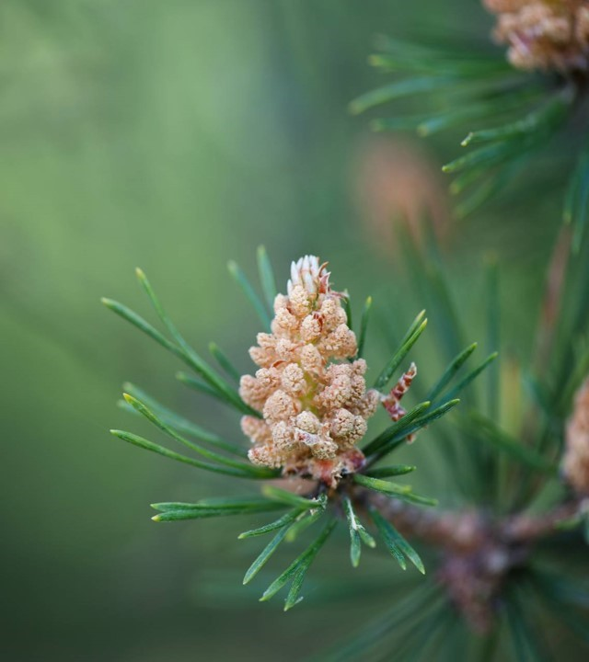
Are you living a life of biblical meditation?
Colossians 1/25-29 striving according to his working

Slide 2
Sps: Are you living a life of biblical meditation?
1. What is biblical meditation?
2. What seeds are you nurturing?
3. Does meditation have purpose beyond knowledge?

Slide 3
1. What is biblical meditation?
Meditate- to ponder, to speak, to utter, to imagine
Psalm 1/1-2
Joshua 1/1-2, 6-9

Slide 4
1. What is biblical meditation?
Biblical meditation requires labor.
Colossians 1/29
I Corinthians 15/58
I Corinthians 3/4-9 biblical meditation is work.

Slide 5
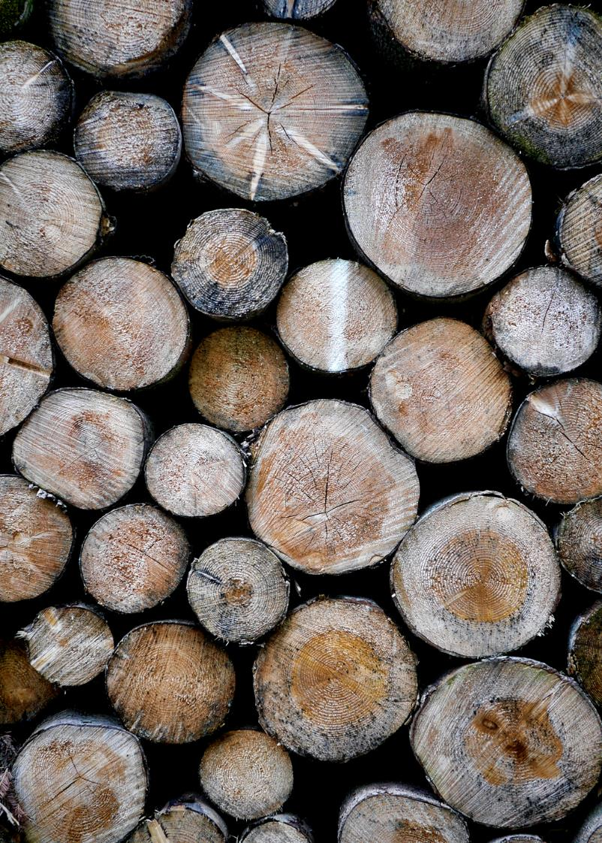
2. What Seeds are you nurturing?
Non-viable seeds- Philippians 4/8
1. Too old
2. Harvested early
3.Mother plant was sterile
4.Flowers not properly pollinated

Slide 6
2. What Seeds are you nurturing?
* Numbers 13/33-14/3
* Galatians 5/19-21
* Galatians 5/22-24
* John 5/39
* Ephesians 3/20

Slide 7
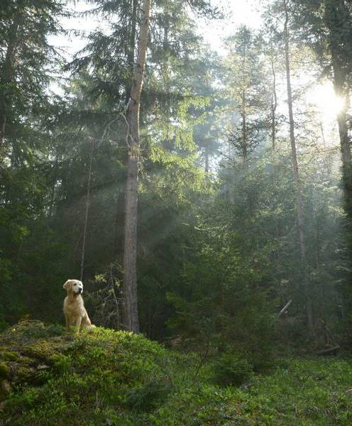
Does Biblical Meditation have purpose BEYOND knowledge?
II Timothy 2/15
I Thessalonians 4/11
Romans 12/2
Wickedness uses this method too, II Corinthians 11/14-15

Slide 8
Let’s LOOK at God’s Meditated Plan
Luke 8/4-11
Acts 13/22-23
Romans 9/6-8
Galatians 3/29
I Peter 1/23
I John 3/9 – Heirloom Seed

Slide 9

What is an Heirloom seed?
They have stood the test of time and may be used reliably.

Slide 10
What is an Heirloom seed?
They usually have an interesting story associated with their history.

Slide 11
What is an Heirloom seed?
They are popular and connect the future with the past.

Slide 12
What is an Heirloom seed?
They are known for a enormous range of special qualities.

Slide 13
What is an Heirloom seed?
They are the most appreciated by their Gardener.
II Corinthians 3/2-3

Slide 14
are you living a life of biblical meditation?
THE FRUIT OF YOUR HEART WILL REVEAL YOUR LABOR IN THE SPIRIT!

