Slide 1
A Better Marriage Through Love and Respect
By Troy Phelps

Slide 2

10 couples say “I Do!”

Slide 3

Half will end in divorce…

Slide 4
What about the other 5 that stay together?

Slide 5

Statistics: 1 is happy…

Slide 6

Statistics: the other 4…well…

Slide 7
“I Do” = Life time of happiness Happy Ever After…Right?

Slide 8
The Truth… Marriage is not easy.

Slide 9
Man didn’t create marriage…
Mat 19:4 And He answered and said to them, "Have you not read that He who made them at the beginning 'MADE THEM MALE AND FEMALE,'
Mat 19:5 and said, 'FOR THIS REASON A MAN SHALL LEAVE HIS FATHER AND MOTHER AND BE JOINED TO HIS WIFE, AND THE TWO SHALL BECOME ONE FLESH' ?
Mat 19:6 So then, they are no longer two but one flesh. Therefore what God has joined together, let not man separate."

Slide 10

Two become One…glued together

Slide 11
Man didn’t create marriage…
Gen 2:18 And the LORD God said, "It is not good that man should be alone; I will make him a helper comparable to him.“
Wasn’t good…that man was alone.
Men and women need each other…

Slide 12
A helper…
NKJV: a helper comparable to him
KJV: A help meet for him
NLT: A helper who is just right for him.
Clarke Commentary: Literally “helper” would be translated one like, or as himself, standing opposite to or before him

Slide 13
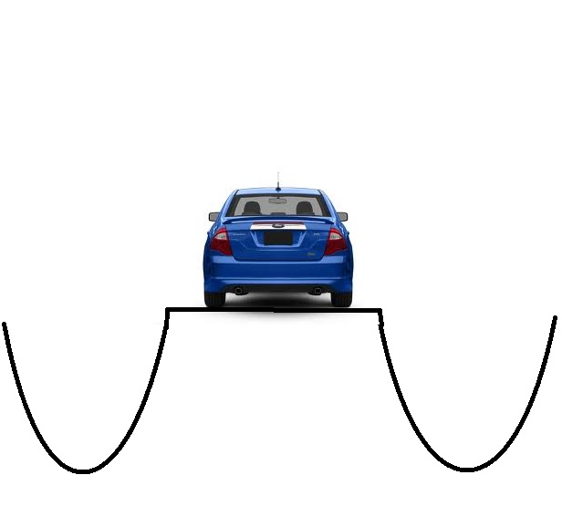
One ditch to the other…
Ditches…
Men oppressed women
“Women are inferior”
Selfish Decisions
“Serve Me”
Women’s opinion doesn’t matter
Don’t need men
“No man is going to tell me what to do.”
“Why should he be in charge”

Slide 14
What does God say?
God defines the roles and family order
Both roles are vitally important
Different roles…not lesser roles
Each role is a needed blessing to the other

Slide 15
Heirs together…
1Pe 3:7 Husbands, likewise, dwell with them with understanding, giving honor to the wife, as to the weaker vessel,
and as being heirs together of the grace of life, that your prayers may not be hindered.

Slide 16
Heirs together…
Gal 3:27 For as many of you as were baptized into Christ have put on Christ.
Gal 3:28 There is neither Jew nor Greek, there is neither slave nor free, there is neither male nor female; for you are all one in Christ Jesus.

Slide 17
Why does this matter?
We can’t have a marriage that God intended if we don’t see marriage the way that God intend and embrace the roles that God gave us.
The role we play doesn’t define our value.

Slide 18
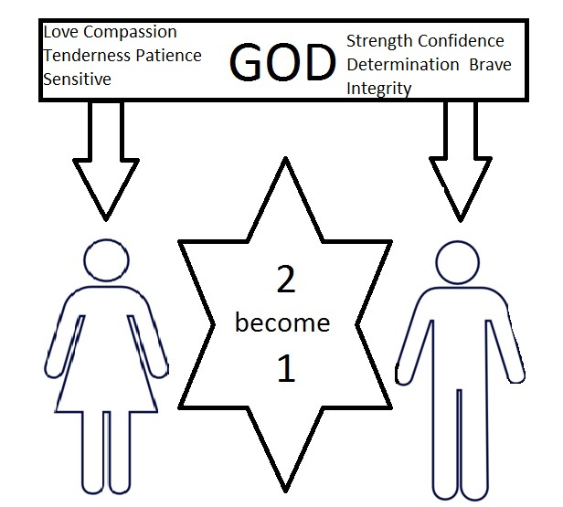

Slide 19
Two Commands that can drastically change your marriage…
Eph 5:33 (NLT) – “So again I say, each man must love his wife as he loves himself, and the wife must respect her husband.”
Husband Command – Must love his wife as he loves himself. (Agape – unconditional love)
Wife Command – Must respect her husband. (Show him reverence)

Slide 20
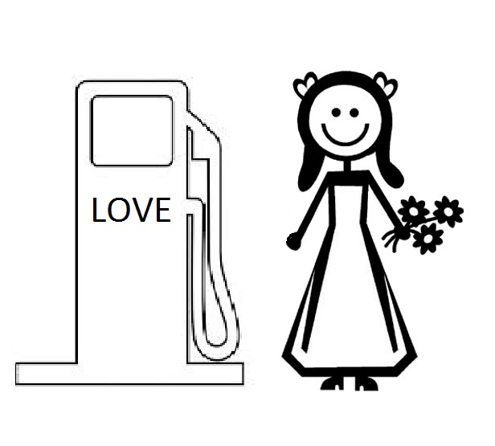
Why these two commands?

Slide 21
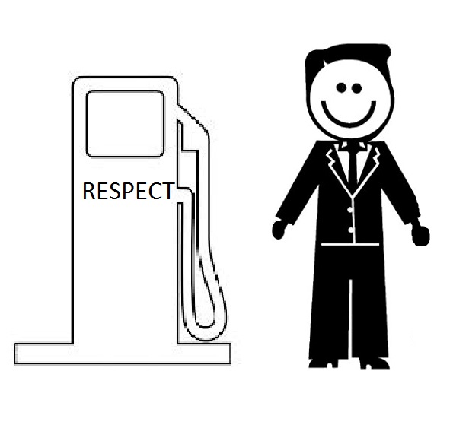
Why these two commands?

Slide 22


Slide 23
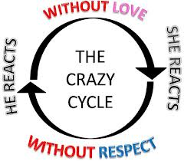

Slide 24


The Result…

Slide 26
Conditional or Unconditional?
“I will love you as long as I am getting respect”
“I will respect you as long as I am getting love”
Commands are not linked or contingent…

Slide 27
Unconditional Love & Respect
Truth is…
Husband– Commanded to love your wife regardless of whether or not your wife ever obeys God’s command to respect you
Wife – Commanded to respect your husband regardless of whether or not your husband ever obeys God’s command to love you

Slide 28
Even one person can make a big difference…
NLT - 1Pe 3:1 In the same way, you wives must accept the authority of your husbands. Then, even if some refuse to obey the Good News, your godly lives will speak to them without any words. They will be won over
1Pe 3:2 by observing your pure and reverent lives.

Slide 30
When she’s feeling unloved
Ask your husband “Did I do something that has made you feel disrespected?”

Slide 31
When he’s feeling disrespected…
Ask “Did I do something that has made you feel unloved?”

Slide 32
To Husbands…
Eph 5:25 Husbands, love your wives, just as Christ also loved the church and gave Himself for her
Sacrificed Himself for her…
Made decisions that was for her benefit…

Slide 33
C.O.U.P.L.E.
Closeness
Openness
Understanding
Peacemaking
Loyalty
Esteem

Slide 34
C.O.U.P.L.E.
Closeness ––
hold her hand
hug her
affectionate (without sexual intentions)
Go for a walk/bike ride together…
You seek to spend time with her…you set up the date. Time and Love (cost nothing)
You want to know her thoughts, opinions.

Slide 35
C.O.U.P.L.E.
Openness –
you share your feelings, difficulties and your day…
you aren’t rushing to end the conversation (to watch TV, newspaper, emails)…
you discuss financial concerns and what you think you should do to take care of them…
Share ideas for the future.

Slide 36
C.O.U.P.L.E.
Understanding –
You listen and can repeat back to her…
don’t try to fix the problems…but seek to understand
Can offer to help if she would like
identify how she is feeling (never be dismiss of them),
tell her you appreciate her sharing that with you…don’t interupt (listen)…
you apologize when you were wrong…
you cut her slack during PMS (not cut her down)…
you take things off her plate because you care
express appreciation for what she does.
Pray for her about things she struggles with.

Slide 37
C.O.U.P.L.E.
Peacemaking –
Let her tell you how she’s feeling…but don’t get angry and shut down communication.
You seek peace by apologizing and asking for her forgiveness.
Never say, just “Forget it.”, you seek to repair breaches
Forgive her quickly…Let go of bitterness…and reassure love.

Slide 38
C.O.U.P.L.E.
Loyalty –
You speak highly of her in front of others (don’t’ put her down).
You are invested in what’s important to her.
You lead the family and what’s going on with them is important to you.
You don’t correct her in front of the children or put her down.
You don’t look lustfully at other women.
You make your wife the priority above all other humans and human things…above sports, friends, work, even the children…
She’s the first you hug, talk to…
You bring her to social gatherings whenever possible…work parties, weddings…
You don’t allow the children to speak poorly to her.
You let her know your plans…your running late…need to stop.
You keep your commitments to her and the family.

Slide 39
C.O.U.P.L.E.
Esteem –
You tell her your proud of her for this or that…,
you speak highly of her in front of others…
you open the door for her…
willing to try something new that’s important to her…
you notice her…her hair, her clothes…
You show her affection, even in public,
you teach your children to show her respect,
you value her opinions as valid,
even if you ultimately must chose a different path and you explain it to her whenever possible.
You make family time as important….and her the most important of all.
You make sure she knows you are proud of her.

Slide 40
To husbands…
Prov 24:16…a righteous man falls 7 times and rises again
We all fail…successful couples keep getting back up…
Unsuccessful couples don’t…

Slide 41
To wives…
NLT - Pro 21:19 It's better to live alone in the desert than with a quarrelsome, complaining wife.
Husbands need your respect desperately…
Not only when it’s deserved and earned…but unconditionally

Slide 42
C.H.A.I.R.S.
Conquest
Hierarchy
Authority
Insight
Relationships
Sexuality

Slide 43
C.H.A.I.R.S.
Conquest –
You tell him verbally or in writing, that you value his work efforts.
You express your faith in him…in work…in the family…
You listen to his work stories the same as you want him to listen to your accounts…
You see yourself as his helpmate...and counterpart…and talk about how you can support him whenever possible.
You allow him to dream…
You don’t dishonor or subtly criticize his work.

Slide 44
C.H.A.I.R.S.
Hierarchy –
you vocalize your admiration of him for protecting you and being willing to die for you.
You praise his commitment to provide for you and the family.
You never mock the idea of looking up to him…to prevent him from possible looking down at you.
You don’t put him down about his career or how much he makes. When you find yourself in a family situation where money is tight…you support and help make the best of a bad situation…not make him feel worse that the family is financially struggling. When concerns need to be voiced…they are done with respect and with a willingness to help with offering solutions…such as ways you could cut spending. Not nagging or complaining at him.

Slide 45
C.H.A.I.R.S.
Authority –
You voice your thankfulness for his strength and your ability to lean on him at times.
You support him as the God ordained leader of the family.
You praise his good decisions…and are gracious when he makes a bad one.
You disagree only in private and honor his authority in front of the kids.
You give your reasons for disagreeing reasonably…and never attack his right to lead.

Slide 46
C.H.A.I.R.S.
Insight –
Tell him upfront when you are simply needing his listening ear and not his insight or counsel.
Thank him for his advice…You are respectful that his problem solving approach is his male way of showing empathy.
You realize your vulnerabilities, especially among males, and value his oversight and protection.
You counsel with him respectfully when you differ with his ideas.

Slide 47
C.H.A.I.R.S.
Relationship –
You tell him you like him and show it…(he knows you love him…but often wonders if you like him)…
you respond to his invitations to engage in recreational activities together and come along to watch him when you can.
Work shoulder to shoulder with you…but let him lead (which enables him to open up and share with you)…
encourage him to take a bit of time alone (when possible)

Slide 48
C.H.A.I.R.S.
Sexuality –
Appreciate his desire for sexual intimacy.
You respond to him sexually more often and initiate sex periodically.
You understand that he has sexual needs (just as you have emotional needs)

Slide 49
The difficult things…
Forgiveness
If you never take the risk…you can never achieve the goal.

Slide 50
The difficult things…
“What if I’m the only one trying?”

Slide 51
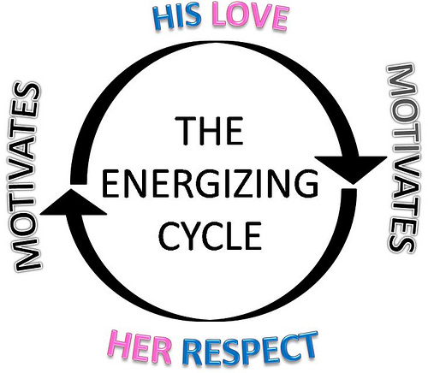

Slide 52
The difficult things…
Fear…
“It won’t work”
Requires Faith – God’s Way Works.

Slide 53
The Real Truth…
What if your actions and implementing Love & Respect, never results in any change what so ever from your mate?

Slide 54
The Real Truth…
What if your actions and implementing Love & Respect, never results in any change what so ever from your mate?
It doesn’t matter…
Ultimately your spouse and your marriage have nothing to do with it.

Slide 55
The Real Truth…
Regardless of what you get out of it…our first and primary motivator must be because we want to please our God and honor Him.
Nothing is wasted. You don’t owe it to your spouse…you owe it to God….out of obedience to God.
So in the ultimate sense…your contributions to your marriage has nothing to do with your spouse…and everything to do with your relationship with God and Jesus Christ.

Slide 56
Conclusion

