Slide 1
Faithful Tithing
United Church of God - San Francisco Bay Area
December 5, 2020
Nipon Temsakun / Alamy Stock Photo - Used with Permission

Slide 2

The Face of Tithing
Proclamation of the Gospel
Ministers to care and teach
Direct financial assistance
Help for the Feast of Tabernacles
The First fruits who care
Photo by Amadeo Valar on Unsplash

Slide 3

Three Points
Faithful Tithing
Traditional Christian Teaching Contrasted with Scripture
How many tithes in the Bible?
Should Christians tithe and, if so, then to whom?
Photo by Glenn Carstens-Peters on Unsplash

Slide 4

Mainstream Protestant Teaching on Tithing
“Tithing is the practice of giving a tenth of one's income or property as an offering to God. The custom of paying a tithe was an ancient practice found among many nations of the ancient world.”
Nelson's Illustrated Bible Dictionary
Photo by Cosmic Timetraveler on Unsplash

Slide 5
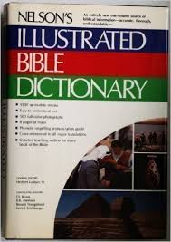
Mainstream Protestant Teaching - Tithing (cont.)
In the Old Testament the purpose of the giving of a tenth was to meet the material need of the Levite, the stranger, the fatherless (the orphan), and the widow (Deut. 26:12-13). The tithe was an expression of gratitude to God by His people. Basic to tithing was the acknowledgment of God's ownership of everything in the earth.
Nelson's Illustrated Bible Dictionary

Slide 6
Mainstream Protestant Teaching - Tithing (cont.)
“The prophet Malachi indicated that Israel had robbed God in withholding tithes and offerings. Thus, the Israelites were exhorted to bring their tithes into the storehouse in order to enjoy the Lord's blessing (Mal. 3:8-12).
In the New Testament the word tithe and tithing appear only eight times (Matt. 23:23; Luke 11:42; 18:12; Heb. 7:5-6,8-9). All of these passages refer to Old Testament usage and to current Jewish practice. Nowhere does the New Testament expressly command Christians to tithe.”

Slide 7
Mainstream Protestant Teaching on Tithing (cont.)
“However, as believers, we are to be generous in sharing our material possessions with the poor and for the support of Christian ministry. Christ Himself is our model in giving. Giving is to be voluntary, willing, cheerful, and given in the light of our accountability to God. Giving should be systematic and by no means limited to a tithe of our incomes. We recognize that all we have is from God. We are called to be faithful stewards of all our possessions (Rom. 14:12; 1 Cor. 9:3-14; 16:1-3; 2 Cor. 8-9).”
Nelson Illustrated Bible Dictionary

Slide 8
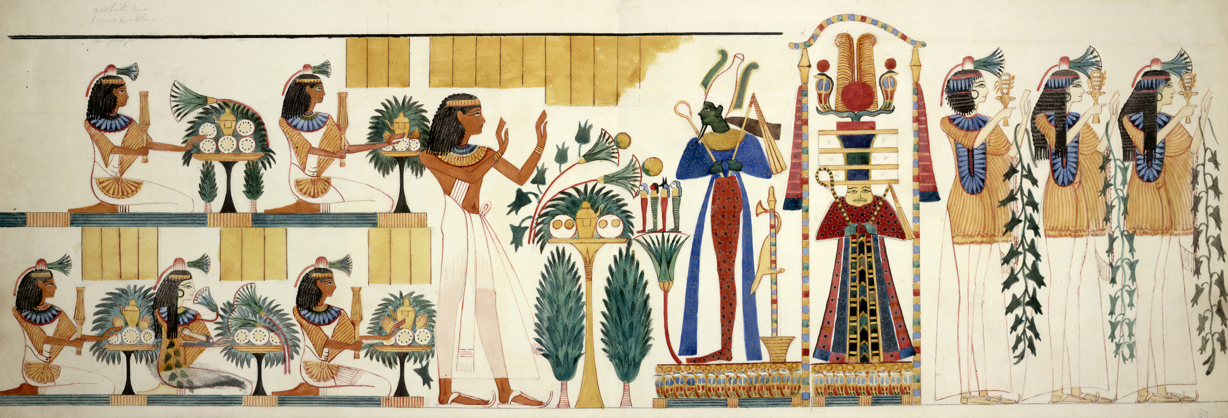
Tithing is an Ancient Practice?
Photo by British Library on Unsplash
Genesis 47:24 – Joseph implemented a 20% tribute
Leviticus 27:30 – The Tithe is Holy
Psalm 24:1 – All Belongs to God
Psalm 50:10-12 – All Belongs to God

Slide 9
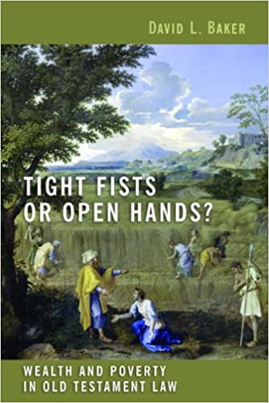
Ancient Practice (continued)
Tight Fists or Open Hands? : Wealth and Poverty in Old Testament Law, page 209
“None of the extant laws (in the Ancient Near East) deal with tithing, though other documents show that it was a widespread practice in the ancient Near East.”
Genesis 14:18-20

Slide 10
How many tithes?

Slide 11
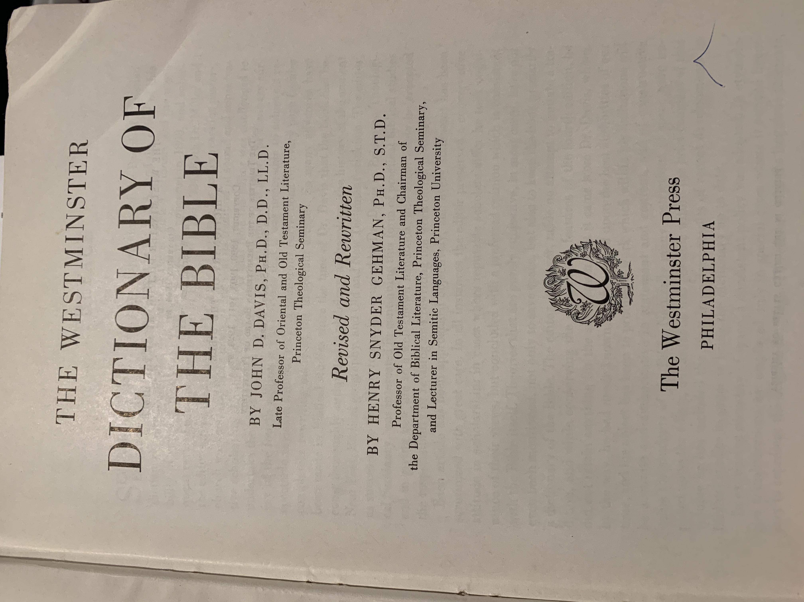
Westminster Dictionary of the Bible, 1944, page 610
One or Three Tithes?
“The Israelites took the tithe to the sanctuary both during the sojourn in the wilderness and after the settlement in the land. There a portion was eaten by the offeror and the Levites in a Eucharistic feast, and the rest was given to Levites. The law was slightly modified in anticipation of the settlement of Canaan.”

Slide 12
One or Three Tithes?
“…and the residence of Levities and producers in many cases far from the sanctuary. Every 3rd year they should store the tithe in town where they dwelt, dispense with the eucharistic meal, place all the tithe at the disposal of the Levites and other dependent persons and make solemn protestation before the Lord.”
Westminster Dictionary of the Bible, 1944, page 610

Slide 13

The Tithe of Leviticus 27:30-33 & Numbers 18:21-24
What are characteristics of this tithe?
Photo by Jordan Rowland on Unsplash
The tithe is God’s tithe and holy to Him
There are specific rules if the offerer wanted to convert the grain to silver they would need to pay an additional 20%
It’s agriculture and livestock
Given to the Levites as an inheritance

Slide 14

The Tithe of Deuteronomy 14:22-27
What are characteristics of this tithe?
Photo by Tim Pebworth
No reference about giving this tithe to anyone
It is for the tither to enjoy in the presence of the Lord
Allowed to exchange for money and can buy whatever we desire

Slide 15

The Place that God Chooses
Deuteronomy 12:4-7
Deuteronomy 12:17-18
Deuteronomy 16:16
Photo by Tim Pebworth

Slide 16

The Tithe of Deuteronomy 14:28-29
What are characteristics of this tithe?
Photo by Kat Yukawa on Unsplash
It is to be stored in your town so that the Levites, minorities (strangers), the fatherless and widow can be cared for
It was given so that the giver might be blessed

Slide 17

One or Three Tithes? A Key Source on Jewish Practices in the 1st Century A.D.
“Let there be taken out of your fruits a tenth, besides that which you have allotted to give to the priests and Levites. This you may indeed sell in the country, but it is to be used in those feasts and sacrifices that are to be celebrated in the holy city” (Antiquities of the Jews, book 4, chapter 8, section 8).

Slide 18
One or Three Tithes? A Key Source on Jewish Practices in the 1st Century A.D.
“Besides those two tithes, which I already said you are to pay every year, the one for the Levites, the other for festivals, you are to bring every third year a third tithe to be distributed to those that want; to women also that are widows, and to children that are orphans” (Antiquities of the Jews, book 4, chapter 8, section 22)

Slide 19
Should Christians Tithe and, if so, to whom?

Slide 20
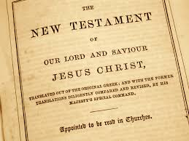
Tithing Commanded for Christians Today
Matthew 23:23
“…without leaving the others undone.”

Slide 21
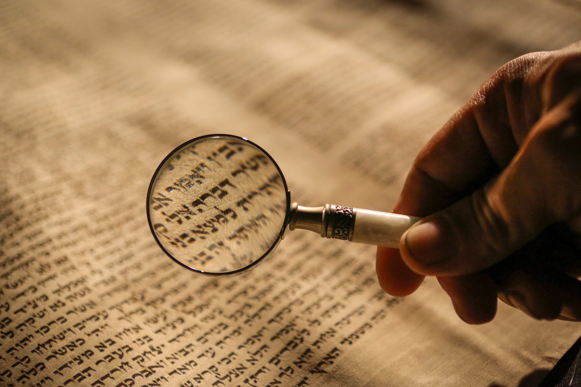
To Whom Do We Tithe?
Hebrews 7:1-14
“Even Levi, who receives tithes, paid tithes through Abraham, so to speak, for he was still in the loins of his father when Melchizedek met him.”
See also Matthew 28:18-20
Photo by Mick Haupt on Unsplash

Slide 22
Why do we tithe as Christians?
Not so the Levites have an inheritance
Not so that the Priests can serve in the Temple
We tithe for God’s greater purpose of which the priestly duties of sacrifices were just a type
We tithe to Christ via His church so that God’s work can be carried forward

Slide 23
Ministers in the House of God
Nehemiah 10:35-37

Slide 24

Conclusion
We all walk by God’s grace
People pick and chose their charities
Tithe is not about picking and choosing, but recognizing who God is
God’s tithes open the door to whom He desires to bless
Let’s be about our Father’s business
Photo by Tim Pebworth

Slide 25
Happy Sabbath

